Slide 2
Scholar Liaison Preview of
the 2023-24 U.S. Scholar Program
Athena Mison Fulay
Outreach & Recruitment Manager
Fulbright Scholar Program
Institute of International Education
Washington, DC
Notes:
Michelle and team Introduce yourself, your affiliation, etc.

Slide 3
Today’s Webinar
Brief Overview of the Fulbright Scholar Program and
U.S. Scholar Competition Cycle Highlights
Trip Around the World – What’s New for the 2023-24 Fulbright
U.S. Scholar Competition
Questions & Answers

Slide 4
Mission
A Brief History
In partnership with 160 countries worldwide, Fulbright offers passionate and accomplished faculty, administrators, artists, journalists, lawyers, and other professionals from all backgrounds an unparalleled opportunity to study, teach, or conduct research.
Our mission is to foster mutual understanding between nations, advance knowledge across communities, and improve lives around the world.
Established in 1946 by Congress, Fulbright is the United States government’s flagship international educational and cultural exchange program.
Fulbright is sponsored by the U.S. Department of State with funding provided by the U.S. Government and administered by the Institute of International Education.
Notes:
For this slide, it is important to stress that the Fulbright program is an international exchange program. The advancement of our mission of fostering mutual understanding between nations, advancing knowledge across communities, and improving lives around the world is the heart of Fulbright.

Slide 5
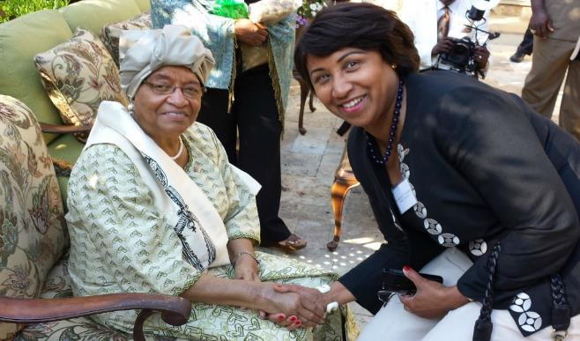
Diversity & Inclusion
Fulbright strives to ensure that it reflects the diversity of U.S. society and societies abroad. We encourage the involvement of people from traditionally underrepresented audiences in all our grants, programs and other initiatives.
Opportunities are open to people regardless of their race, color, national origin, sex, age, religion, geographic location, socioeconomic status, disability, sexual orientation or gender identity.
Notes:
We are actively recruiting a diverse pool of applicants for the Fulbright program. Please encourage all people to consider Fulbright. Ellen Johnson Sirleaf, President of Liberia 2006-2018, first elected female head of state in Africa with Jeanne Toungara former associate provost at Howard U and emerita Alumna Ambassador

Slide 6
Why Fulbright?
Fulbright is family-friendly.
Approximately 60% of our awards provide dependent support
Many Fulbright dependents go on to have international careers
Fulbright is supportive.
70% of applicants engage with IIE staff
Continued support while in country from IIE and host country staff
Access to Fulbright alumni as a resource
Fulbright is transformational.
Foster relationships that are real and lasting
Expand your publishing network
Become more multicultural in the classroom
Serve as an ambassador for international exchange
Gain the professional recognition as being identified as a “Fulbright Scholar”
Join a vibrant alumni network
Notes:
While scholar is the smallest piece of this puzzle, it is the most strategic. All of the other programs are only possible through the development of the relationships that faculty foster and create while on Fulbright awards.

Slide 7
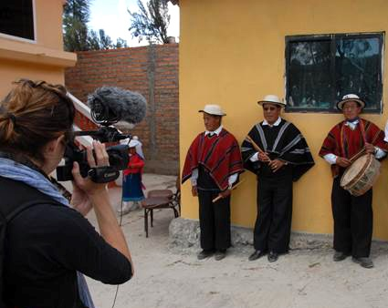
Fulbright by the Numbers
The Fulbright Program funds over 8,000 awards annually:
900 U.S. scholars and administrators
900 visiting scholars
2,200 U.S. students
4,000 foreign students
400+ language teaching assistants
Approximately 400,000 “Fulbrighters” have participated in the program since its inception in 1946.
Notes:
While scholar is the smallest piece of this puzzle, it is the most strategic. All of the other programs are only possible through the development of the relationships that faculty foster and create while on their Fulbrights.

Slide 8
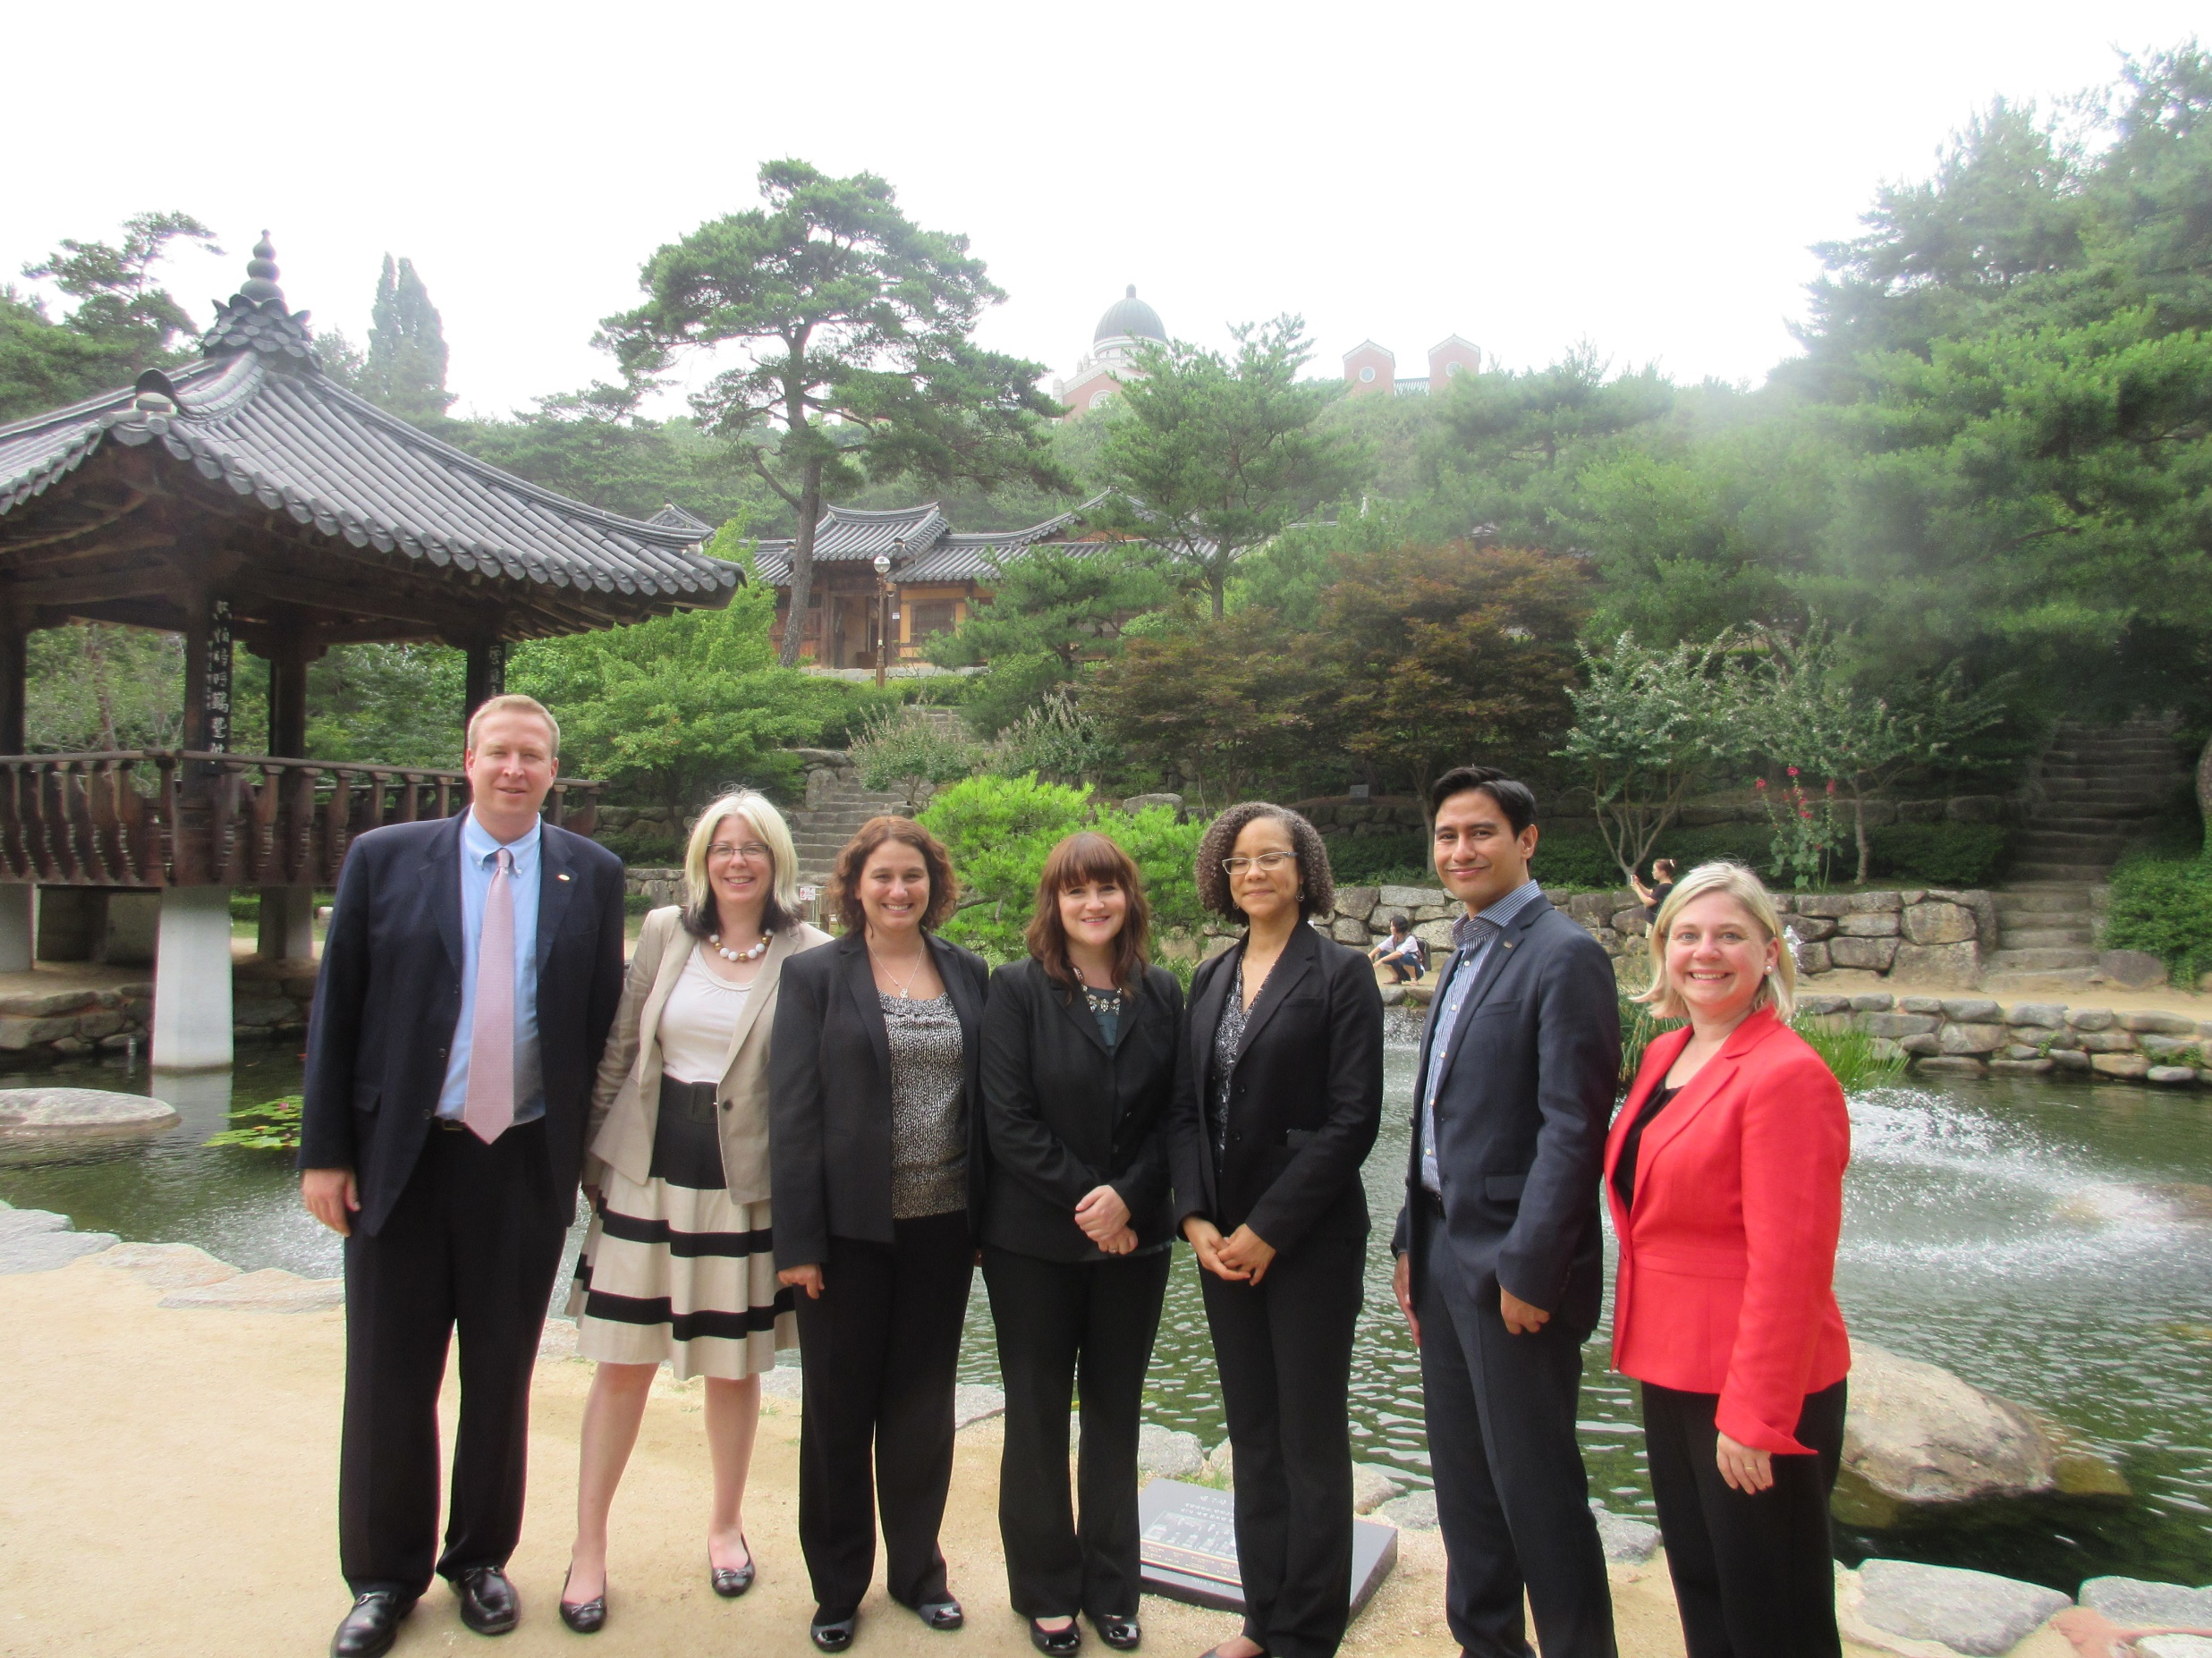
Eligibility for U.S. Scholar Program
U.S. citizenship
Degree and experience, as required by award:
      Ph.D. or other terminal degree
      MA and higher education teaching or professional experience
      Professional and/or artistic experience with substantial accomplishments
      Teaching experience
Compliance with policies on previous Fulbright Scholar awards and waiting periods between grants
Notes:
These are the overall eligibly requirements. The most essential one to keep in mind is that the program is only open to U.S. citizens. Green card holders are not eligible. For the “Degree and experience, as required by award” section, the categories listed are the most common ones seen in the “award requirements” tab.
The “policies” state that there must be 2 full years between the completion of a grant to the application deadline of the next grant.
Applicants can review the award description or contact the Fulbright office to review/confirm eligibility.
Categories with awards
Professionals 7+ years of experiences
Early career no more than 7 years
Mid career 7-13 years
Senior level is 13 years and above

Slide 9
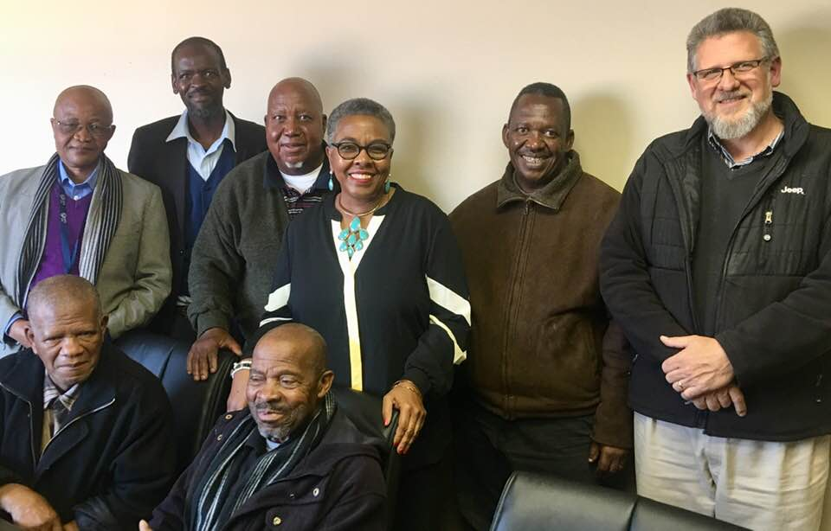
Fulbright Scholar Award Types
4 Award Types:
Scholar Awards
Postdoctoral Awards
Distinguished Scholar Awards
International Education Administrator Awards
Flex Option
Available in 63 countries and all world areas
Allows multiple visits over two years
Global & Regional awards
Notes:
Regional Research Awards exist in most world regions: EU Schuman, Carlos-Rico North American Studies
+Flexibility of Fulbright. Most awards do take place during the academic year. However, the length of time varies from award to award. If someone asks about doing research during the summer, the “flex” option for countries that offer it allow the most flexibility. However, the majority of awards take place during the academic year of the host country.

Slide 10
The Fulbright Scholar Program in 2022
Competition Opens February 1, closes September 15
Catalog Enhancements
  Summer Month Flex Options
  What is Life as a Fulbrighter?
  Alumni Spotlight
  Estimate Cost of Living
  Dependent Benefits Section
Fulbright Scholar Newsletter
Public Policy NEW Countries
Scholar-In-Residence Deadline: JUNE 1
Fulbrighter Network
Postdocs

Slide 11
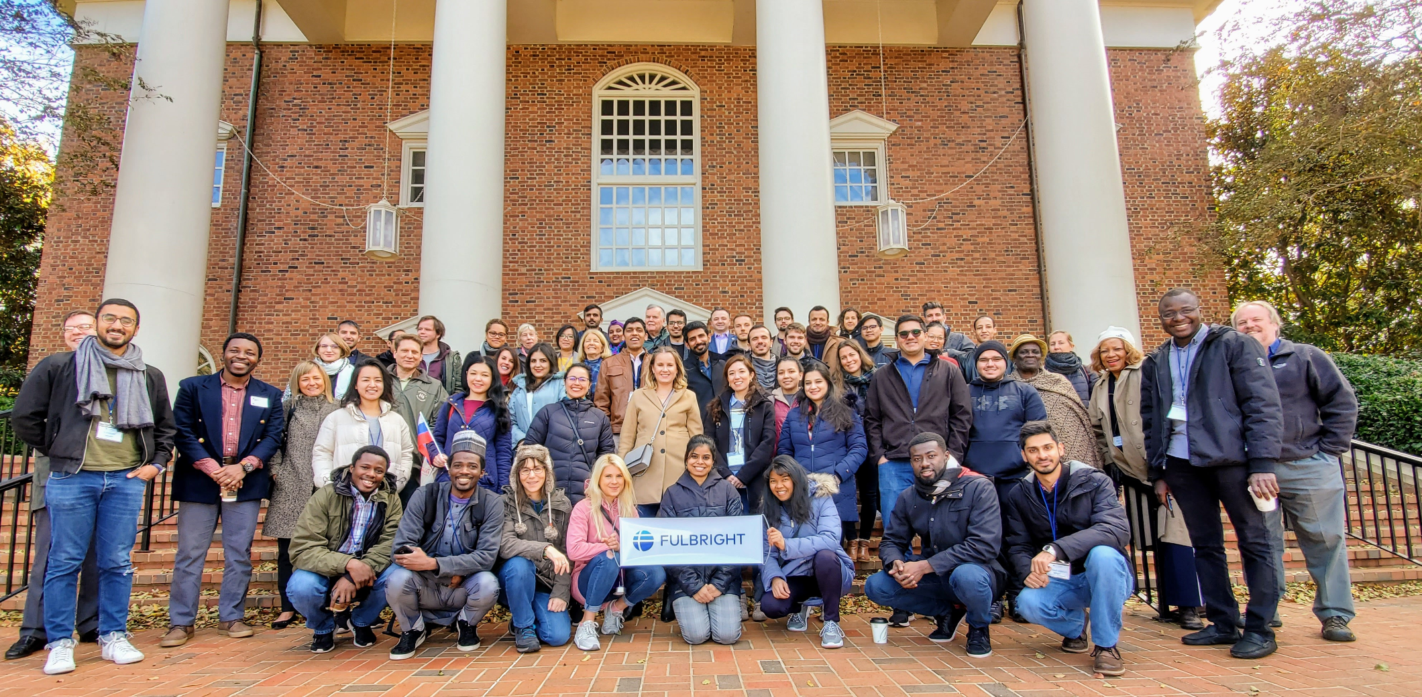
Regional Highlights: Trip Around the World
East Asia & the Pacific
Europe & Eurasia
Middle East & North Africa
South & Central Asia
Sub-Saharan Africa
Western Hemisphere

Slide 12
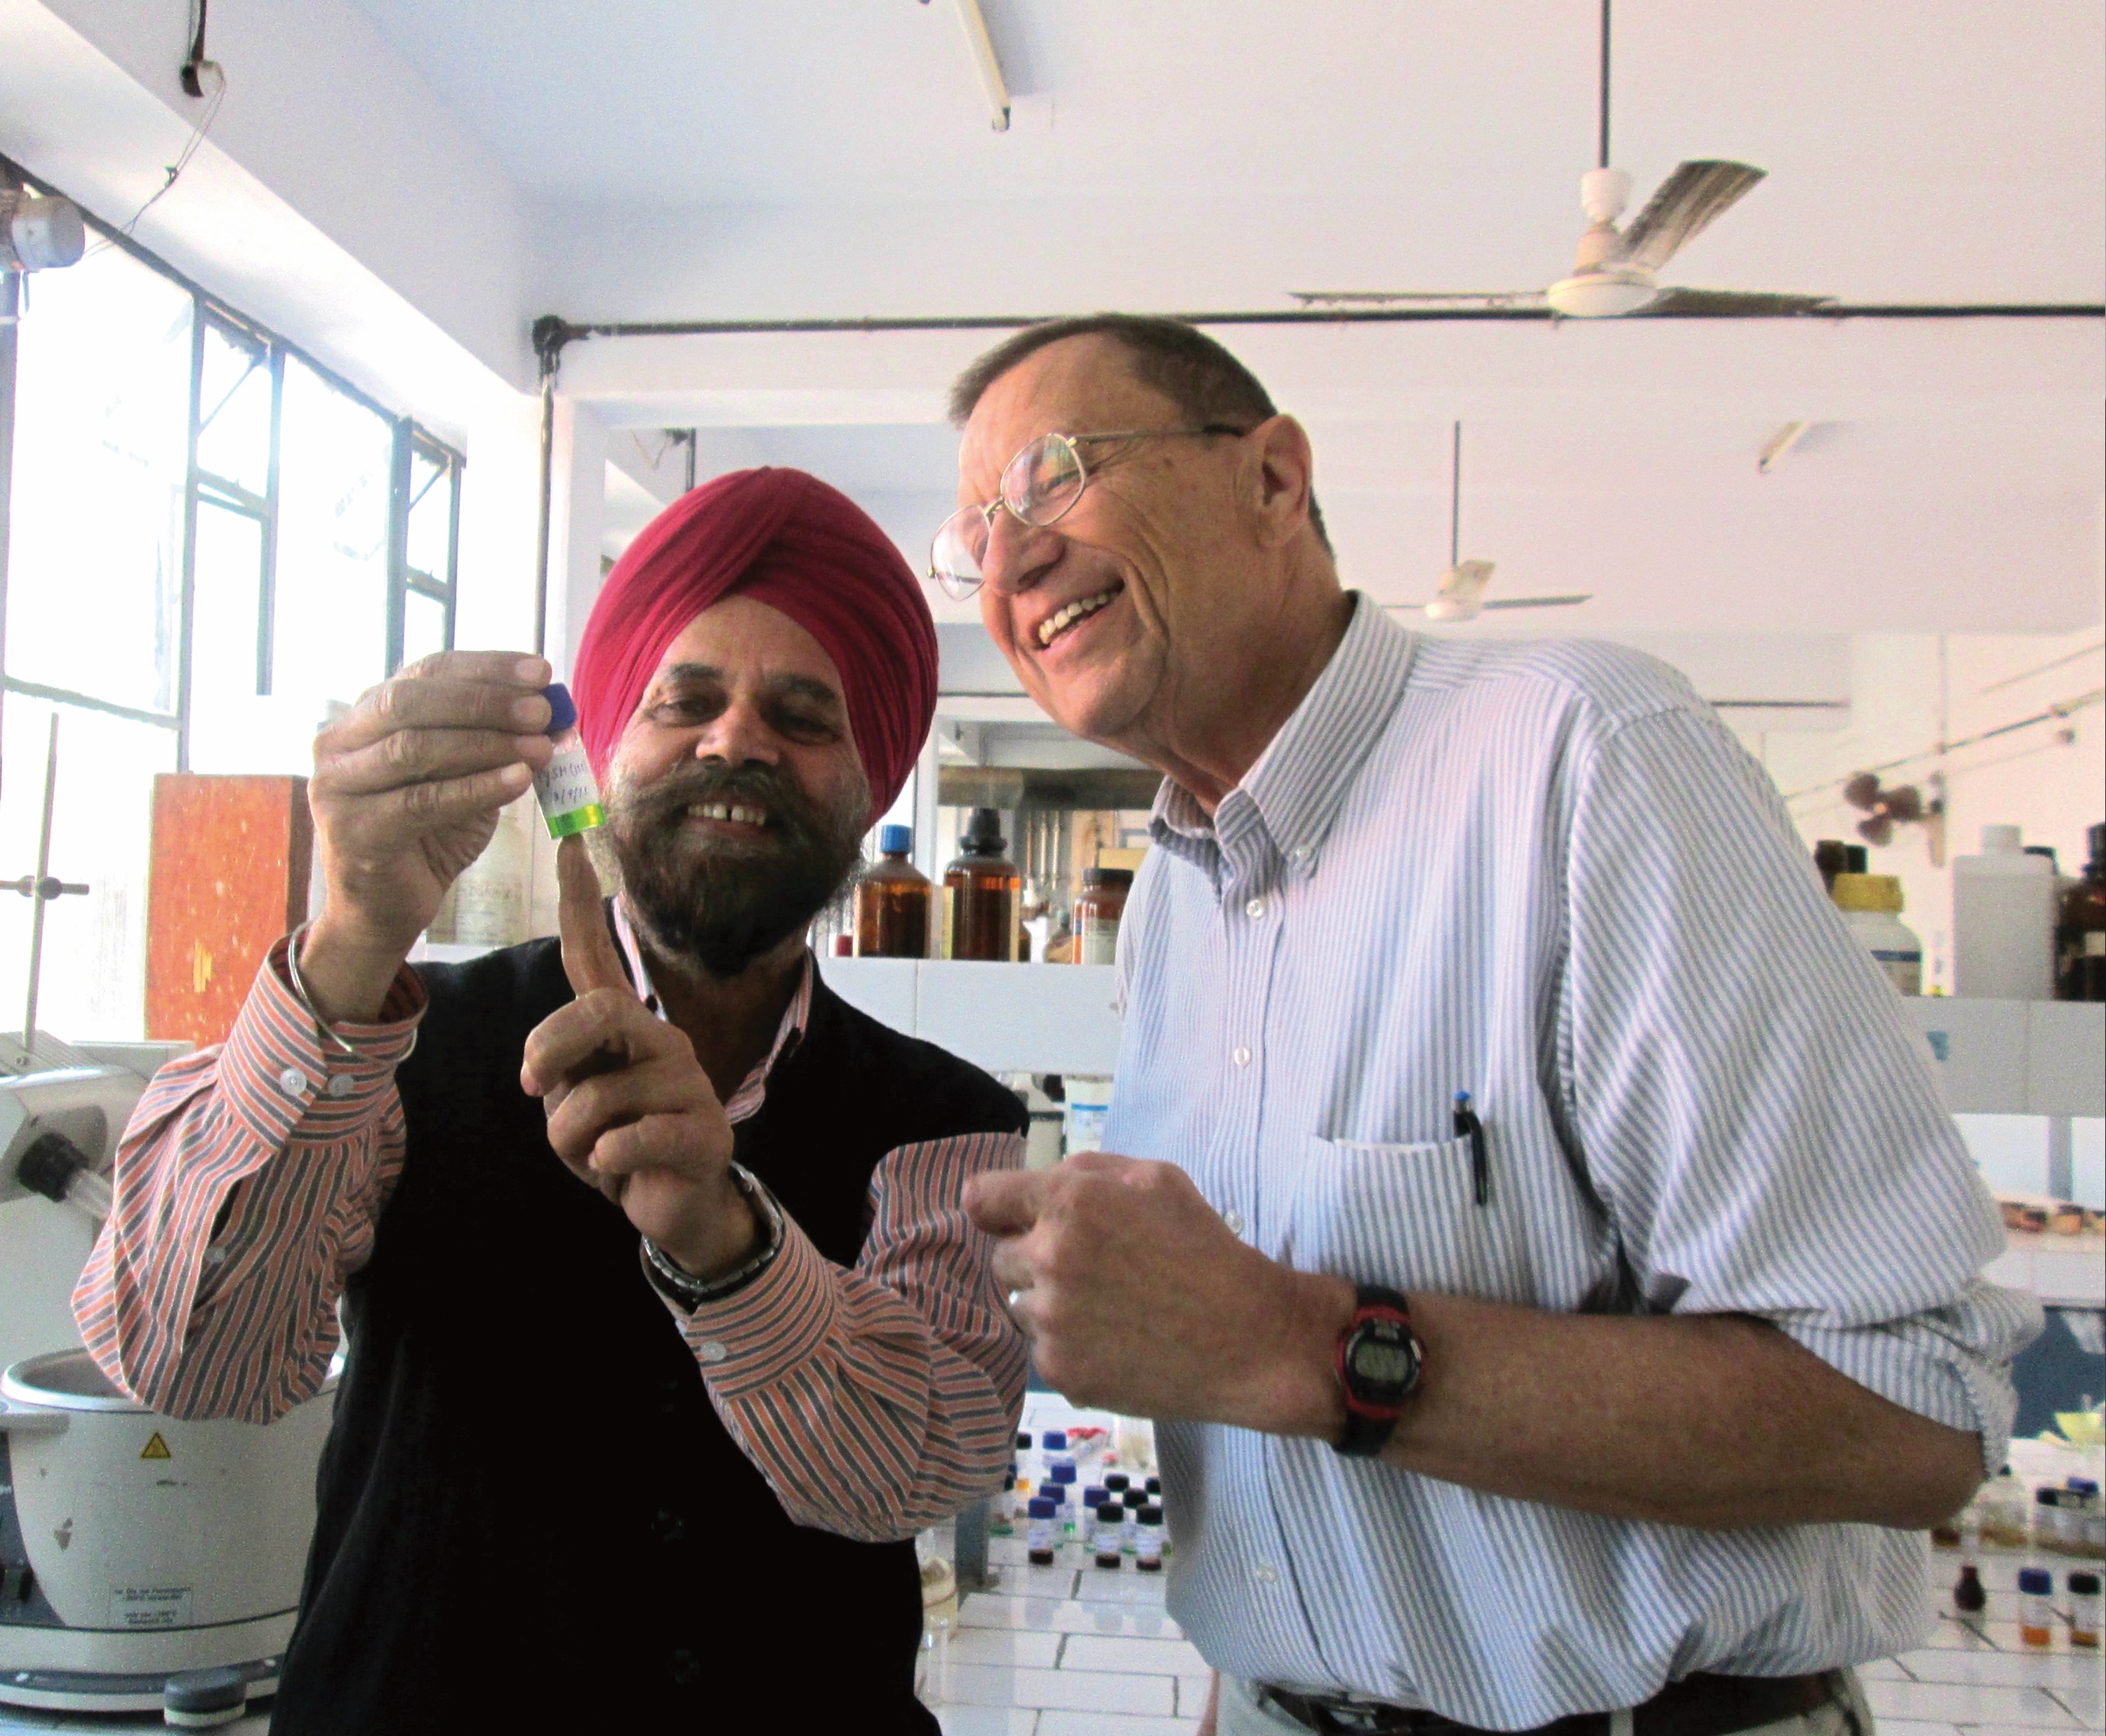
East Asia & the Pacific
Australia: Regional Universities Network of Australia;
Fulbright Future Scholarship
Cambodia, Indonesia, Malaysia, Mongolia,
Thailand, Vietnam: All Disciplines
Japan: Journalism; Study of the U.S.
(Teaching Social Sciences & Humanities)
Korea: Peace Studies Award (Teaching)
Philippines: U.S.-Philippine Relations

Slide 13
Europe & Eurasia
Albania: Judicial Training, Improving Media and Information Literacy ​
Austria: Fulbright-Diplomatic Academy Visiting Professor of International Studies
Azerbaijan: All Disciplines
Bulgaria: Journalism and Strategic Communication​
France & Italy: Regional Awards
​Iceland: Fulbright-National Science Foundation Distinguished Scholar Award in
Cybersecurity and Critical Infrastructure
Poland: Teaching at the Faculty of Architecture, Tadeusz Kosciuszko Cracow University of Technology
Spain: Postdoctoral Awards
United Kingdom: Fulbright – University of Leeds Distinguished Chair​
​
​

Slide 14
Middle East & North Africa
Bahrain: Education Administration and Teacher Education
Egypt: NEW Distinguished Scholar Award and All Disciplines, Business Administration,
Sciences and Visual & Performing Arts
Israel: Distinguished Scholar and Postdoc opportunities
Palestinian Territories: Journalism/Media
TEFL/Applied Linguistics: Algeria, Jordan, Palestinian Territories (West Bank)

Slide 15
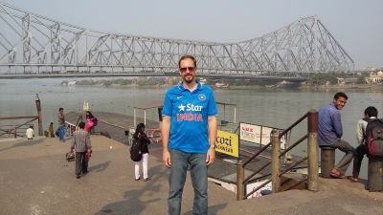
South & Central Asia
India: Distinguished Scholar Award, Fulbright Kalam Climate Fellowship​, All Disciplines Award is now open to professional projects in addition to teaching and research, over 40 fellowships available​
​
Maldives: 2 teaching grants for 6 months at Maldivian National University​
​
Sri Lanka: Up to 3 grants for 3 to 9 months, Open to all disciplines

Slide 16
Sub-Saharan Africa
Botswana: Security & Digital Forensic, Computing: Mobile Technologies and Multimedia
Cape Verde: NEW award this cycle!
Uganda: Artists and Professionals are encouraged to apply & propose any appropriate
host institutions
Zambia: Mulungushi University
Zimbabwe: Public Health, Computer Science, Public Policy and Governance

Slide 17
Western Hemisphere
Brazil: Several NEW Distinguished Scholar awards in STEM, public policy, and democracy studies, up to 40 fellowships
​
Canada: Approximately 50 fellowships available for a variety of disciplines
Chile: Astronomy and Antarctic Studies is now open to all levels of academia
Colombia: All Disciplines award​
​
Mexico: TEFL; U.S. Studies; Post-doc; Border Scholars Awards
​
Uruguay: Agriculture​
​
Carlos Rico Award: For trilateral research related to US, Canada, and Mexico​
Notes:
new Distinguished Scholar awards to Brazil:
1) Biodiversity and Environmental Conservation
2) Renewable Energy and Green Hydrogen Production
3) Education and Reducing Inequality
4) Urban Studies

Slide 18
Fulbright Public Policy Fellowship
Opportunities for U.S. early and mid-career professionals and practitioners in a Public Policy related field, to serve in placements in a foreign government ministry or institution around the world.
Fulbright Public Policy Fellowships are available in:
  Africa: Botswana, Ghana, and Rwanda
  East Asia and the Pacific: Cambodia, Thailand, Vietnam, Timor-Leste, and Fiji
  Western Hemisphere: Peru and Colombia
A Project Statement is not required. Applicants complete a short series of essay questions. Letter of Affiliations are not sought.
Fellows will work with ministry officials as “technical specialists” under the supervision of host government officials.
Notes:
ABD – mention U.S. Student Program
Career level – early career, mid-career, senior level, administrator, professional, artist, Emeriti, Adjunct, and independent scholar

Slide 19
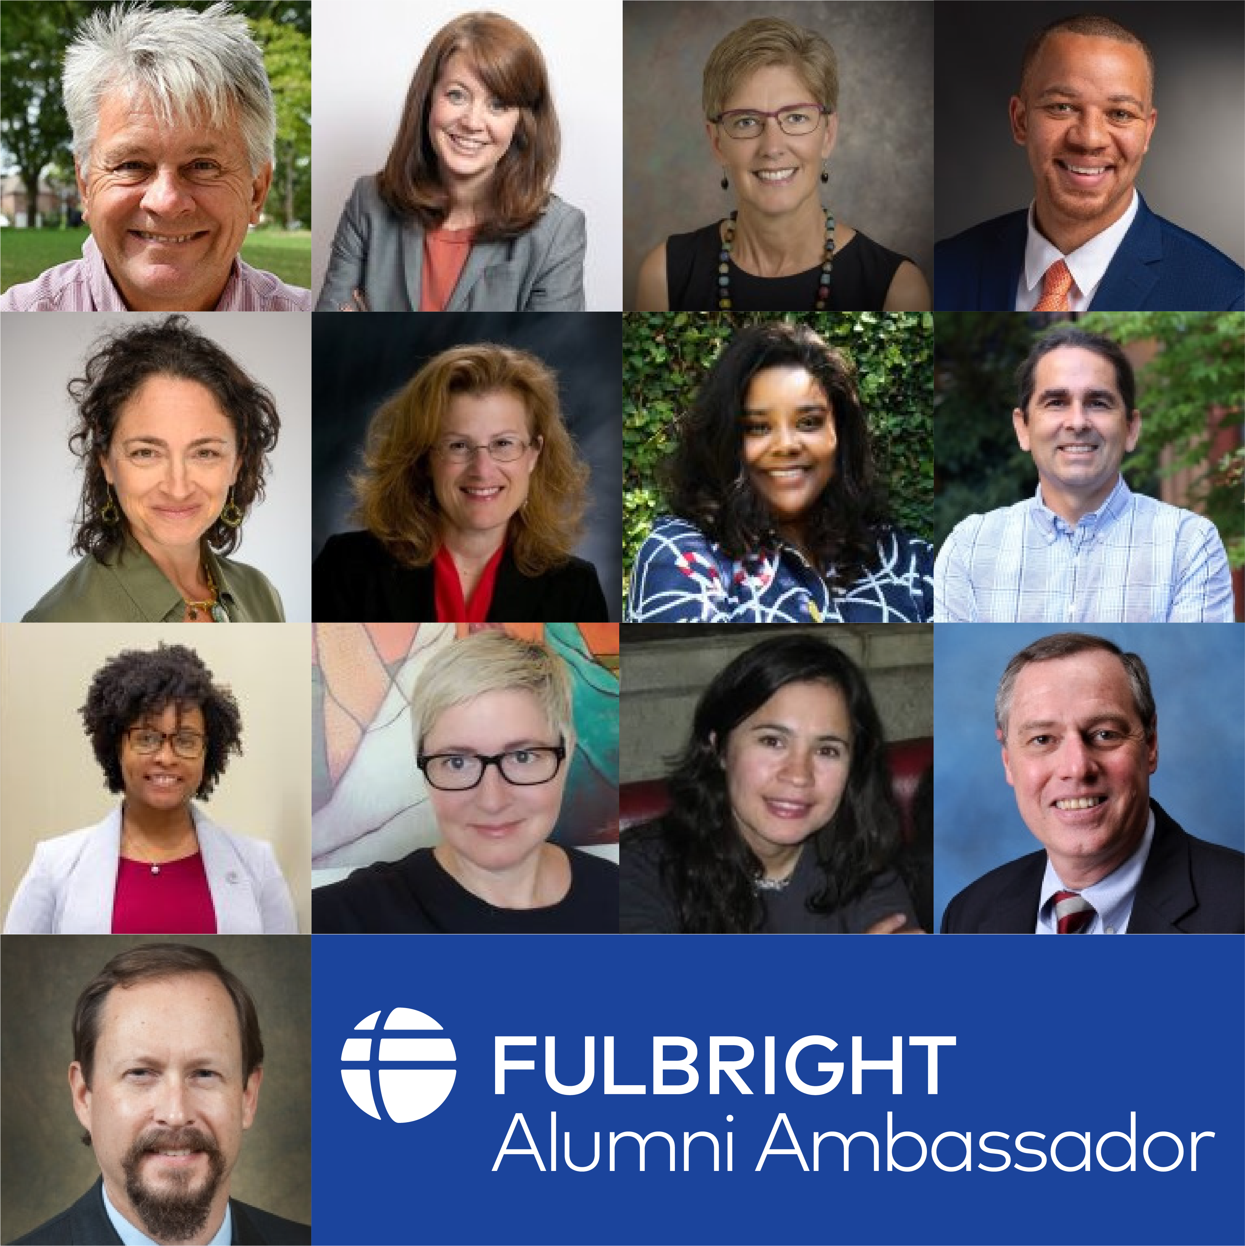
Invite a Fulbright Alumni Ambassador
Fulbright U.S. Scholar Alumni Ambassadors are official representatives of the program and can share with your faculty and administrators about the impact their Fulbright had on them personally and professionally, as well as on their institution.
72
Emeriti Ambassadors
26
New Ambassadors
80
+ Events Annually
More information on inviting an Ambassador can be found on: cies.org/alumni-ambassadors

Slide 20
Bring Foreign Fulbrighters to your Campus
Fulbright Scholar-in-Residence (S-I-R) Program
Fulbright Outreach Lecturing Fund (OLF)
Fulbright Language Teaching Assistant (FLTA) Program
Host scholars from other countries to teach for a semester or an academic year
NEW DEADLINE:
June 1
Website: cies.org/sir
Email: SIR@iie.org
Host current Fulbright Visiting Scholars for short-term lectureships of 2 – 6 days on discipline or cultural topics to internationalize the campus
Website: cies.org/olf
Email: OLF@iie.org
Host native speaking language teaching assistants to enhance students’ understanding different languages and cultures
Website: foreign.fulbrightonline.org
Email: Dcook@iie.org
Notes:
SIR – The Fulbright Scholar-in-Residence (S-I-R) Program assists U.S. higher education institutions in expanding programs of academic exchange, by supporting non-U.S. scholars through grants for teaching at institutions that might not have a strong international component and/or serve minority audiences. Both the U.S. institution and the scholar grantee benefit from this experience.
OLF – The Outreach Lecturing Fund (OLF) provides funding for campuses to host Fulbright Visiting Scholars, already in the United States, for short-term speaking engagements. To see a list of current Visiting Scholars in the U.S. please visit our Scholar Directory. The OLF travel award is designed to enrich both institutions and Visiting Scholars through lectures that will promote academic disciplines and cultural understanding.
FLTA - The Fulbright Foreign Language Teaching Assistant (FLTA) Program supports language assistantships at universities and colleges throughout the U.S., providing institutions with an opportunity to enhance their language programming and expose students to native speakers who bring an energetic, up-to-date cultural component to the foreign language classroom as well as student life at a campus in general.

Slide 21
Additional Fulbright U.S. Programs
Scholars
Students
Teachers
Arctic Initiative
Arctic@iie.org
Fulbright-Hays Group Projects Abroad Program
GPA@ed.gov
Specialist Program
FulbrightSpecialist@worldlearning.org
Fulbright-Hays Doctoral Dissertation Research Abroad Program
DDRA@ed.gov
English Teaching Assistant (ETA) Program
FBstudent@iie.org
Student Program
FBstudent@iie.org
Distinguished Award in Teaching Research Program
FulbrightDA@irex.org
Group Projects Abroad
GPA@ed.gov
Teachers for Global Classrooms
FulbrightTGC@irex.org
Notes:
This slide should be a basic overview of the wide variety of “Fulbright” programs, administered by IIE or other DOS partners. You do not need to be an expert on each of these programs, but I included a sentence or so below about each so you can be informed. Please encourage the audience to reach out using the appropriate email to ask further questions.
U.S. Scholars
Arctic Initiative – LIVE: Deadline May 11! The Fulbright Arctic Initiative creates a network to stimulate international scientific collaboration on Arctic issues while increasing mutual understanding between people of the United States and the people of other countries. Using a collaborative model to translate theory into practice, program participants address public-policy research questions relevant to Arctic nations’ shared challenges and opportunities. Canada open, Norway midyear, DC final.
Fulbright-Hays Group Projects Abroad Program - Funding to spend time in a foreign country or region acquiring resource materials for curriculum development in modern foreign languages or area studies programs
Fulbright Specialist - The Fulbright Specialist Program is a unique opportunity for U.S. academics and established professionals to join a roster of candidates who are eligible to engage in two- to six-week, project-based exchanges at host institutions across the globe. Institutionally driven from overseas, so projects must be approved for funding abroad before matches take place.
U.S. Students
ETA - Places grantees in schools overseas to supplement local English language instruction and to provide a native speaker presence in the classrooms
Fulbright-Hays Doctoral Dissertation Research Abroad Program - Funding for individual doctoral students who conduct research in other countries in modern foreign languages and area studies for periods of six to 12 months
Fulbright U.S. Student Program - Recent graduates, post-graduate candidates through dissertation level, developing professionals and artists to study and research abroad
U.S. Teachers
Fulbright Distinguished Award in Teaching Program - K-12 educators can take part in a three-to six-month professional development experience abroad, pursue individual inquiry projects, take courses at a host university, and collaborate with colleagues on best educational practices
Fulbright-Hays Group Projects Abroad - Funding to spend time in a foreign country or region acquiring resource materials for curriculum development in modern foreign languages or area studies programs
Fulbright Teachers for Global Classrooms - Fulbright TGC is a year-long professional development opportunity for U.S. elementary, middle, and high school teachers to develop skills for preparing students for a competitive global economy.

Slide 22

Stay Connected with Fulbright
Connect with Fulbright at cies.org
Email us at scholars@iie.org
Visit our website to learn more about the Fulbright U.S. Scholar Program
Refer your colleagues
Notes:
Sign up for MyFulbright, follow all our media for inspiration and stories, refer your colleagues!

