Slide 2
Pre-Departure Resources and Reminders
Fulbright Visiting Scholar Program, Africa
Fulbright Program
Institute of International Education (IIE)
June 2021

Slide 3
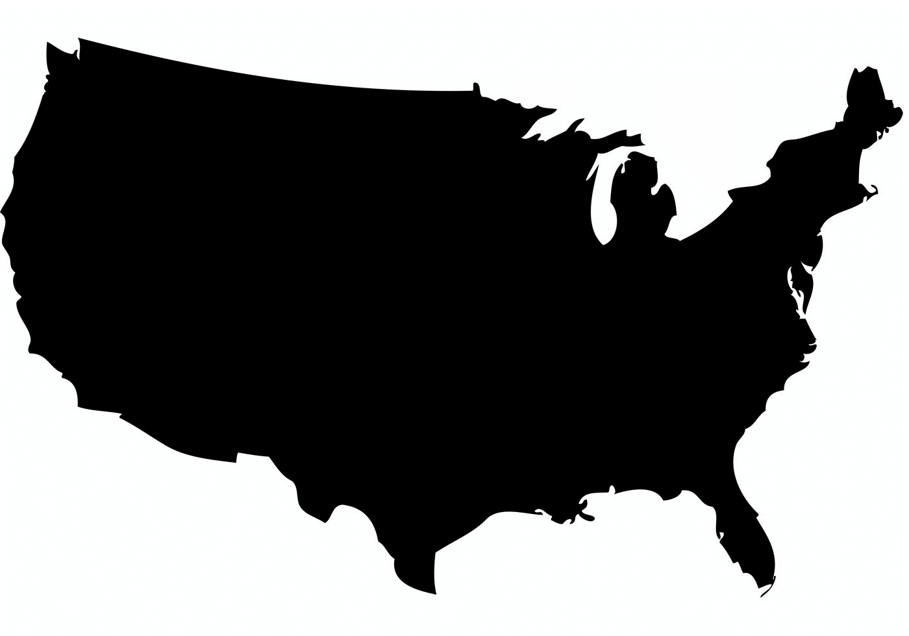
Welcome to the Fulbright Family!
Over 800
Visiting Scholars each year
Over 150
Countries
50
States

Slide 4
Program Stakeholders & Administering Agencies
The U.S. Department of State’s Bureau of Educational and Cultural Affairs (ECA) sponsors the Fulbright Program.
The Fulbright Foreign Scholarship Board (FFSB) was created by Congress to establish policy guidelines for the Fulbright Program.
Individuals who meet eligibility requirements for the Visiting Scholar Program apply for grants through the Fulbright Commission or public affairs section of the U.S. Embassy in their home country.
The Institute of International Education (IIE) administers the Fulbright Program in coordination with ECA, Fulbright commissions and U.S. embassies.

Slide 5
Presentation Overview
Receiving Your Grant Payments: IIE Pay
Introduction to Health Benefits
COVID-19 Preparations
Bringing Your Family
Post-Arrival Reminders
Pre-Departure Resources
Terms of Appointment & Conditions of Sponsorship
Research Considerations
Arranging Housing in the U.S.
Making Travel Arrangements

Slide 6
Preparing for Your Departure

Slide 7
Pre-Departure Resources
Terms of Appointment/Grant Document
Outlines grant benefits, payment schedule and the terms and conditions of your Fulbright Program.
Made available to our U.S. Embassy contacts via the Partner Portal, once placements are finalized.
DS-2019 Form
IIE will send the DS-2019 form for your visa interview to the U.S. Embassy contacts in your home country.
When you receive your DS-2019 form, confirm all information is correct - ensure the name on the DS-2019 matches your passport!
Be sure to carry your DS-2019 form with you when you travel.
Fulbright Arrival Email
Includes reminder link to the online Visiting Scholar Guide, login details for the IIE's Self Service Portal, IIePay and ASPE details, and Social Security Number application information.
Sent directly to the grantee from their IIE Advisor approximately one month prior to departure (once DS-2019 is processed).
Institutional Response Form (IRF)
The IRF includes host institution information such as the closest airport and Faculty Associate contact details. In some cases, it also provides housing resources.
IRFs are made available to our U.S. Embassy contacts via the Partner Portal, once placements are finalized.
Fulbright Scholar Website (https://fulbrightscholars.org)
Contains critical information related to your Fulbright Program, including access to:
- Visiting Scholar Guide
- Digital Grant Packet
- IIE Advisor Contact Info
Grantee login details for the Fulbright Scholar Website are included in the DS-2019 cover letter and listed below:
- Password for Grantee Login: VSResources
- Password for Post Login: Resources
Please be sure to review these helpful resources prior to your departure.

Slide 8
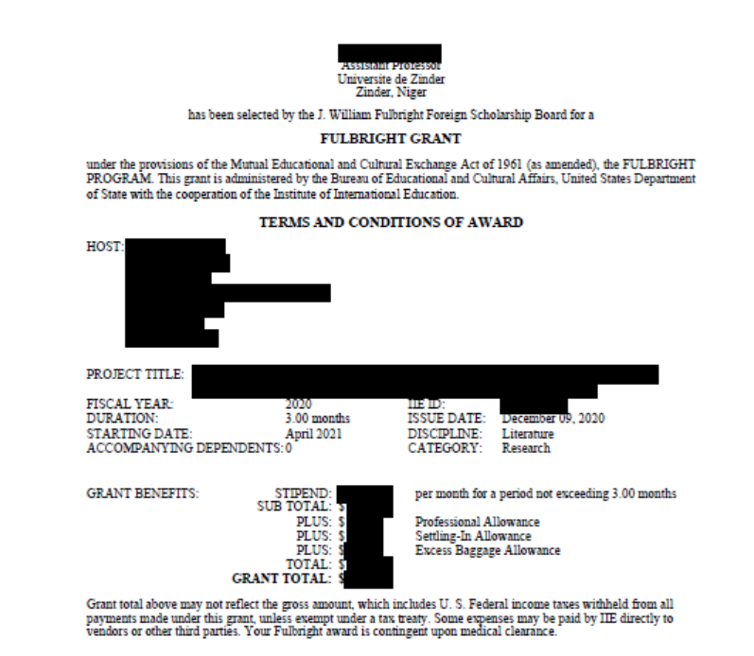
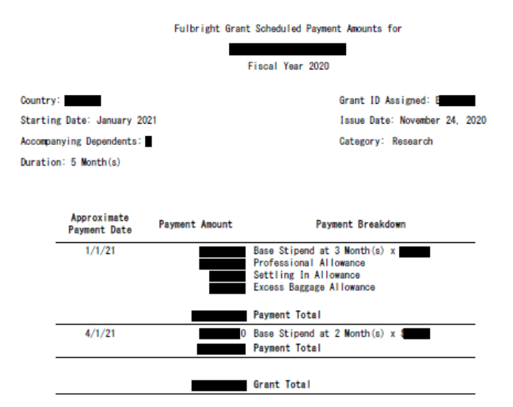
Terms of Appointment & Conditions of Sponsorship
Your Fulbright Grant Document is a critically important document that describes the benefits and conditions of participation in the Fulbright Program, as well as details that apply to your individual grant. Read it carefully and bring a copy with you to the U.S. for your records.

Slide 9
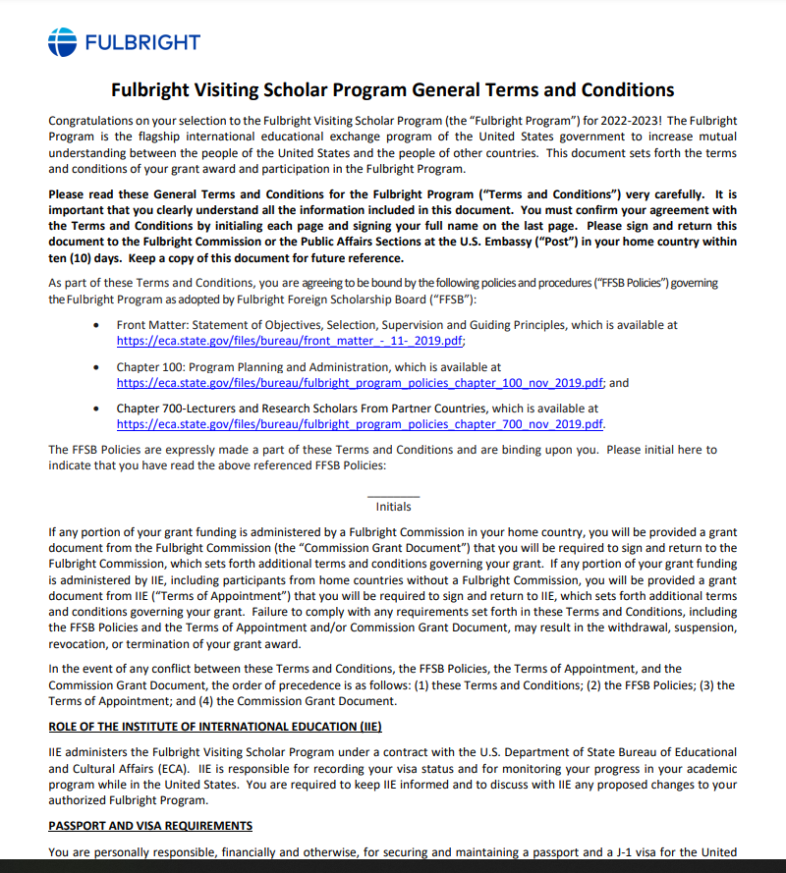
Terms of Appointment & Conditions of Sponsorship Cont’d
Terms and Conditions of Grant:
Applies to all Fulbright Visiting Scholar grantees
Details general program terms
Confirms two-year home residency requirement
Defines benefits and responsibilities
Reporting and tax responsibilities
Dependent responsibilities
Must initial every page of the document!

Slide 10
Research Considerations
Research Fees and IRB regulations:
Coverage of lab fees/research costs is not part of the standard benefits package of the Fulbright Africa Program. Fulbrighters should work with their home and host institution to confirm required fees will be covered.
Fulbrighters are responsible for the shipment and costs of any samples that may need to be sent to the U.S. as part of their research.
Please consider any Institutional Review Board (IRB) approvals that may be needed to carry out your research in the U.S.
Direct Patient Contact:
Per FSB Policy 726.3, grants shall not authorize activity for which a license to practice medicine or nursing is required.
As an exchange visitor in the J-visa category sponsored by the Fulbright Program, research activities must not involve direct clinical contact.
Fulbrighters whose projects are related to the medical and veterinary fields or who’s projects include human or animal subjects are required to complete the, Guidelines for the Medical and Clinical Fields Memo.

Slide 11
Arranging Housing in the U.S.
You are responsible for arranging your accommodation:
Secure temporary housing prior to your arrival while you find permanent housing. Inspect accommodation before paying.
Know your rights. Read your lease very carefully and learn about local tenancy laws before signing a lease.
Be aware of housing scams:
Try to avoid paying without first signing a lease/agreement.
Do your research! If it sounds too good to be true, it probably is.
Housing types and costs vary immensely by region. Research housing prices and how students and scholars live in your city before your departure.
Helpful Housing Resources:
University housing websites
Fulbright fellows or alumni
In some cases, housing resources are also listed on the IRF

Slide 12
Making Travel Arrangements
Work with the U.S. Embassy contacts in your home country to arrange air travel in advance.
Once confirmed, send the flight itinerary to your Faculty Associate at the host institution.
Remember to consult with your airline for luggage weight limits. The Fulbright Program will provide you with a one-time payment of $150 to assist with baggage fees. This allowance will be included in your first grant payment.
Organize travel to your host institution or temporary accommodation from the airport in advance (bus, train, car rental, etc.).
Make suitable plans for weekend and holiday arrival.

Slide 13
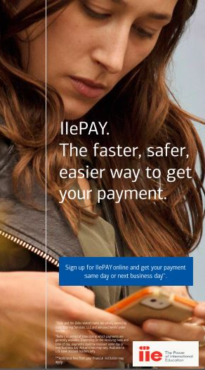
Receiving Your Grant Payments: IIEPAY
What is IIEPay?
If your Fulbright grant funds are IIE-administered, you will receive your monthly stipend from IIE directly in your bank account through IIEPay. IIEPay is the digital technology, powered by Zelle, that sends funds from IIE’s Bank, Bank of America, directly into your bank account.
How do I sign up?
Bring some money with you upon arrival in the U.S. to open a bank account and for initial settling-in costs.
Ask the bank if they support Zelle transfers and ask if there are limits on Zelle transfers.
IIEPay sends payments via the email address that we have on file from your application.
If your email address has changed, please make updates in the portal no later than 5 days before your start date.
Is there a fee?
IIE, Bank of America, and Zelle will not charge you a fee. When selecting a bank, research and make sure the bank you choose does not charge fees to receive Zelle payments.
For more information visit https://www.iie.org/iiepay.
IMPORTANT: You will not have access to your Fulbright stipend, until you arrive in the U.S. and open a U.S. bank account and register for IIE Pay/Zelle.
There may be delays setting up an account, so it is advised that all grantees have sufficient personal funds available to cover at least one month’s living expenses.

Slide 14
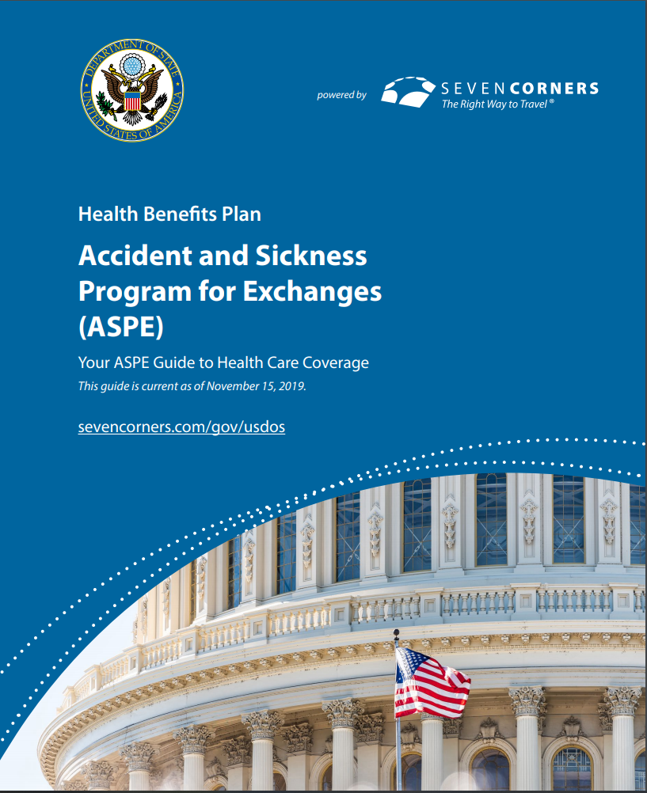
Introduction to Health Benefits
You will be covered by Accident and Sickness Program for Exchanges (ASPE) for the duration of your Fulbright program.
ASPE meets the minimum health insurance requirements for J-1 Exchange Visitors.
Some U.S. universities may require a Visiting Scholar to purchase additional health insurance if ASPE benefits do not meet university requirements for coverage.
Your IRF will indicate whether this is necessary.
Refer to the Visiting Scholar Guide and the ASPE Health Benefits Guide for additional information regarding ASPE coverage.
The Fulbright Arrival Email provides instructions for downloading your ASPE ID Card.
ASPE is not intended to replace insurance you may already have. If you want coverage for situations or conditions that are not covered by ASPE, you should maintain your private policy or purchase additional coverage.

Slide 15
Health Benefits: Key Points
ASPE Health Provider: Seven Corners (https://www.sevencorners.com/about/gov/usdos)
Basic Medical Expenses: Maximum benefit per injury or illness: $100,000
YOU pay $25.00 co-pay for office visits
YOU pay $75.00 co-pay for ER, Hospitalizations and Urgent Care
Key Points of Coverage:
Policy is not intended to cover preventative care such as annual examinations or check-ups
Does not provide coverage outside of the U.S.
Does not cover alcohol/substance abuse instances
Does not cover dental or vision care
Coverage for dependents must be purchased separately
Where to Get Medical Treatment:
Primary Care Provider: General doctor in a private practice or at a hospital. Typically require appointments, useful for non-urgent accidents/illnesses. Can treat minor or ongoing medical issues and prescribe medication.
Campus Health Center: Sometimes offer walk-in services but may not be in the ASPE network.
Urgent Care Centers & Clinics: Located conveniently inside common pharmacies; can treat minor medical issues and prescribe medication
Emergency Room: For life threatening major sickness or accidents such as a broken leg. Should not be used for non-emergency accidents/illness. Emergency telephone number is 911.
ASPE Mental Health Support Hotline (ASSIST):
1-833-963-1269 or ASPEsupport@anvilgroup.com
Please note, healthcare in the U.S. can be extremely expensive, so it’s important to familiarize yourself with your ASPE health benefits prior to visiting a healthcare provider.

Slide 16
Health Benefits: Pre-Departure Checklist
Complete Your Immunizations and Screenings
Bring any necessary medications with you
Visit your eye doctor and dentist before traveling
Review your ASPE Health Benefits to assure sufficient coverage for your medical needs
If you will have accompanying dependents identify a health insurance plan for them

Slide 17
COVID-19 Preparations
Make sure prior to travel you monitor any shifting requirements related to COVID-19:
CDC Website (cdc.gov) for up-to-date information for travelers arriving in the United States, including any information on required vaccines or testing
Verify you meet Vaccination and/or Testing Requirements
Consider Airline Requirements
Consider Home and Transit Country Requirements
Consider Host Institution Requirements

Slide 18
Bringing Your Family
Depending on your country program policy, your family members may be eligible to apply for J-2 visas.
A J-2 dependent is defined as any unmarried child under 21 years of age or the spouse of a J-1 visa holder.
J-2 dependents must reside in the same location as the J-1 Fulbright participant.
Fulbrighters are required to inform their IIE Advisor of any changes to the status of their J2 dependents.
Fulbrighters may be eligible for international flight benefits for one J-2 dependent, if the grant length is 8-9 months, and the J-2 is staying at least 80% of the time.
A dependent allowance may be provided if J-2 dependents are staying at least 80% of the time.

Slide 19
J-2 Dependents: Insurance Requirements
Please keep in mind, ASPE only covers the Fulbrighter.
Fulbrighters with dependents are required to purchase health insurance that meets J-visa requirements.
Dependents must have insurance for the duration of their stay in the U.S. and it must be reported to IIE.
In the event a dependent is pregnant or becomes pregnant during the grant period, the Fulbrighter must show proof of medical insurance that covers pregnancy and childbirth in the U.S. Failure to do so, may result in the termination of the grant.
J-exchange visitors and dependents cannot receive public assistance because it can jeopardize their visa status and future entries: https://www.uscis.gov/greencard/public-charge
It can be extremely difficult to identify health insurance plans in the U.S. that cover pregnancy-related care. Please consider this when arranging to bring your dependents.

Slide 20
Before You Go….
Have with you when traveling to the U.S.:
Passport + J1/J2 visas + National Interest Exception (NIE) stamp (if applicable)
DS-2019 for J1 and J2 dependents
Grant Document/Terms of Appointment + Letter of Invitation
Institutional Response Form (IRF) → FA contact information
J1 supplemental health insurance ID card (if applicable)
J2 health insurance ID card and/or policy information (if applicable)
IIE Visiting Scholar Cover Letter
Proof of Vaccination/Negative COVID-19 test results (confirm COVID requirements for entry to the U.S. at cdc.gov prior to departure)
IMPORTANT: Do not put these documents in your checked luggage!

Slide 21
Post-Arrival Reminders

Slide 22
Remember…
J-1 Reporting Requirements
Within 10 days of arrival to the United States, you must report your and your dependents’ (J-2) arrival to maintain legal status. Upload the following for you and any J-2s to IIE's Self Service Portal:
Copy of J-Visa
Electronic I-94 document (from www.cbp.gov/I94)
Your local mailing address, physical address and contact information
Signed Arrival Form
If applicable, J visa-compliant proof of insurance for J-2s
Social Security Number (SSN) and Taxes
Fulbrighters are eligible for and encouraged to obtain a Social Security Number (SSN).
You will receive a letter in the mail with instructions on applying for an SSN after your arrival documents are approved.
Do NOT reapply if you already have an SSN—once you have an SSN it's good for life!
Once you have it, make sure to add your SSN to the IIE Portal.
All Exchange Visitors are required to file forms relating to their tax status, even if you do not end up owing taxes.
An SSN or ITIN is required by law to appear on your tax returns.
You will receive more information about filing taxes after your arrival in the U.S.
Refer to the Fulbright Arrival email and Visiting Scholar Guide for additional details.

Slide 23
Post-Arrival Orientations
Make sure to visit the online scholar guide Webinar library to view videos on the following:
https://fulbrightscholars.org/visiting-scholars/guide/webinar-library
Travel
Taxes
Program Conclusion
On Program Reporting
J2 Dependents
Frauds and Scams
Health Benefits

Slide 24
Additional Resources
Online Visiting Scholar Guide: https://fulbrightscholars.org/visiting-scholars/guide
IIE Advisor Directory: https://fulbrightscholars.org/fulbright-visiting-scholar-program-advisors
If your IIE Advisor is unavailable or if it is outside normal business hours (9 a.m. - 5 p.m. EST), please call (212) 984-5332. For life-threatening emergencies (police, medical or fire), immediately dial 911.
Should you have any issues at the U.S. border upon arrival, you can contact IIE’s Visa Sponsorship team at +1-929-310-3046.
IIE Self-Service Portal: https://connect.iie.org/user/login (access not available until after receival of Arrival Email)
ASPE Website: https://www.sevencorners.com/about/gov/usdos
ASPE Benefits Guide: https://www.sevencorners.com/docs/default-source/usdos-documents/usdos-benefit-guide-pdf.pdf?sfvrsn=786a4f2d_5
Public assistance regulations are subject to change at any time, please visit the USCIS website if you have questions about what is public assistance: https://www.uscis.gov/green-card/green-card-processes-and-procedures/public-charge/public-charge-resources

Slide 25
Thank You!
We wish you all the best during your Fulbright experience in the United States!

