Slide 2
Fulbright U.S. Scholar Program:
Opportunities in 2023-24
Name and Title
Institute of International Education
Notes:
Update to include your information + any other speakers + the date

Slide 3
Today’s Presentation
Program Overview
Why Fulbright?
Eligibility
Types of Awards
Application Cycle and Tips
Questions
Notes:
Edit this section as is necessary for your audience. Always take a moment to specify that you will cover U.S. scholar awards for faculty and professionals. Those interested in Student or Visiting Scholar Programs are welcome to stay, but the information is not for them.

Slide 4
Mission
A Brief History
In partnership with 160 countries worldwide, Fulbright offers passionate and accomplished faculty, administrators, artists, journalists, lawyers, and other professionals from all backgrounds an unparalleled opportunity to study, teach, or conduct research.
Our mission is to foster mutual understanding between nations, advance knowledge across communities, and improve lives around the world.
Established in 1946 by Congress, Fulbright is the United States government’s flagship international educational and cultural exchange program.
Fulbright is sponsored by the U.S. Department of State with funding provided by the U.S. Government and administered by the Institute of International Education.
Notes:
Yes, Fulbright allows people to teach, research and conduct professional projects abroad, but at its core it remains a cultural and educational exchange program to accomplish our stated mission.

Slide 5
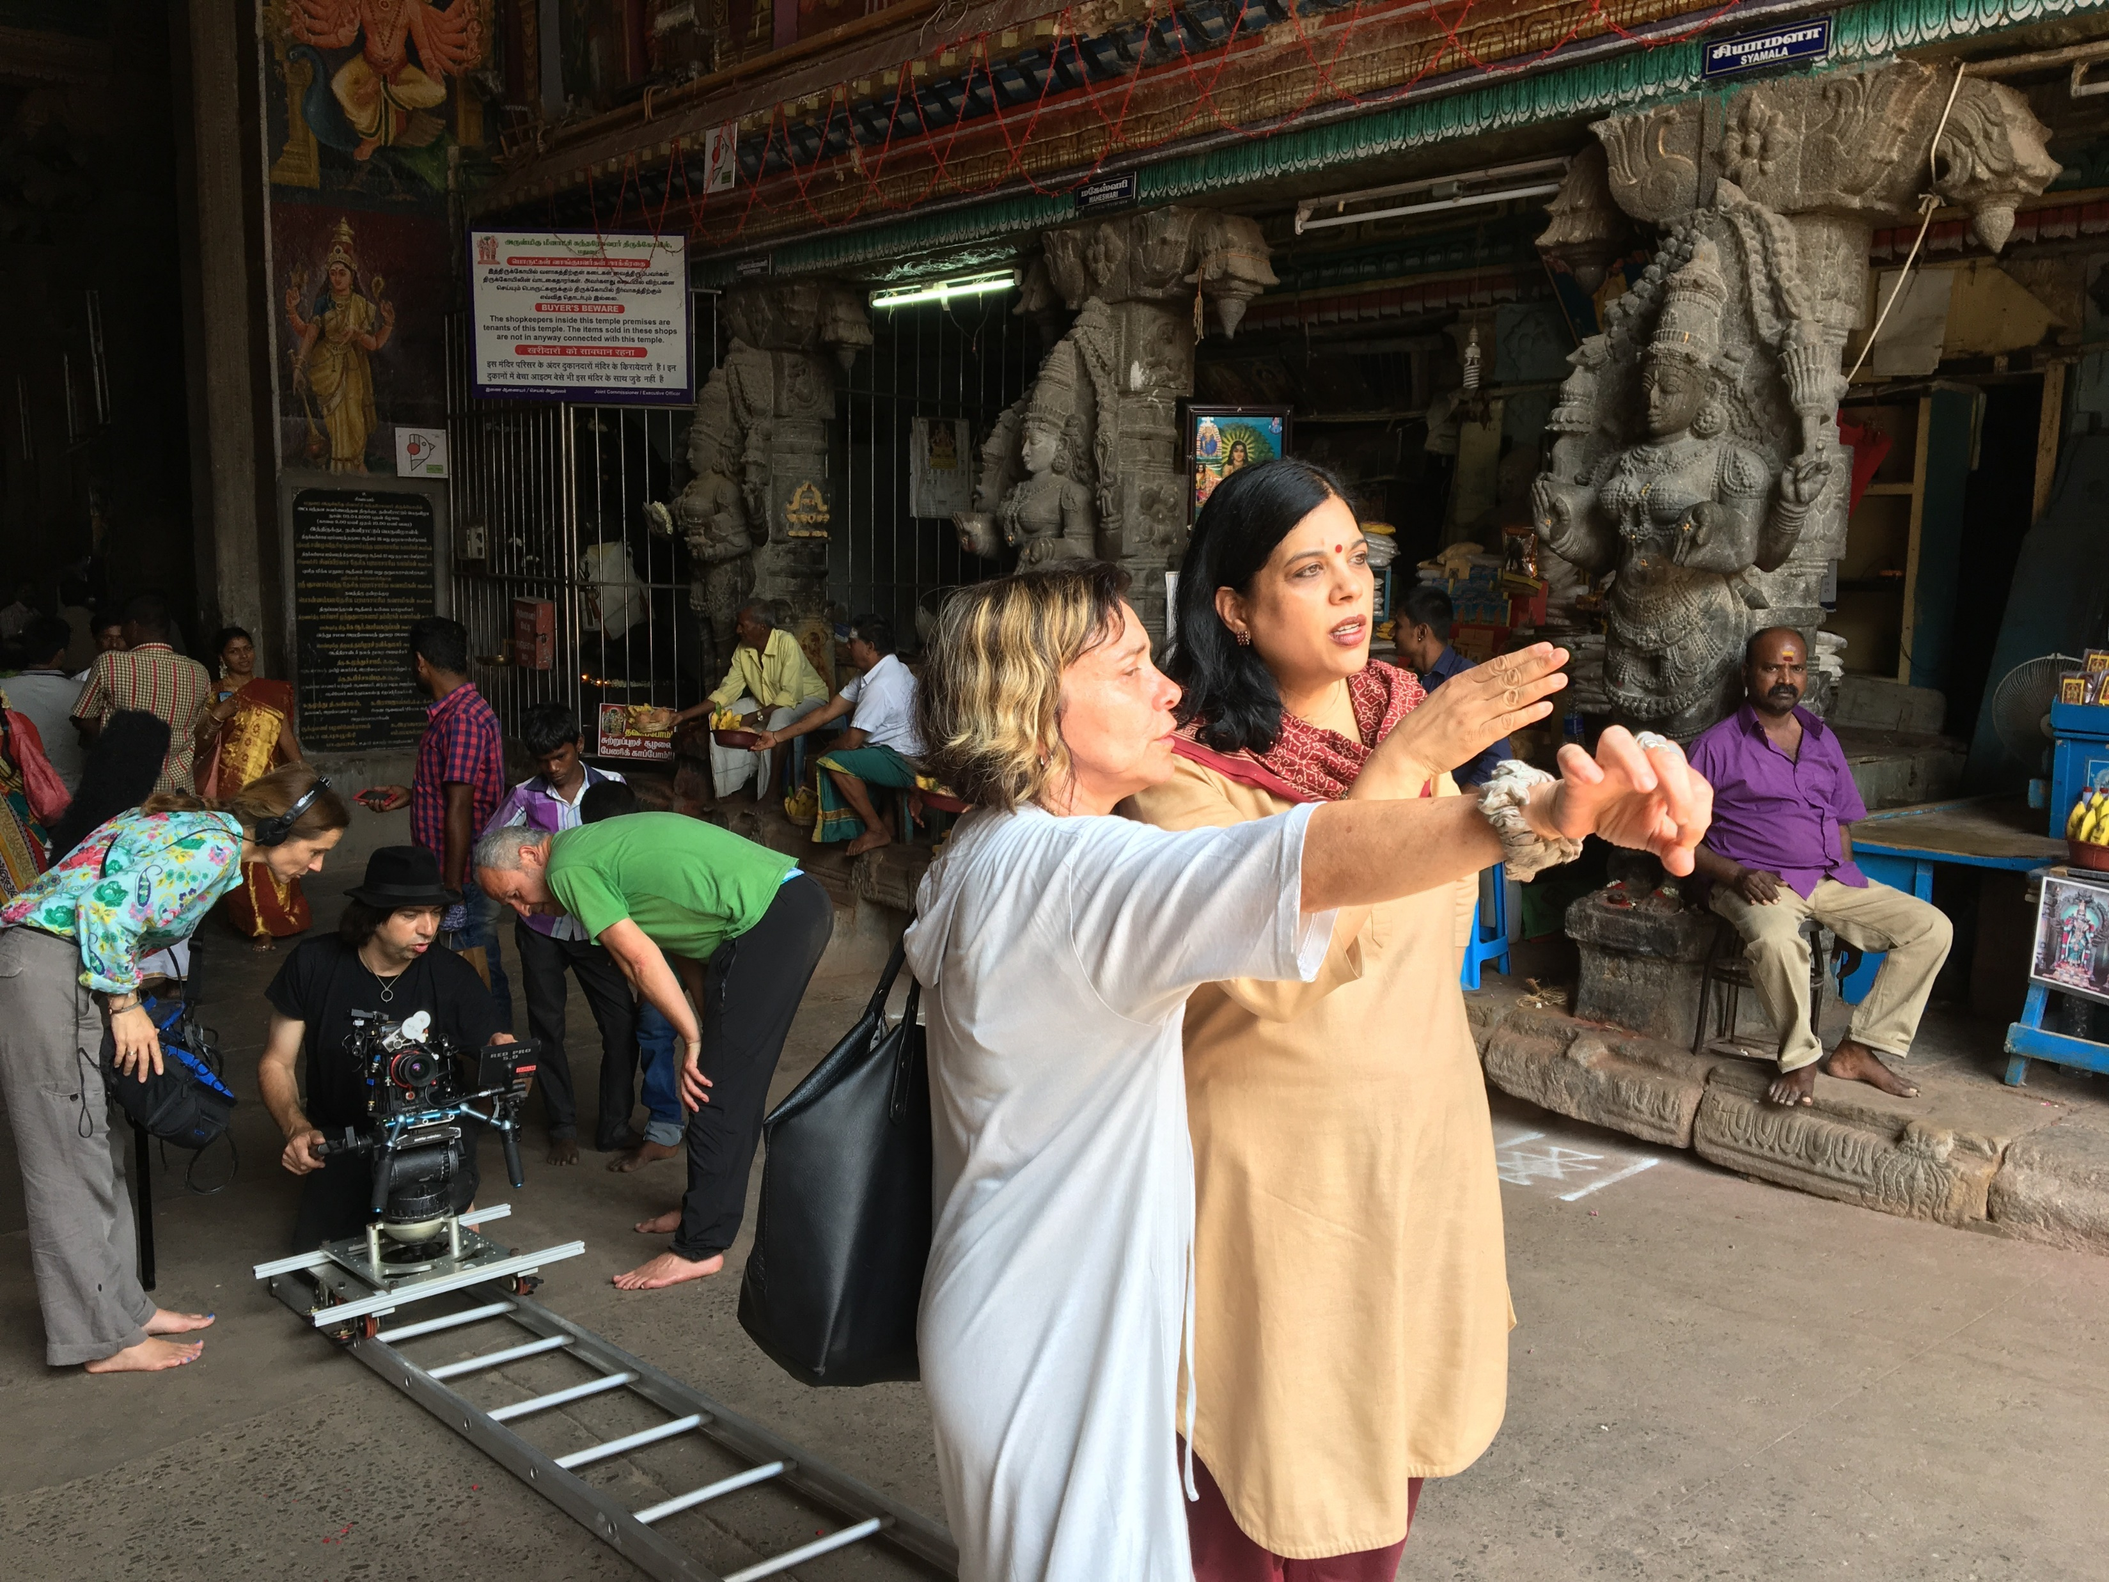
Diversity & Inclusion
Fulbright strives to ensure that it reflects the diversity of U.S. society and societies abroad. We encourage the involvement of people from traditionally underrepresented audiences in all our grants, programs and other initiatives.
Opportunities are open to people regardless of their race, color, national origin, sex, age, religion, geographic location, socioeconomic status, disability, sexual orientation or gender identity.
Notes:
As a program that “represents the American people”, diversity and inclusion is critical to our work. We strive to have a broad range of American experiences represented by Fulbrighters abroad. With that in mind, we are actively seeking a diverse pool of applicants for the Fulbright program. No matter where you’re from in the US or how you identify, Fulbright welcomes you to participate.

Slide 6
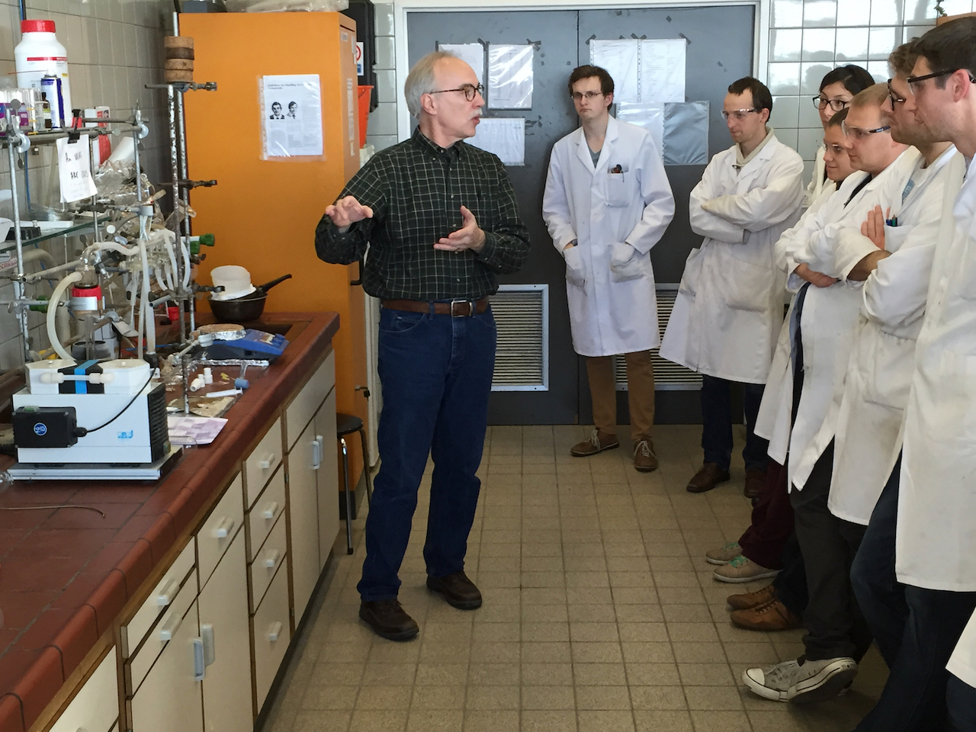
Fulbright by the Numbers
The Fulbright Program funds over 8,000 awards annually:
900 U.S. scholars and administrators
900 visiting scholars
2,200 U.S. students
4,000 foreign students
400+ language teaching assistants
Approximately 400,000 “Fulbrighters” have participated in the program since its inception in 1946.
Notes:
While US Scholar is the smallest piece of this puzzle, it is the most strategic. All other programs are possible through the development of relationships that faculty foster while abroad through programs like Fulbright.

Slide 7
Why Fulbright?
Fulbright is family-friendly.
Approximately 60% of our awards provide dependent support
Many Fulbright dependents go on to have international careers
Fulbright is supportive.
70% of applicants engage with IIE staff
Continued support while in country from IIE and host country staff
Access to Fulbright alumni as a resource
Fulbright is transformational.
Foster relationships that are real and lasting
Expand your publishing network
Become more multicultural in the classroom
Serve as an ambassador for international exchange
Gain the professional recognition as being identified as a “Fulbright Scholar”
Join a vibrant alumni network

Slide 8
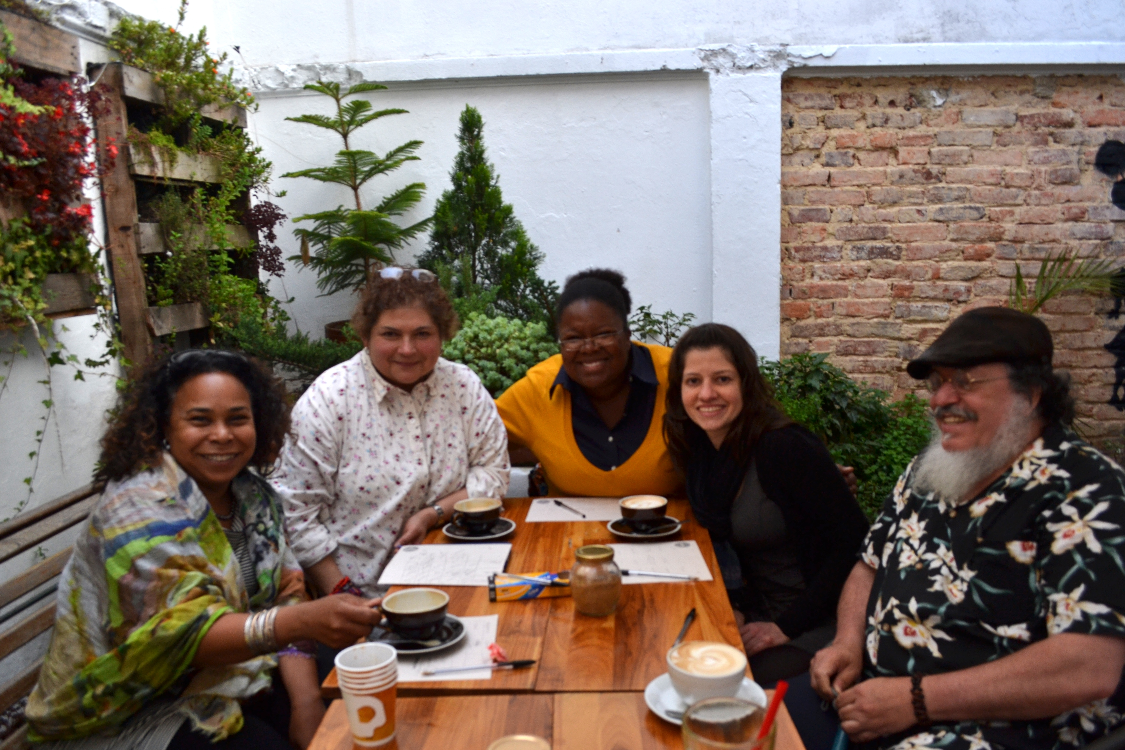
Eligibility for U.S. Scholar Program
U.S. citizenship
Degree and experience, as required by award:
      Ph.D. or other terminal degree
      MA and higher education teaching or professional experience
      Professional and/or artistic experience with substantial accomplishments
      Teaching experience as required
Compliance with policies on previous Fulbright Scholar awards and waiting periods between grants
Notes:
These are the overall eligibly requirements. The most essential one to keep in mind is that the program is only open to U.S. citizens. Green card holders are not eligible. For the “Degree and experience, as required by award” section, the categories listed are the most common ones seen in the “award requirements” tab.
The FFSB policy on alumni: 2 full years must elapse between the completion of a grant to the application deadline of the next grant. For this fall, applicants applying on September 15, 2022 need to have completed their grants before September 15, 2020 to be eligible in this regard.
Always be sure to review the award description or contact the Fulbright office to confirm eligibility regarding allowed disciplines for your award, career profile (e.g. postdoctoral vs. Distinguished Scholars, etc.)

Slide 9
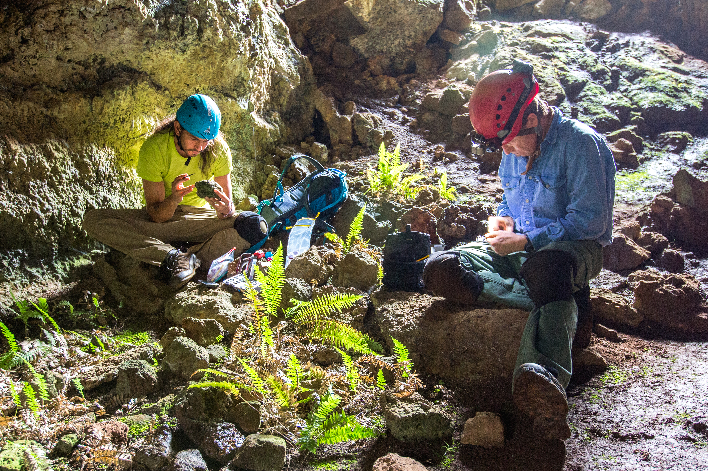
Fulbright Scholar Awards – Which is for you?
4 Award Types:
Scholar Awards
Postdoctoral Awards
Distinguished Scholar Awards
International Education Administrator Awards
Flex Option
Available in 63 countries and all world areas
Allows multiple visits over two years
Fulbright Public Policy Fellowship
Global & Regional Awards
Notes:
Scholar awards are by far the largest category, ranging in grant length and professional profile. These can be for postdoctoral researchers to full professors and everyone in between.
Postdoctoral awards are specific to researchers who have completed their PhD within 5 years of the fellowship start date.
Distinguished Scholar awards are intended for more accomplished faculty. Some awards look for those at associate or full professor rank or above – always consult award description
IEA awards – for administrators at US campuses to participate in seminars abroad. These are not for faculty and do not support research or teaching.
The Fulbright Public Policy Fellowship is unique among Scholar awards, intended for early and mid-career professionals and practitioners to serve in placements in a foreign government ministry or institutions in select countries around the world. Graduates of public policy programs at U.S. universities plus early career faculty who are still practitioners can be great candidates for this opportunity!
Regional Research Awards exist in most world regions, allowing you to visit 2 or more countries throughout a region. There are also those that cross world regions, like the Global Scholar Award.
Note the Flexibility of Fulbright: Most awards do take place during the academic year. However, the length of time varies from award to award. If someone asks about doing research during the summer, the “flex” option for countries that offer it allow the most flexibility. However, the majority of awards take place during the academic year of the host country.

Slide 10

Selecting the Right Award
Match country interest, expertise, career profile, and proposal to the award description
Language ability (if applicable)
Discipline preferences, when specified
Project relevance to the host country and/or institution
Benefits to you and your community
Remember: you can only apply for ONE AWARD per application cycle
Notes:
Read award description carefully!
Career level – early career, mid-career, senior and senior academics, professionals and artists are all categories listed on the award descriptions
Language ability – note that many awards do not require a language other than English. Check award description’s application requirements for details!
Scholars can only apply for one award per cycle. If they have difficulty choosing, they should contact the regional staff listed on the award for guidance or attend an office hour.

Slide 11
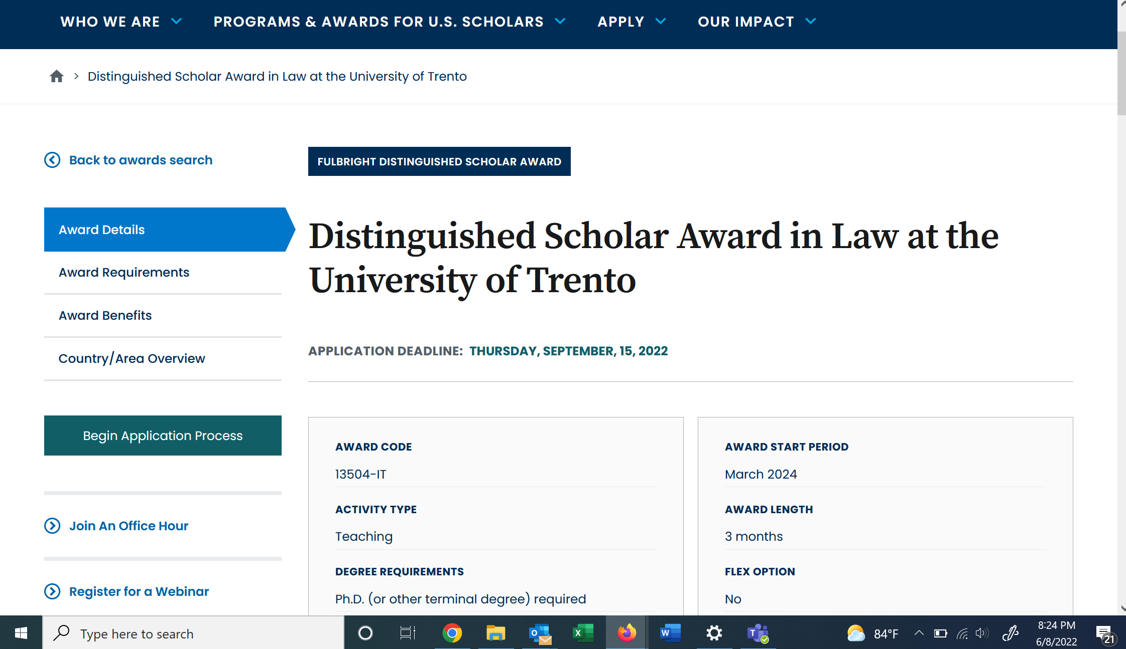
Understanding the Awards
Visit
fulbrightscholars.org to search awards
Notes:
EVERY AWARD contains 4 parts:
award details
award requirements
award benefits
country/area overview
Potential applicants should carefully read the information on EVERY tab to understand the award completely.
Please encourage scholars to pay specific attention to the “Award Requirements” tab. This provides critical information regarding eligibility, language proficiency requirements, and whether a letter of invitation is required. Note that the Award Details and Requirements tabs often have contacts listed at institutions abroad or the Fulbright office in country.
I encourage you to not answer specific questions about any award requirements because they differ across awards. Remind the audience to consult the “Award Requirements” tab and reach out to the Fulbright office if they have any questions or need clarification.
If time allows at the end, I often will walk people through the application resources on the website + an award description

Slide 12
Application Components
Requirements:
Supplemental Materials:
Application Form
Project Statement
Curriculum Vitae or Resume
2 Letters of Recommendation
Language Proficiency Report (if required)
Letter of Invitation (if required)
Course outlines or syllabi (for teaching)
Select bibliography (for research)
Portfolio submissions (for artists, architects, and journalists)

Slide 13
Tips to submit a strong application:
Before you start, read your award’s description carefully to ensure you meet all requirements and your proposed project is possible.
Start your application and enter your referees’ information as soon as possible. You can always save and return to it.
Take advantage of IIE resources, including webinars, office hours and pointed application guidance on our website.
Remember: You only can receive an award if you apply!
Notes:
The last point is included as another chance to stress that faculty often don’t realize that Fulbright U.S. Scholar opportunities are open to a wide range of scholars in EVERY discipline and at all points in their careers, from postdocs to distinguished scholars and everything in between.

Slide 14
Application Cycle
2023-24 Competition Now Open
FEBRUARY
Catalog of Awards Opens
SEPTEMBER 15
Application Deadline
SEPTEMBER
Program staff conducts technical reviews for completeness
OCTOBER – NOVEMBER
U.S. peer review
NOVEMBER – JANUARY
Applicants notified of status. Recommended applications are sent to host countries and to the Fulbright Foreign Scholarship Board.
JANUARY – JUNE
Final decisions are made
JUNE – ONWARD
Participants prepare for departure
Notes:
Note that the notification window for hearing final decisions is wide but also accurate. People can year as early as January and as late as the end of May.

Slide 15
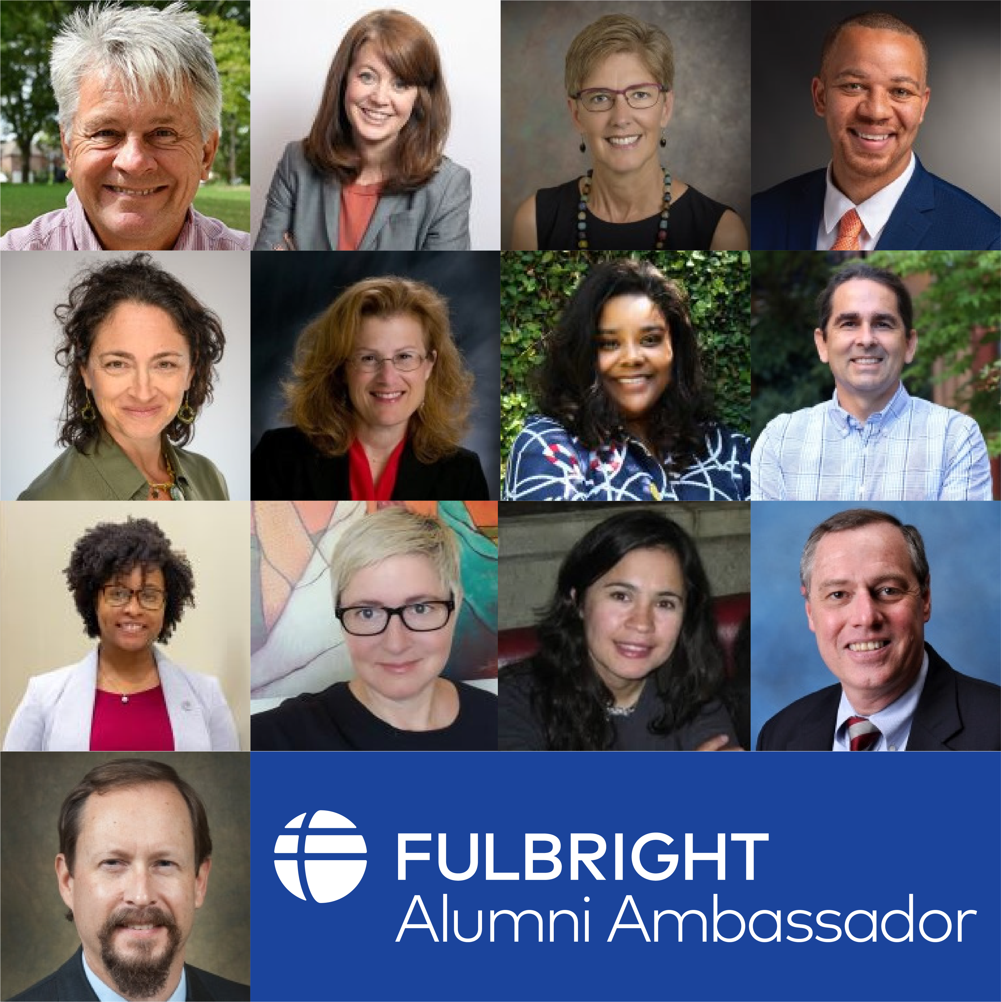
Connect with a Fulbright Alumni Ambassador
Fulbright U.S. Scholar Alumni Ambassadors are official representatives of the program and can share with your faculty and administrators about the impact their Fulbright had on them personally and professionally, as well as on their institution.
72
Emeriti Ambassadors
26
New Ambassadors
80
+ Events Annually
Visit our site for more information:
https://fulbrightscholars.org/alumni-ambassadors

Slide 16
Bring Foreign Fulbrighters to your Campus
Fulbright Scholar-in-Residence (S-I-R) Program
Fulbright Outreach Lecturing Fund (OLF)
Fulbright Language Teaching Assistant (FLTA) Program
Host scholars from other countries to teach for a semester or an academic year
NEW DEADLINE:
June 1
Website: fulbrightscholars.org/sir
Email: SIR@iie.org
Host current Fulbright Visiting Scholars for short-term lectureships of 2 – 6 days on discipline or cultural topics to internationalize the campus
Website: https://fulbrightscholars.org/OLF
Email: OLF@iie.org
Host native speaking language teaching assistants to enhance students’ understanding different languages and cultures
Website: foreign.fulbrightonline.org
Notes:
SIR – The Fulbright Scholar-in-Residence (S-I-R) Program assists U.S. higher education institutions in expanding programs of academic exchange, by supporting non-U.S. scholars through grants for teaching at institutions that might not have a strong international component and/or serve minority audiences. Both the U.S. institution and the scholar grantee benefit from this experience.
OLF – The Outreach Lecturing Fund (OLF) provides funding for campuses to host Fulbright Visiting Scholars, already in the United States, for short-term speaking engagements. To see a list of current Visiting Scholars in the U.S. please visit our Scholar Directory. The OLF travel award is designed to enrich both institutions and Visiting Scholars through lectures that will promote academic disciplines and cultural understanding.
FLTA - The Fulbright Foreign Language Teaching Assistant (FLTA) Program supports language assistantships at universities and colleges throughout the U.S., providing institutions with an opportunity to enhance their language programming and expose students to native speakers who bring an energetic, up-to-date cultural component to the foreign language classroom as well as student life at a campus in general.

Slide 17
Additional Fulbright U.S. Programs
Scholars
Students
Teachers
Fulbright Public Policy Fellowship
FPPF@iie.org
Fulbright-Hays Group Projects Abroad Program
GPA@ed.gov
Specialist Program
FulbrightSpecialist@worldlearning.org
Fulbright-Hays Doctoral Dissertation Research Abroad Program
DDRA@ed.gov
English Teaching Assistant (ETA) Program
FBstudent@iie.org
Student Program
FBstudent@iie.org
Distinguished Award in Teaching Research Program
FulbrightDA@irex.org
Group Projects Abroad
GPA@ed.gov
Teachers for Global Classrooms
FulbrightTGC@irex.org
Notes:
The U.S. Scholar Program is large but is one of many programs under the Fulbright umbrella. Note that there are opportunities other opportunities for U.S. Scholars, students and teachers to pursue abroad. I encourage people to take a photo or screenshot this to follow up if interested.
This slide should be a basic overview of the wide variety of Fulbright programs, administered by IIE or other DOS partners. You do not need to be an expert on each of these programs, but I included a sentence or so below about each so you can be informed. Please encourage the audience to reach out using the appropriate email to ask further questions.
U.S. Scholars
Arctic Initiative – The Fulbright Arctic Initiative creates a network to stimulate international scientific collaboration on Arctic issues while increasing mutual understanding between people of the United States and the people of other countries. Using a collaborative model to translate theory into practice, program participants address public-policy research questions relevant to Arctic nations’ shared challenges and opportunities. Canada open, Norway midyear, DC final.
Fulbright-Hays Group Projects Abroad Program - Funding to spend time in a foreign country or region acquiring resource materials for curriculum development in modern foreign languages or area studies programs
Fulbright Specialist - The Fulbright Specialist Program is a unique opportunity for U.S. academics and established professionals to join a roster of candidates who are eligible to engage in two- to six-week, project-based exchanges at host institutions across the globe. Institutionally driven from overseas, so projects must be approved for funding abroad before matches take place.
U.S. Students
ETA - Places grantees in schools overseas to supplement local English language instruction and to provide a native speaker presence in the classrooms
Fulbright-Hays Doctoral Dissertation Research Abroad Program - Funding for individual doctoral students who conduct research in other countries in modern foreign languages and area studies for periods of six to 12 months
Fulbright U.S. Student Program - Recent graduates, post-graduate candidates through dissertation level, developing professionals and artists to study and research abroad
U.S. Teachers
Fulbright Distinguished Award in Teaching Program - K-12 educators can take part in a three-to six-month professional development experience abroad, pursue individual inquiry projects, take courses at a host university, and collaborate with colleagues on best educational practices
Fulbright-Hays Group Projects Abroad - Funding to spend time in a foreign country or region acquiring resource materials for curriculum development in modern foreign languages or area studies programs
Fulbright Teachers for Global Classrooms - Fulbright TGC is a year-long professional development opportunity for U.S. elementary, middle, and high school teachers to develop skills for preparing students for a competitive global economy.

Slide 18

Stay Connected with Fulbright
Email us at scholars@iie.org
Visit fulbrightscholars.org to learn more about the Fulbright U.S. Scholar Program
Refer your colleagues
Notes:
Sign up for MyFulbright, follow all our media for inspiration and stories, refer your colleagues!

