Slide 1
Notes:
1

Slide 2
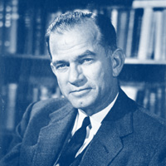
History of the Program
Senator J. William Fulbright (1905-1995)
“International education exchange is the most significant current project designed to continue the process of humanizing mankind to the point, we would hope, that nations can learn to live in peace.”
Established 1946
Sends U.S. academics and professionals overseas and brings scholars and professionals from abroad to the U.S.
Sponsored by U.S. Department of State’s Bureau of Educational and Cultural Affairs
Administered by the Institute of International Education’s Council for International Exchange of Scholars (CIES)

Slide 3
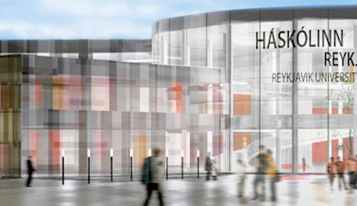
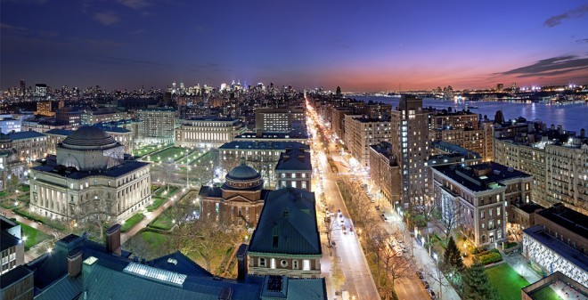
John P. Allegrante
Fulbright Specialist 2005 Iceland
Fulbright Scholar 2007 Iceland
Professor of Health Education & Director of the Institute for Global Engagement
Columbia University, New York
Health Education and Public Health
Professor of Public Health
Reykjavik University
Health Behavior and Academic Achievement in Icelandic School Children

Slide 4
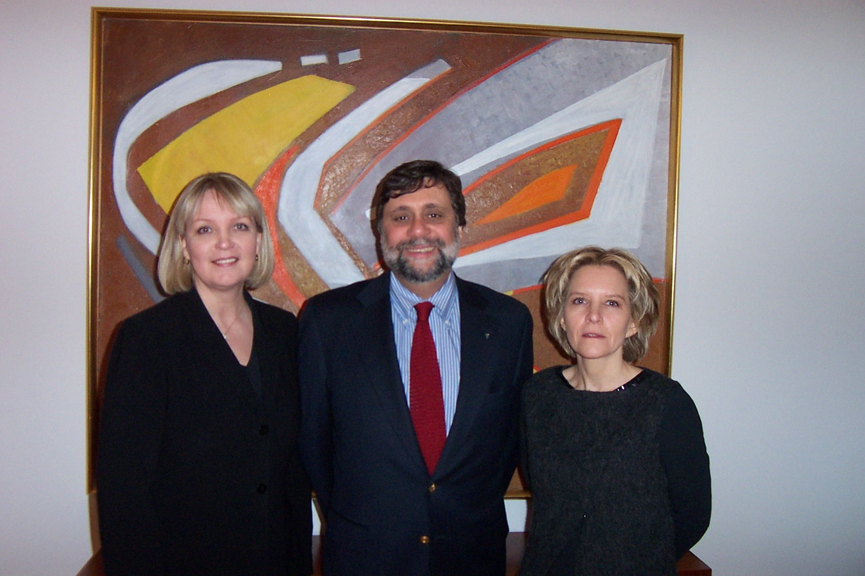

Slide 6
Why I Chose to Apply
Professional Development: Opportunity to develop a new research collaboration in a different cultural context
Exposure to Different Culture and People: Chance to gain deep understanding of another culture and what we can learn from it and its people by living in the country
Make a Difference: Opportunity to contribute to the development of a fledgling private university in the host country as well as bring new insights back to my own institution
Prestige: Recognition of my own scholarship and the opportunity to be a cultural ambassador for American public
Rewarding Sabbatical Experience: Provided an intellectually challenging activity that coincided with sabbatical schedule

Slide 7
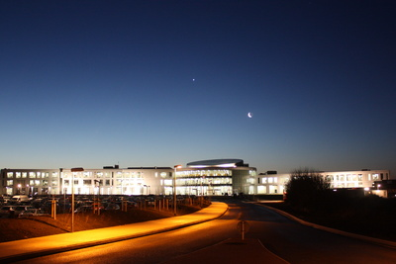

Slide 8
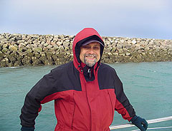
Health Behavior and Academic Achievement in Icelandic School Children
Lecture: Taught several modules in public health education
Research: Launched a collaborative program of research on the health of children and adolescents
Seminar: Conducted seminars on curriculum and faculty development and how to organize multidisciplinary research
Institutional Collaboration: Developed MOU with Columbia University Teachers College to support exchanges of scholars and students

Slide 9
Visit John Allegrante’s Ambassador Page and view his Scholar Story

Slide 10
Professional and Personal Outcomes
Expanded Curriculum: Included a new geo-cultural aspect to my lectures, involving extensive cultural highlights from Iceland and my research there.
Networking: Met new colleagues and further developed relationships with peers in and outside my field. Currently continuing collaboration on the development of a new LIFE COURSE—Iceland research project.
Flexibility: Living and working in a different environment and culture has enhanced my understanding of that part of the world and of my own country.
Rewarding Experience: Satisfaction in knowing I was able to contribute to the development of my host institution.

Slide 11
Institutional Impact
Curriculum Development: Incorporated more international content into existing courses. Shared newly developed insights and expertise with relevant departments.
Study Abroad: Advocated for study abroad programs. Informally reviewed and met with students interested in going abroad. Became the Fulbright Program Advisor and Campus Representative at my institution.
Enhance International Engagement: Invited my counterpart to visit our campus, where she is now a regular visitor. Used the Occasional Lecturer Fund to invite Fulbright Visiting Scholars to campus. Continue to encourage faculty colleagues to engage in international exchanges, including Fulbright.
Spokesperson for International Dialogue: Raised awareness about the issues between the U.S. and Host Country

Slide 12
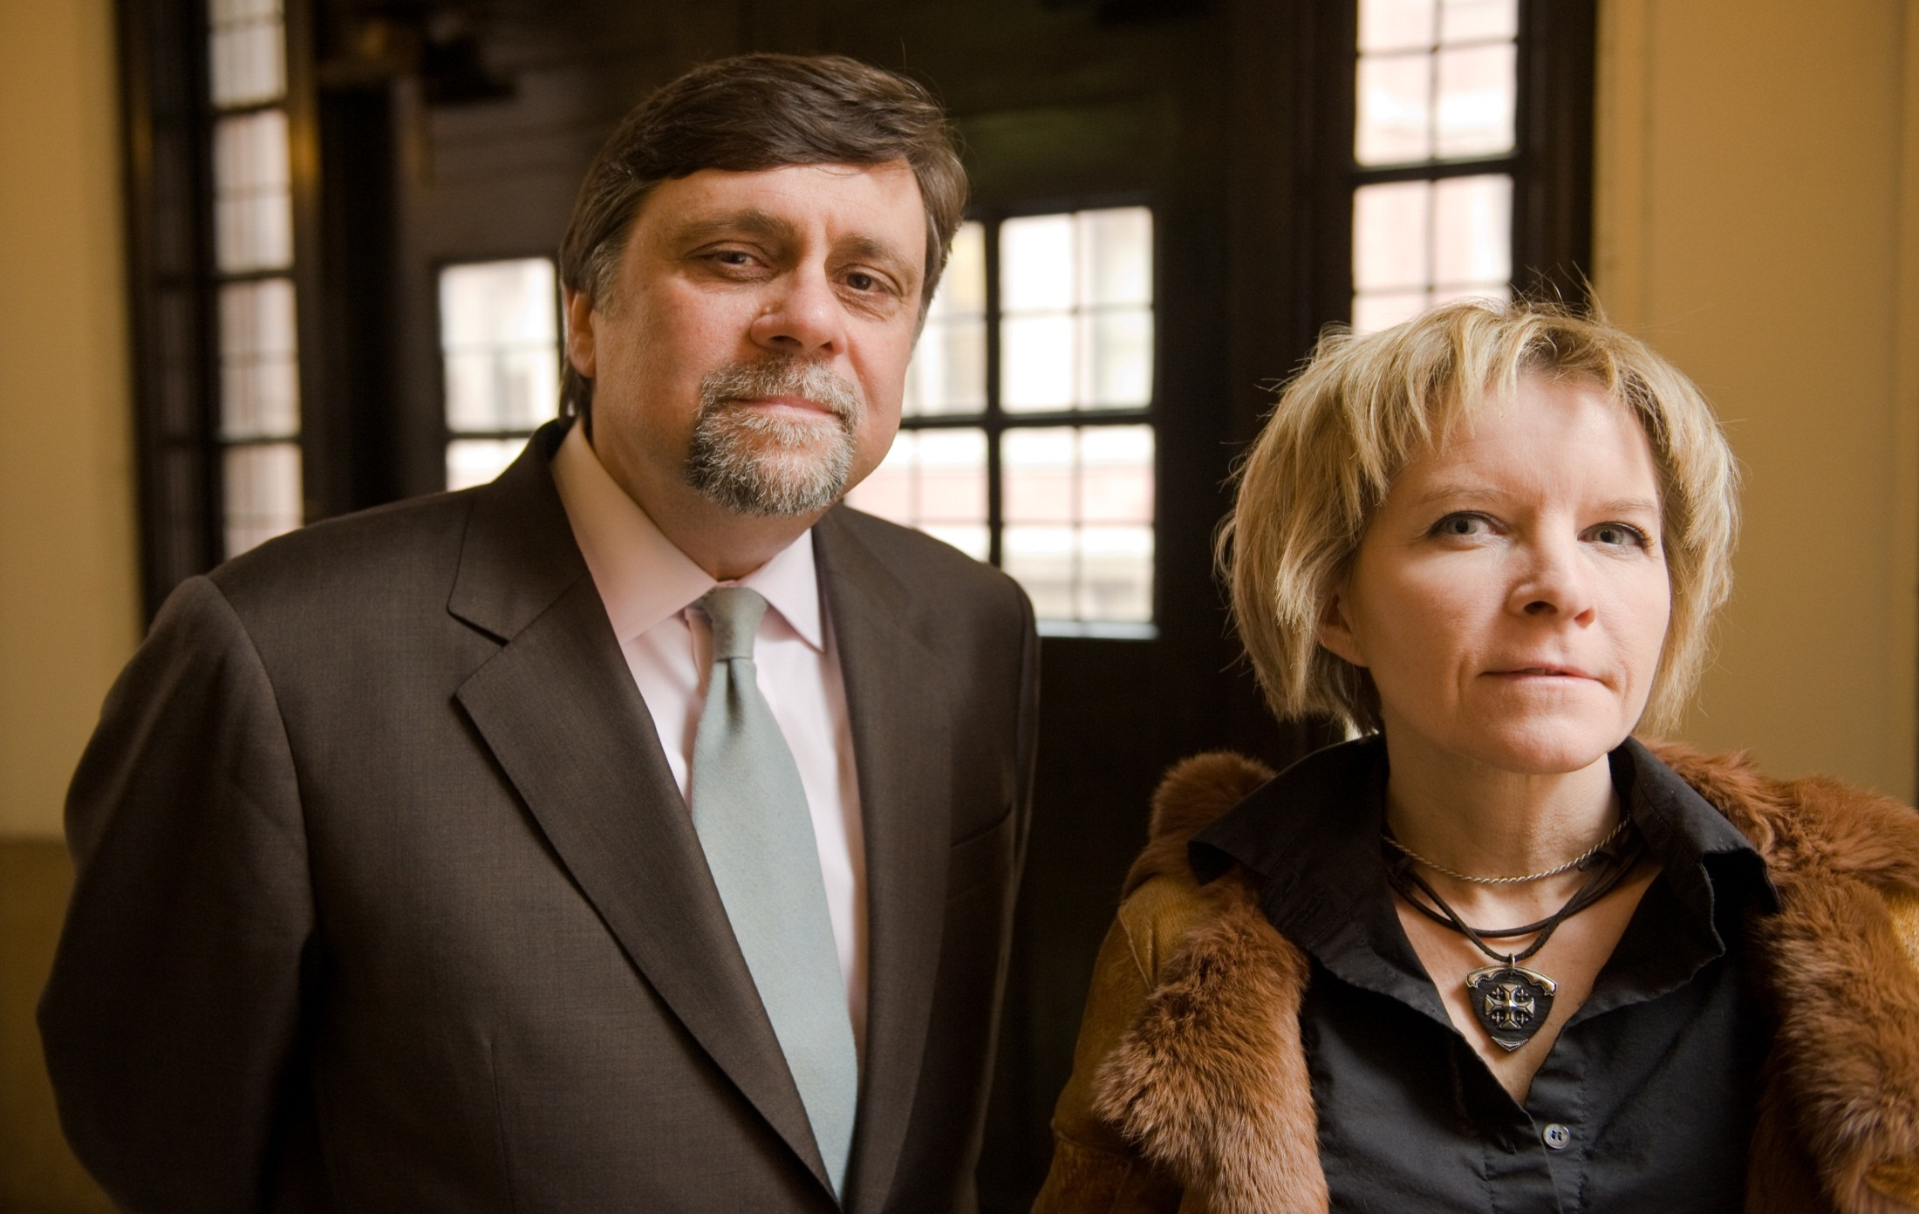

Slide 13
Council for International Exchange of Scholars (CIES)
U.S. SCHOLAR Programs offer U.S. faculty, administrators and professionals grants to lecture, conduct research in a wide variety of academic and professional fields, or to participate in seminars.
NON-U.S. SCHOLAR Programs support the research and teaching of scholars visiting colleges and universities in the United States. These programs offer joint collaborative opportunities with U.S. Scholars.
Opportunities for U.S. INSTITUTIONS allow campuses to host Fulbright Visiting Scholars and professionals from abroad to lecture at U.S. colleges and universities.
www.cies.org

Slide 14
Other Fulbright Programs
Fulbright U.S. Student Program: For recent graduates, postgraduate candidates up through dissertation level and developing professionals and artists to study and research abroad
Fulbright Teacher Exchange Programs: Principally for primary- and secondary- level educators
Fulbright-Hays Awards: For faculty research, group projects and seminars abroad in certain social sciences and humanities fields
Learn more about IIE programs: www.iie.org

