Slide 2
Fulbright Scholar-in-Residence Program: Alumni Panel
Susan Muendl, Assistant Director, Fulbright Multi-Regional Scholar & Student Programs
Institute of International Education
Kate Edney, Regis College
Lauren Bell, Randolph-Macon College
January 30, 2023

Slide 3
Today’s Topics
Overview of the Scholar-in-Residence Program
Host Impact: Institutional Internationalization and Benefits to Campus and Local Community
Presentation
Panel Discussion
Tools/Resources Available
Q&A

Slide 4
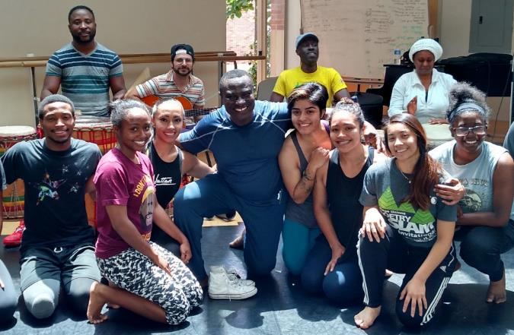
Fulbright Scholar-in-Residence Program
Driven by the goals U.S. institutions of higher education to enhance internationalization efforts on their campuses
Brings scholars and professionals from abroad to campuses that do not often host visiting scholars
S-I-R grantees
Teach courses and/or guest lecture
Assist in curriculum development
Develop study abroad/exchange partnerships
Provide cross-cultural/international perspective
Engage with the campus and the local community
Full academic year or One Semester options
Benjamin Ayettey, Ghana, 2015-16 S-I-R at Ohio Northern University
Notes:
SIR is a wonderful opportunity to bring scholars and faculty members from overseas to campus that might not have the opportunity to host scholars or have a strong international presence. It helps with internationalizing your campus and develop an exchange courses moving forward. These scholars teach primarily undergraduate and graduate academic courses for either a semester or full academic year. It provides a cross-cultural international perspective for the campus. The application is made by the interested U.S. institution, as I mentioned is for either a semester or full academic year.
While there are over 900 Fulbright Visiting Scholars on campuses around the U.S., what really sets this program apart, aside from the fact that the institutions drive the process, is that these scholars are highly integrated into the campus and community life. These scholars are teaching full course loads and should be engaging within the campus culture. Often times these scholars are viewed as all-stars and tend to be more visible than other visiting scholars who might often be stuck in a research lab and less exposed.
The application opened in February and has a deadline of June 1.
Photo Caption: Benjamin Ayettey, a dance instructor from Accra, Ghana, was a Scholar-In-Residence at Ohio Norther University from 2015-2016.

Slide 5
Eligibility
Open to all accredited U.S. institutions of higher education. Non-U.S. institutions are ineligible.
Foreign scholars are eligible to serve as Scholars-in-Residence. U.S. citizens and permanent residents are ineligible.
Scholar teaching responsibilities are limited to a maximum of two courses per semester.
Proposals shall not authorize engagement in professional religious activities or activities for which a license to practice medicine or nursing is required.
U.S. institutions may not host Fulbright Scholar-In-Residence participants in consecutive academic years.
Grant length minimum 3 months, maximum 10 months
Notes:
An institution hosting an S-I-R in a given academic year must wait one academic before hosting a subsequent S-I-R. Preference will be given to applicants who have not previously received a Scholar-in-Residence award.

Slide 6
2022-2023 S-I-R Participating Institutions
Appalachian State University
California Polytechnic State University-San Luis Obispo
California State University-Bakersfield
Carolina University
Colorado State University, Pueblo
CUNY City College
Florida State University
Forsyth Technical Community College
Georgia State University
Hendrix College
Marymount University
Metropolitan State University of Denver
Mississippi Valley State University
Mott Community College
Nebraska Wesleyan University
New Jersey City University
Northeastern Illinois University
Northern Arizona University
Pittsburg State University
Salisbury University
Seattle University
Snow College
SUNY at Purchase College
Temple University
Texas A & M University-Corpus Christi
The University of New Mexico
UNC Charlotte
University of Alaska Fairbanks
University of Central Florida
University of Delaware / Delaware State
University of Hawaii at Manoa
University of Massachusetts-Lowell
University of Pittsburgh-Greensburg
University of Richmond / Virginia Commonwealth
University of South Alabama
University of Texas Rio Grande Valley
University of West Alabama
University of Wisconsin-La Crosse
Utah State University
Washington State University
William Rainey Harper College

Slide 7
Impact on Institutional Internationalization Efforts and the Campus Community
Regis College
2016-2017, Brazil
2018-2019, Bangladesh
Randolph-Macon College
2009-2010, China
2012-2013, Egypt
2017-2018, Japan
2019-2020, Netherlands
Notes:
Host institutions gain new knowledge, new courses and new perspective from scholar
U.S. Students learn about a particular world region or country
Experience impacts scholar’s field, career, home institution, and home community
Outcomes and Impact:
Develop new world area studies programs
Add an international dimension to existing coursework
Expand an existing international program
Study Abroad program
Virtual Exchange/online courses

Slide 8
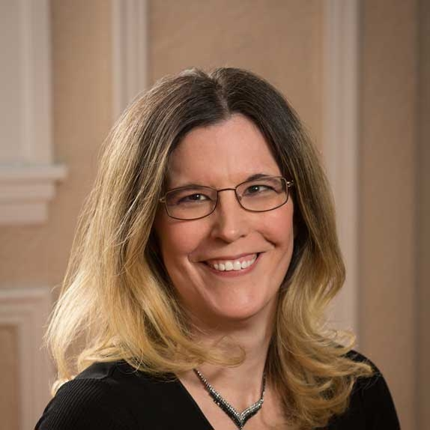
Regis College
Located in Weston, MA
Kate Edney, PhD
Associate Provost of Accreditation, Assessment and Research
Formally served as Dean of the School of Arts and Sciences
A private Roman Catholic institution founded by the Sisters of St. Joseph in 1927
Enrollment: 3,599
1,271 undergraduate students
2,328 graduate students (inclusive of DNP and EdD students)

Slide 9
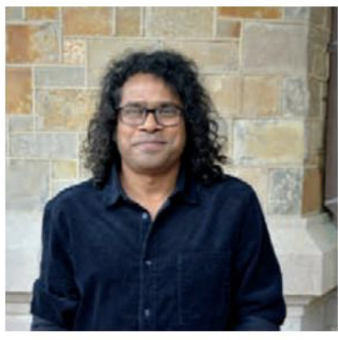
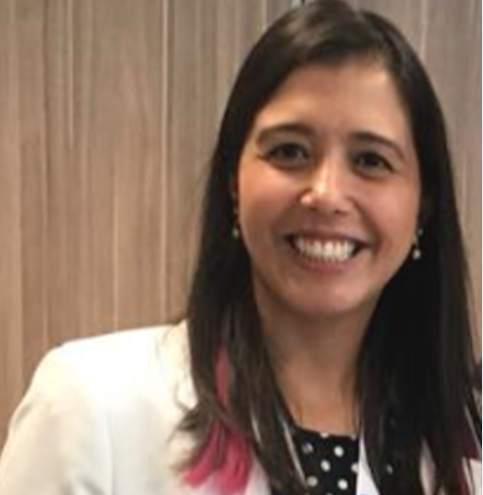
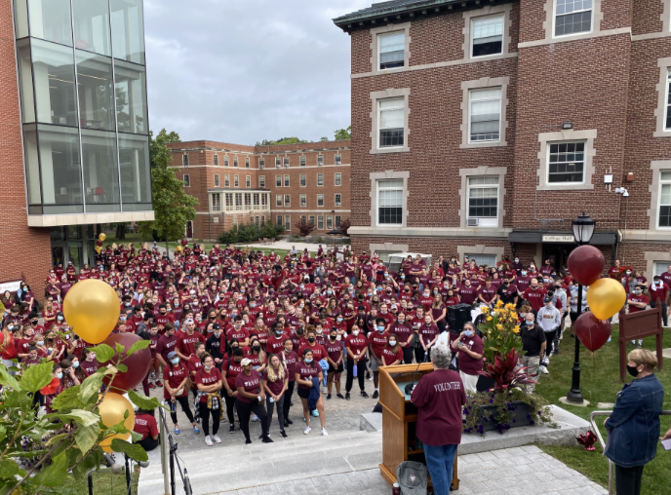
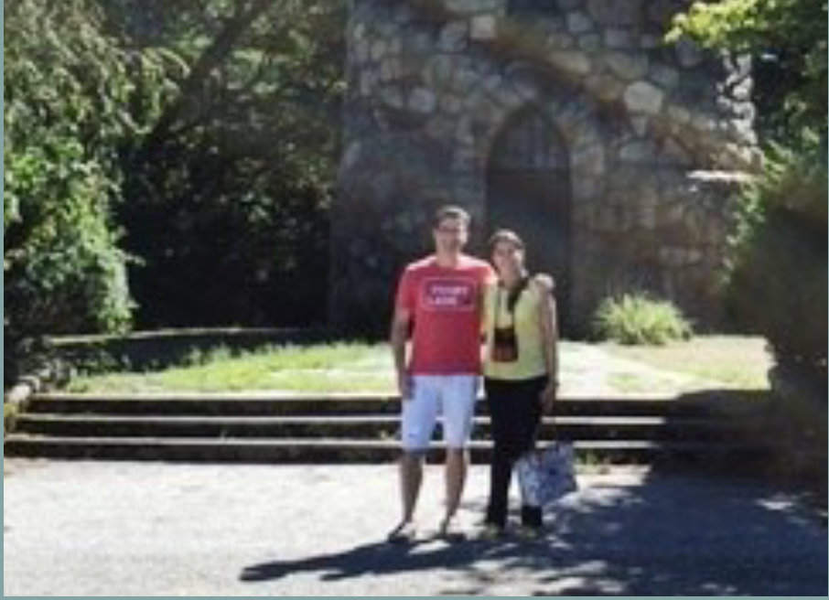
Both Scholars served in our Department of Humanities which is home to a multi-disciplinary faculty (Ethics, Music, Philosophy, English, History, Political Science…)
Dr. Lania Stefanoni Ferreira
Brazil
Scholar in Residence, 2016-2017
Dr. Maswood Akhter
Bangladesh
Scholar in Residence, 2018-2019
Notes:
Dr. Lania Stefanoni Ferreira

Slide 10
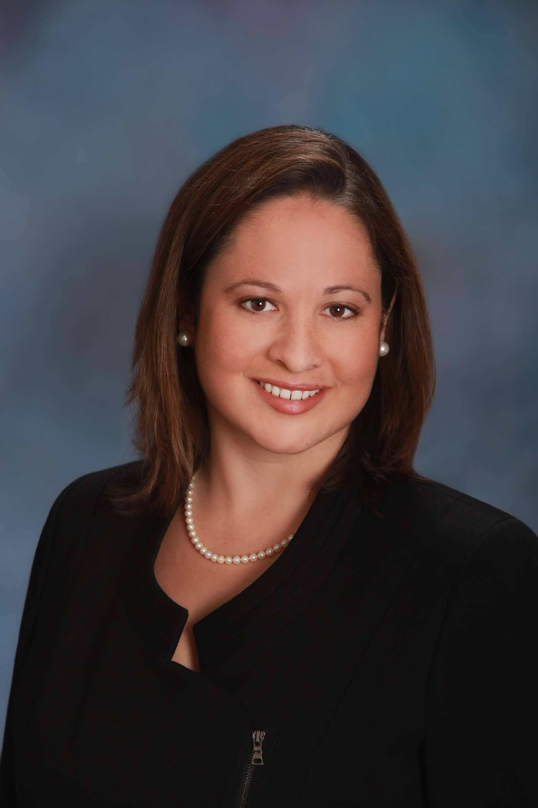
Randolph-Macon College
Located in Ashland, VA
Lauren Bell, PhD
James L. Miller Professor of Political Science & Special Assistant to the Provost
Dean of Academic Affairs with supervisory authority over the Office of International Education, 2014-22
Administrative coordinator for four previous S-I-Rs at Randolph-Macon College
Hao “Larry” Tang, China, 2009-10 (political science)
Shaza Gamal Ismail, Egypt, 2013-14 (int’l studies)
Yasushi Maruoko, Japan, 2017-18 (int’l studies)
Lucien Lameijer, The Netherlands, 2019-20 (chemistry)

Slide 11
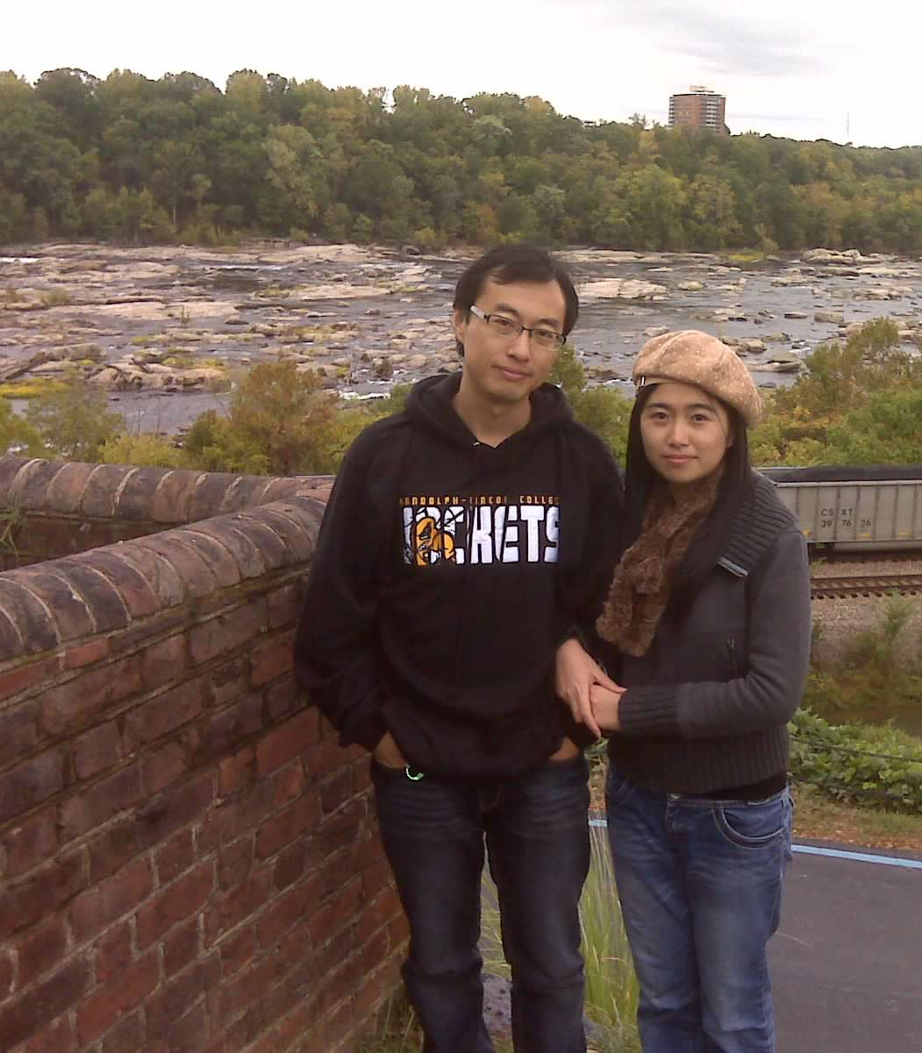
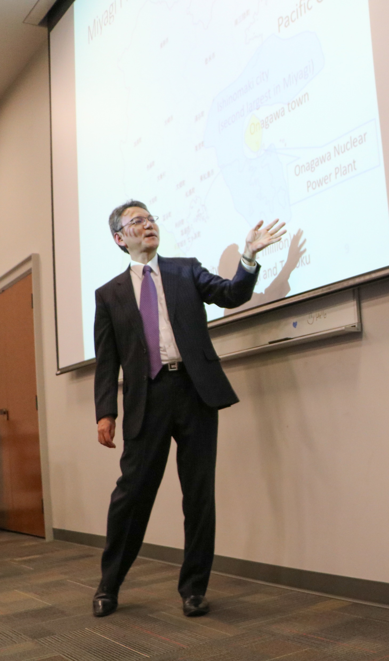
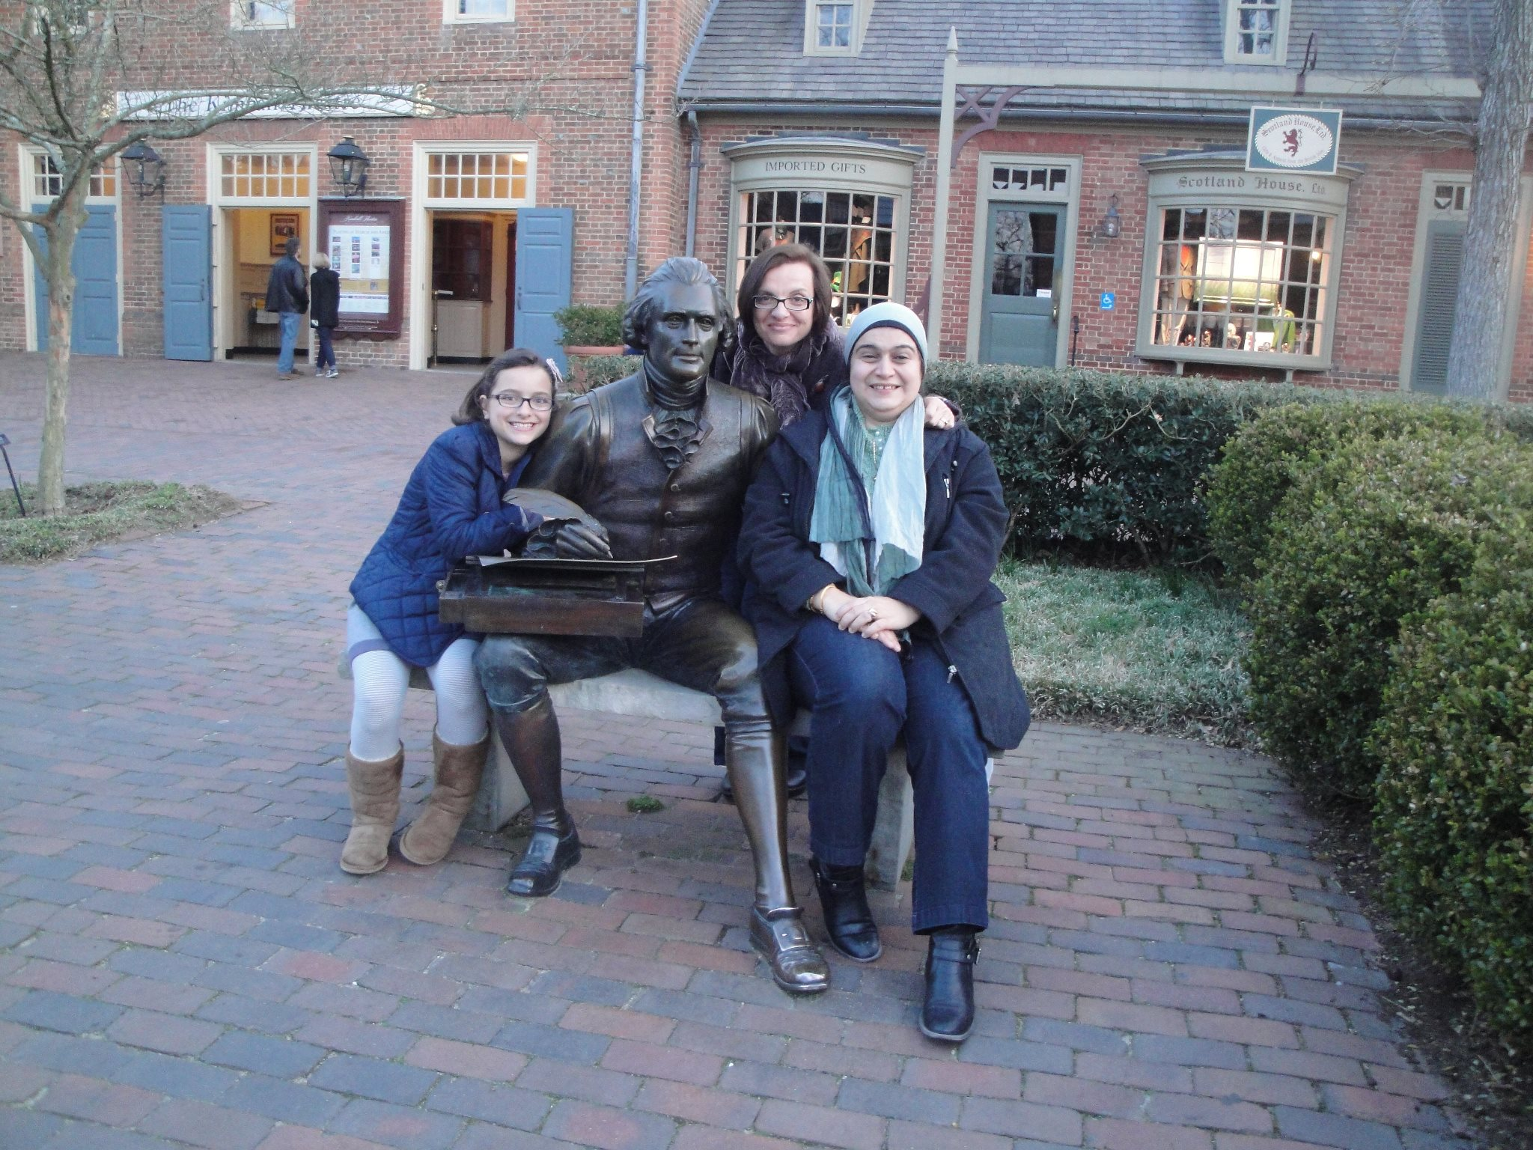
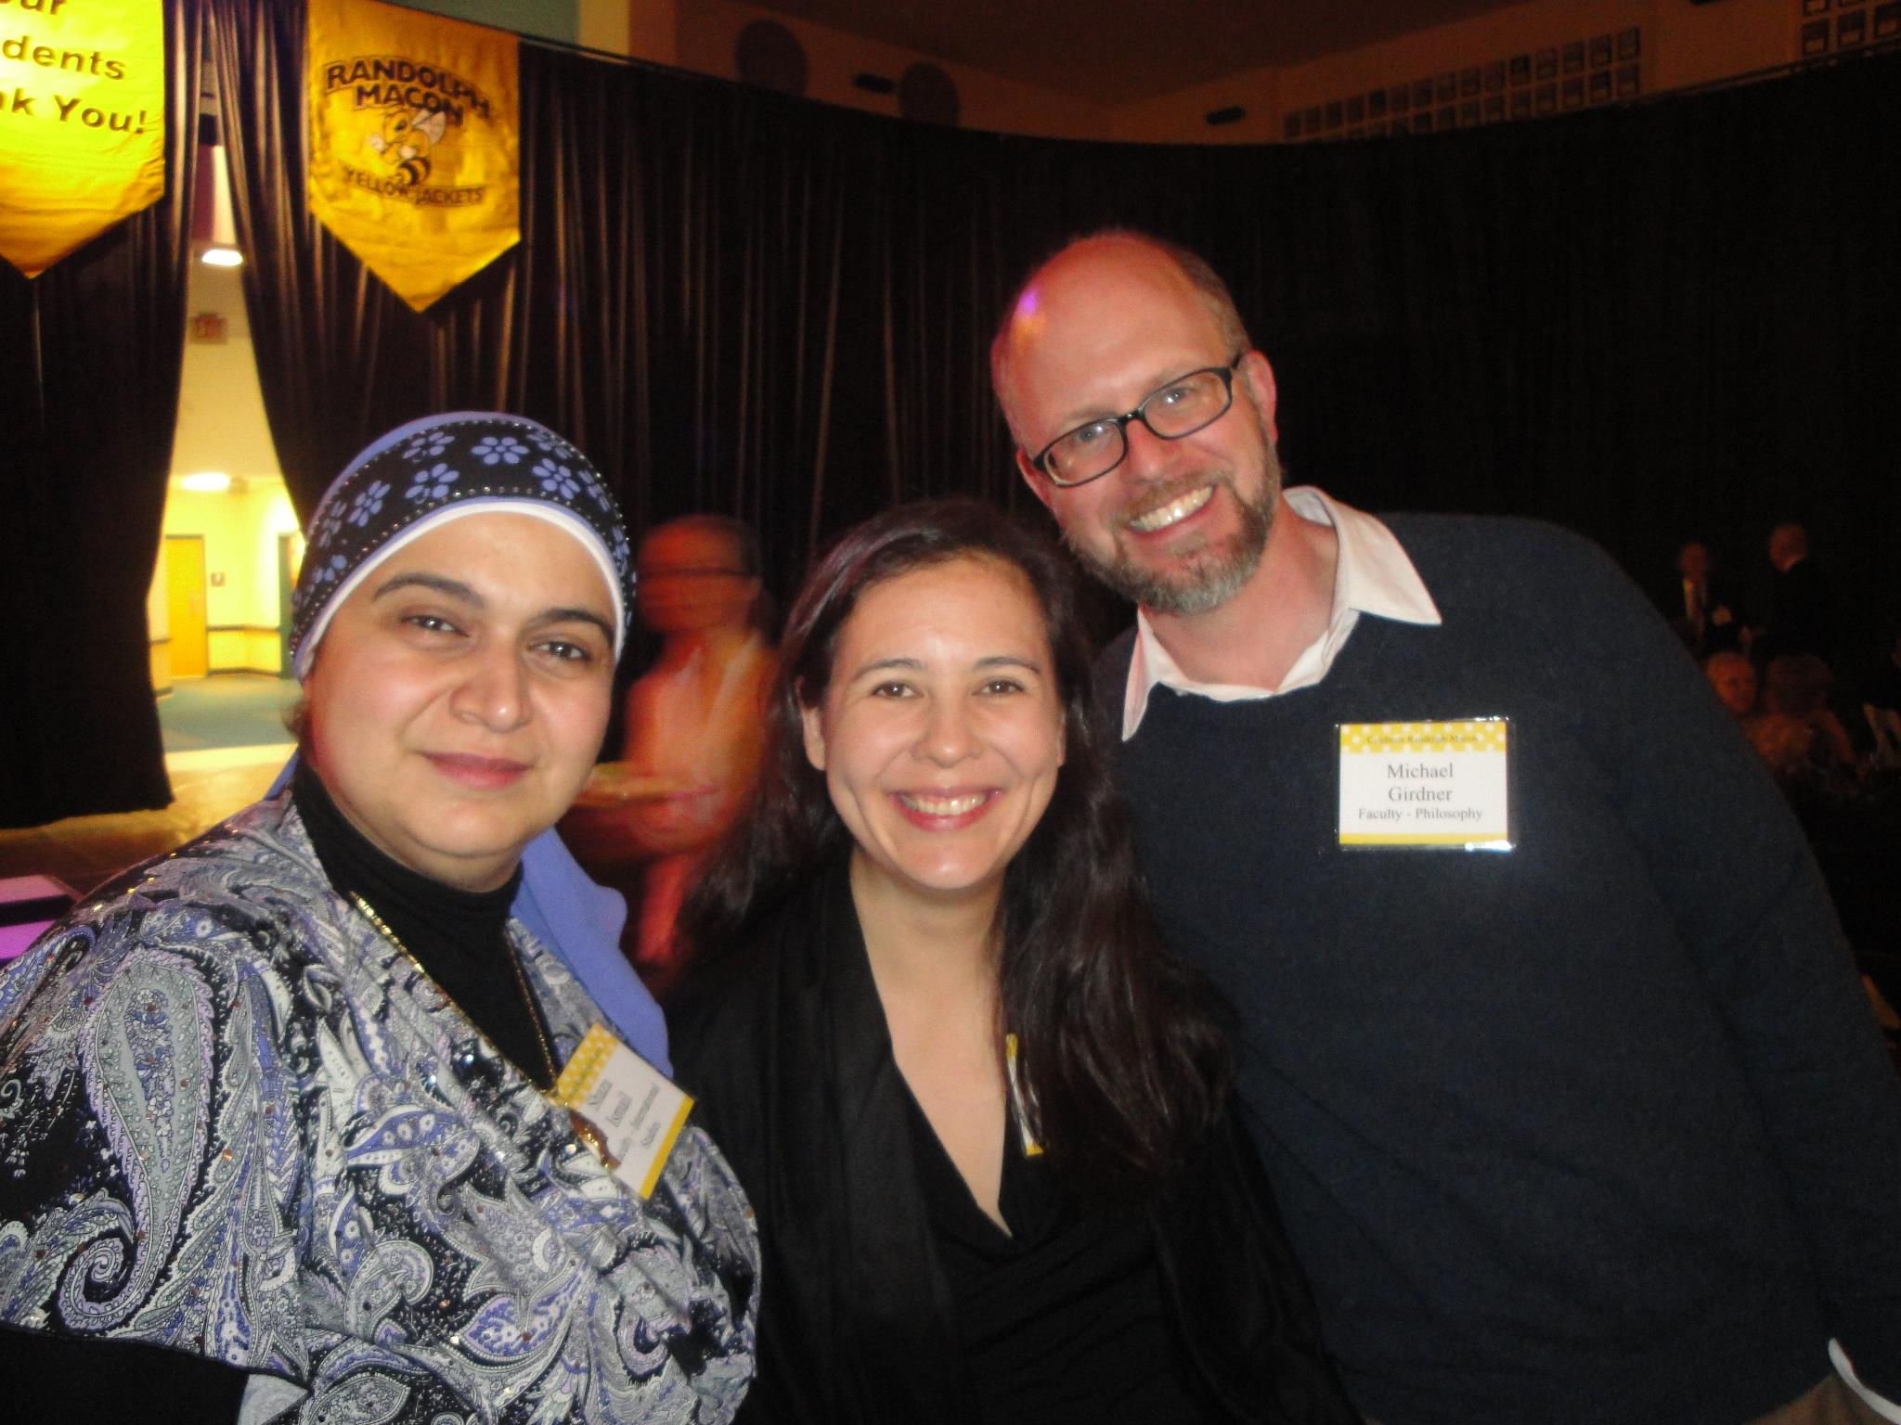
S-I-Rs at Randolph-Macon College
Hao “Larry” Tang
(China)
2009-10
Shaza Gamal Ismail
(Egypt)
2012-13
Yasushi Maruoka
(Japan)
2017-18

Slide 12
Panel Discussion
Benefits of hosting an S-I-R on short-term and long-term goals
Sustained activities
Outside the Classroom: Benefits to Community, Both on- and off-Campus
Partnerships and Letters of Support
Takeaways Personally, Professionally
Tips for Applicants

Slide 13
S-I-R Host Application for 2024-25 Academic Year
Online through Slate: https://apply.iie.org/sirhost
Deadline: June 1, 2023 5:00pm ET
Contents:
Institutional Information
Institutional Contacts
Program Information
Scholar Profile
Project Statement (essay upload)
Institutional Support
Notes:
The application to host in the 2024-2025 academic year has just opened and will close on June 1, 2023. The application is completed online through a system called Slate. It is helpful for institutions to start the application early to gain insight into what is asked of them and get a sense of all components.
Within the application, you will outline institutional information, contacts on campus for this scholar, academic program for the scholar, plans for community engagement activities on-campus outside the hosting department as well as off-campus, and scholar profile. Institutions can either name a specific scholar or request recruitment from 1-2 countries from a geographical world region.

Slide 14
Application Resources
S-I-R Program Website and FAQs
Tips for a Successful S-I-R Application
Information for named or recruited S-I-R Candidates
Webinars
Office Hours
Alumni Host Mentors
Lauren Bell – Randolph-Macon College
Kate Edney – Regis College
Vilma Fuentes – Santa Fe College
Andrew Hill – St. Philip’s College
Rich Johnson – William Harper Rainey College
Notes:
Program page we have link to application on Slate. Application guidelines, Tips for completing a successful application and Information for Named/Recruited S-I-R Candidates. Our website is a valuable resource that provides Institution and Scholar Stories and FAQs.

Slide 15
Upcoming S-I-R Information Sessions
S-I-R Program Webinars
2-3pm ET
S-I-R Office Hours
March 15: S-I-R Opportunities for CC’s and MSI’s
May 4: Application Q&A - Last Call
Beginning in March
Notes:
Upcoming Webinars and office hours, beginning in March.

Slide 16
Stay connected with us.
Connect with Fulbright at fulbrightscholars.org/sir
Email us at SIR@iie.org
Visit our website to learn more about the Fulbright S-I-R Program

