Slide 2
Before we get started…
If you are seeing this screen, the audio portion of today’s presentation has begun.
The GoToWebinar service offers two methods of listening to today’s presentation: by computer speaker or by telephone.
If you are attempting to listen by computer speaker, please make sure the speakers are turned on.
If you’d like to listen by telephone, select Use Telephone from the module on your screen and enter in the information provided in your registration confirmation e-mail.

Slide 3
Applying for A Fulbright U.S. Scholar Award: Insights for Applicants with Disabilities
David Levin U.S. Department of State Dr. Joseph Hill
Rochester Institute of Technology Justin Harford
National Clearinghouse on Disability and Exchange Mobility International USA Peter Raucci
Institute of International Education
July 20, 2018 | scholars@iie.org
Notes:
Peter Raucci: I'm so delighted today to present with my colleagues on applying for a Fulbright U.S. scholar award with some insights for applicants with disabilities.
So today we will be joined by David Levin from U.S. Department of State.
Dr. Joseph hill from Rochester Institute of Technology, Justin Hartford, national clearinghouse, and myself Peter Raucci.
I wanted to start with information about the Fulbright program.
It was established in 1946 really to expand and strengthen the relationships between people of the United States and citizens of the rest of the world.
The goal of Fulbright is to really increase mutual understanding between people of the U.S. and people from citizens of other countries throughout the world.
The Fulbright program is sponsored by the bureau of educational and cultural affairs at the U.S. Department of State and administered in part by the institute of international education council for international exchange of scholars.
So let's look at the Fulbright program at large.

Slide 4
The Fulbright Program
Established 1946 to expand and strengthen the relationships between the people of the United States and citizens of the rest of the world
Sponsored by U.S. Department of State’s Bureau of Educational and Cultural Affairs and administered by the Institute of International Education’s Council for International Exchange of Scholars (CIES)
Notes:
What is the Fulbright U.S. scholar program?
So with this program we have opportunities to send faculty administrators, professionals outside academia to different countries throughout the world.

Slide 5
What is the Fulbright Scholar Program?
More than 800 Grants in +125 countries
Programs designed in the hosting country
Grants for teaching, research and teaching/research
Faculty
Administrators
Professionals
Grant Lengths
Core grants of – two to twelve months – annual competition
Seminars – two to three weeks – annual competition
Notes:
There are more than 800 grants available and over 125 different countries.
Grants include activities that could encompass teaching, research, combination of teaching and research.
And really, they are tied to what is important in the host countries and how again, the platform for this is building that mutual understanding between people of the United States and other countries.
We have awards available for faculty, administrators, artists, lawyers, really we have so many different opportunities on the Fulbright scholar program but again it's grounded in that sense of mutual understanding.
Grant lengths, the core grants are anywhere from 2 months to 12 months with every iteration of that in between.
We even offer flex grants which allow you to segment the awards in multiple short-term visits.
We also have seminars for visitors which are generally 2-3 week opportunities.

Slide 6
Fulbright in Numbers
380,000+ Fulbrights awarded since 1946 800
U.S. Scholar grants annually
160
Participants countries
37
Heads of State or Government
59 Nobel Laureates
84
Pulitzer Prize recipients
71
MacArthur Fellows
16
Presidential Medal of Freedom recipients
Notes:
About 380,000 grants have been administered since the inception of the program in 1946 and we have issued 800 grants annually.
There are over 160 participating countries throughout all Fulbright programs, though specifically for the Scholar program, we work with about 130 countries.
Heads of state, Nobel Laureates, Pulitzer prize recipients, Mac Arthur fellows, president medal recipients are among our alumni.

Slide 7
U.S. SCHOLAR PROGRAM
Who are Fulbrighters?
Grantees from nearly 500 institutions
50 states, the District of Columbia, Puerto Rico and Guam
All levels and ranks of academe
Tenured and untenured
Postdoc and new faculty
Professionals
Artists, writers, independent and retired scholars
From every type of institution
Notes:
Who are Fulbrighters?
For the Fulbright U.S. scholar program, the program is focused on, again, faculty, administrators, professionals outside academia, we have from over 500 institutions.
All 50 states, district of Columbia, Puerto Rico and Guam.
Our scholars include folks from all levels and ranks of academia.
Tenured faculty, untenured faculty, independent scholars, scholar emeritus, postdoc faculty and new faculty members.
We have awards appropriate for professionals.
We have awards appropriate for artists, writers, independent scholars, retired scholars, as I mentioned and coming from every type of institution.
From community colleges to comprehensive research institutions and everything in between.

Slide 8
U.S. SCHOLAR PROGRAM
Eligibility for U.S. Scholar Programs
U.S. citizenship
Degree as required by award
Ph.D. or other terminal degree may be required
Many awards in the Core Program are open to applicants with a Masters and professional or academic experience – see Award Description for details
Professionals and artists outside academia – recognized professional standing and substantial accomplishments
Teaching experience as required by award
New policies on previous Fulbright Scholar grants and waiting periods between grants
Notes:
Eligibility for the U.S. Scholar program includes U.S. citizenship.
So for the U.S. Scholar program you have to be a U.S. citizen.
If you aren't a U.S. citizen you could participate potentially in the visiting scholar program which brings international scholars to the U.S.
But for the U.S. Scholar program we have the eligibility criterion of being a U.S. citizen.
Our awards do vary in terms of their requirements and our awards are really well spelled out in our materials.
Some require a doctoral degree or other terminal degree other awards are open to applicants with masters degrees or professionals outside academia, artists, etc.
We really do have alumni that span all academic disciplines so really because we have over 470 different awards, about 800 grants under those awards meaning each award is an instance of an opportunity and each opportunity could have multiple grants.
So we have a lot of opportunities to go to a country and really focus on whatever your interests are.
If you are applying for a teaching award we generally will want to see some kind of teaching experience and that will be expressed in the award description.
And there were new policies on previous Fulbright scholar grants.
There is no limit to the number of Fulbright U.S. scholar grants you could receive in your lifetime but you do have to wait two years from the end of one grant to beginning the application for a subsequent grant.

Slide 9
U.S. SCHOLAR PROGRAM
Diversity Statement
Bureau of Educational and Cultural Affairs
The Bureau of Educational and Cultural Affairs of the United States Department of State strives to ensure that its efforts reflect the diversity of U.S. society and societies abroad.
The Bureau seeks and encourages the involvement of people from traditionally underrepresented audiences in all its grants, programs and other activities and in its workforce and workplace.
Opportunities are open to people regardless of their race, color, national origin, sex, age, religion, geographic location, socio-economic status, disability, sexual orientation or gender identity.
The Bureau is committed to fairness, equity and inclusion.
Notes:
David Levin: We specifically designed the sequence of remarks first to talk about Fulbright in general and the Fulbright scholar program.
Literally any program that Peter is talking about, the whole range of opportunities for you, as a scholar to participate in Fulbright, it's open to anyone.
We take pride in that.
It's part of the mandate of the Fulbright program.
It's federally funded, therefore it's literally open to anyone.
In terms of bureau of education, cultural affairs, the sponsorship of the Fulbright program we have a diversity statement, it's been in place for 20 years, it's evolved over time and specifically talks about the fact that we are consciously and concertively reaching out to diversive audiences to participate in Fulbright.
That includes people with disabilities.

Slide 10
U.S. SCHOLAR PROGRAM
Funding Reasonable Accommodations
ECA and cooperating agency staff are committed to providing reasonable accommodations.
Disability-related accommodations are intended to remove barriers and provide equal access.
If accommodations have costs, this does not reduce participant grants/stipends; if costs are high, cost-sharing is between program partners.
Specifics of what is needed is case by case, so discuss this early with Fulbright staff to give time for planning with partners to happen.
Notes:
We are encouraging people with disabilities to apply to the program.
What we would then say to you is, if you get selected, it's not part of a selection process but if you are selected and you have a disability and you would like accommodations, over and above the grant, that would enable you to function, essentially in Fulbright to complete your grant, to talk to us about that.
In terms of what we obviously call reasonable accommodation.
We do that on a case-by-case basis, working with each individual grantee, determining what your needs are, what your particular situation might be.
Where are you going.
What are the resources available to you in the country that you are going to.
What are the resources available to you that you may be bringing with you from your home institution, or home organization.
So the point of that is, this is part of the process.
And it's a way to encourage you to apply.
We will work with you on these accommodation questions and you will hear further in the webinar about resources available to you, to anyone who is looking at international exchange, whether Fulbright or other programs through the national clearinghouse on disability and exchange which is a project administered by mobility international U.S.A. and funded by the state department as another way of demonstrating we are working diligently to include people with disabilities in all of our exchange programs.

Slide 11
U.S. SCHOLAR PROGRAM
National Clearinghouse on Disability and Exchange
An ongoing project to increase participation of people with disabilities in international exchange
We provide practical advice and referrals for people with disabilities on international exchange options and planning
We provide technical assistance to the international exchange providers on disability inclusion practices and policies
Sponsored by the U.S. Department of State, Bureau of Educational and Cultural Affairs (ECA)
Administered by Mobility International USA
Notes:
Justin Hartford: As David mentioned the national clearinghouse on disability and exchange is funded by U.S. Department of State cultural affairs and administered by mobility international U.S.A.
The goal of the clearinghouse is to increase the participation of people with disabilities in all kinds of international exchange between the United States and other countries including programs like Fulbright.

Slide 12
U.S. SCHOLAR PROGRAM
National Clearinghouse on Disability & Exchange
NCDE Resources
Free advising
Online stories
Disability travel tips
Social media campaigns
Our website: www.miusa.org/ncde
Notes:
First of all we do that by offering practical advice on international exchange with a disability to prospective disabled participants.
So we respond to a variety of questions that people have about international exchange, including organizing reasonable accommodations, identifying scholarships and more.
We also offer technical assistance to international exchange providers, including E.C.A. in order to guide them on how best to go about including people with disabilities in their programs.
That could include any number of things from logistical concerns to a particular situation, such as finding accessible housing for a particular individual or it could be more broad based such as for example how to set up policies or training practices in order to make the overall process of disability inclusion a little bit smoother.
So generally, what we offer, as far as what does that look like, first of all to start, we have, if you go to www.miusa.org, we offer a pretty extensive database on resources, both directed at professionals and prospective participants.
You can find any number of things by putting your topic in the search field.
You could pull up articles related to your topic and also if you look on the side, if you get a chance to take a look at the website after the webinar, you will see also, we have filters, so you can narrow your search results based on if you are an individual with a disability, a provider, somebody from overseas looking to come to the U.S. for Fulbright or someone looking to do exchange abroad.
If you have more specific questions after you view the website, or even before for that matter, if it's a bit overwhelming, we offer free advising service, contact clearinghouse@miusa.Org or by using our contact us form.
Through that we will respond over email or we could also talk to you over the phone, giving you specific information from our website and also assisting you with doing online research relating to your particular situation.
As part of the online resources, we also do feature stories of people who successfully participate in international exchange, including many stories of people who have successfully completed the Fulbright program.
Those stories could be really helpful as a way to give you an idea what it looks like to travel on the Fulbright with the disability.
We also offer tips and also we do social media campaigns, such as, for example, if you look at the #language, or #2USA those are a couple examples of campaigns we have done.
David mentioned, people will come with a lot of different questions.
You could feel free to reach out to us.
All the questions we receive are confidential.
We don't go sharing the information with other people.
So if you are concerned, you have something, or if you just want to get information and you are looking for a resource, you can contact us.

Slide 13
U.S. SCHOLAR PROGRAM
Commonly Asked Questions
Should I disclose on my Fulbright Application?
Will I be accommodated abroad related to my disability?
What if it is my first time traveling internationally?
Why should I apply for a Fulbright?
How does a scholar find accessible housing and living arrangements?
Notes:
We get questions, such as for example, disclosure, many people ask if they should disclose on the application process and the case of Fulbright, as with anything else, whether you disclose on the application is completely up to you and depending on your situation.
Companies, providers can not necessarily require you to disclose your disability on the application, or for that matter in any part of the process.
But we would recommend after you do apply and you are accepted, if you wish to have assistance from the program, we recommend disclosing your disability in order to get collaboration from the program.
But in the case of the Fulbright, I'm sure you wouldn't have any worries.
Offer such accommodations, Post acceptance and if you need accommodations for the actual application process itself.
The other thing to think about with disclosure too, you don't have to necessarily have it be request for accommodations.
If it's part of your application, such as for example, one of the reasons why you are so widely qualified for the program you should also share that, for example in your essay.
Others will I be accommodated abroad.
David said accommodations will be taken on a case-by-case experience.
If your first travel abroad, we could put you in touch with other people who have done the program or other exchanges who could offer you guidance and tips.
You could always expect on any program whether Fulbright or anything else there will be a rather extensive orientation process before you depart.
They will make sure you have all the information you need.
And of course, why should I get a Fulbright?
I will leave that up to David and Peter's comments.
Really great points about the tremendous value Fulbright could add to your experience.
And the tremendous value you could add as a Fulbright representative with any experience you have.
Questions about finding accessible housing abroad or accessible questions.
It's all a case-by-case basis.
A pretty straight forward process.
If you are talking about a country like the United Kingdom and other places you have to just be a bit more creative.
Contacting us or checking with the representative of your exchange program including Fulbright.
Finding accessible living situations, it could definitely, it's something that definitely could be taken care of.
I would like to possibly invite Peter to invite Joseph Hill, who is an alumnus of the program.
We interviewed him for a podcast, it was a great interview.
Will you hear from him now.

Slide 14
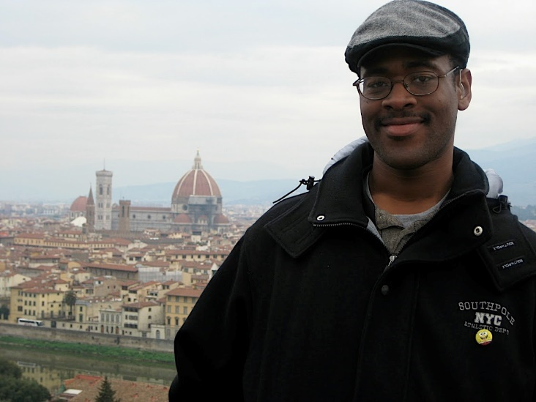
U.S. SCHOLAR PROGRAM
Fulbright Scholar Alumnus
Dr. Joseph Hill
Rochester Institute of Technology
Fulbright Alumnus to Italy
Notes:
Dr. Joseph Hill, working with interpreter, Nikki Cherry: I am Dr. Joseph Hill, assistant professor from R.I.T., national institute for the deaf at R.I.T.
I'm also the lab director of the deaf studies lab here at N.I.T.
I got a Fulbright, my Fulbright fellowship in 2008 and I went to Italy.
At that time, I was at university as a Ph.D. student and I met many people, students who were deaf from Italy who came over from the U.S. and I met them every year, I would meet different individuals.
I also met American students who went to Italy for a Fulbright experience.
So I was curious about that opportunity.
I decided to apply in 2007.
Submitted my application and was accepted for the Italian deaf education focus program.
My studies at that time was language attitudes in deaf education in Italy.
And that, I chose that because it related to my dissertation which focused on how people perceive another person's use of language.
For example, in America, there are many different dialects throughout the U.S.
North, south, east, west, Midwest.
Some people from the south look at those from the north as more snooty and those from the north look at those from the south as less educated.
So those are types of attitudes I was looking at in the American Deaf community.
I noticed there's a lot of sign variation, and I'm wondering how we perceive each other and judge each other based on language use.
That was my dissertation topic.
In Italy I looked at language attitudes related to sign language in school, or education systems.
I looked at the teacher's perspective, administration perspective and parental perspective.
They accepted my proposal to go to do this study.
Now, yes, I was very concerned about communication.
I'm deaf myself.
I knew I would arrive and have to learn their language.
I didn't know how I was going to communicate with people.
I had all these thoughts in my head but I did see American students who had gone over to Italy, did fine.
So I asked them some questions ahead of time to get myself ready.
And then also, there were individuals in Italy who were responsible for the American Fulbright students.
And so I contacted them and they gave me everything I needed.
For example, the orientation, well, all Fulbright students in Italy were required to go to an orientation.
They found an interpreter there who was American themselves.
Could speak English, sign American sign language and speak Italian and sign Italian sign language.
So for orientation it was beautiful, I was able to participate completely with everyone.
But I also had to try to prepare myself for if there was no interpreter, I would need to speak for myself, so I needed to wear a hearing aid and speak with people in spoken English, I didn't know spoken Italian.
I realized after orientation that I would be on my own.
Different schools that I went to had deaf students.
But my host institution, Sienna school for liberal arts was my institution and they were wonderful to work with.
I worked with the secretary of the school there and they helped me to translate my letter from English to Italian to send it to the schools I wanted to reach.
I sent it to six different deaf schools I interviewed people there.
Also the secretary helped me translate from English to Italian and Italian to English.
I needed to film the individuals I was interviewing so I had a form in their language that they could understand.
But when I met with a deaf person, I had to sign.
And before I went to Italy, I did start to learn the basics of Italian sign language.
Once I got there, I only had three months to learn Italian sign language, anyway I could.
And I met with deaf people in Italy.
I use Italian sign language dictionary book.
I picked up as much as I could by three months and at the end of the three months I was able to have a pretty good conversation in person.
It was successful, even though, yes, I have challenges with communication.
It seems that myself and those involved on the Fulbright committee and others, were very helpful, also with my Sienna school, my host institution were great.
So I very much enjoyed and appreciated that experience.
When I got to Italy, everyone was very friendly, they were familiar with deaf people, they knew how to work with deaf individuals.
I felt good connections with them.
And really, there were almost no issues that I experienced with that.
From that experience I feel like I did learn a lot.
I learned a lot about myself as a Fulbright scholar.
Before going, I wasn't sure if I could do specific things but I realized I really could, and I realized I needed to self-advocate for the accommodations I might need that others might not know about.
It was really a nice experience, overall.
And also from that experience, I'm still in contact with the Sienna school.
I have been for about 4-5 years, collaborating with them on teaching American sign language to Italian students that are in their program, for summer program.
So I'm still in contact with them.
And I have not ended my relationship with them.
I'm still in touch with them for, you know, I help them to recruit American students to go to the Sienna school for learning Italian sign language and studying, etc..
So I'm still assisting, even now at R.I.T., I'm still doing what I can to stay in touch with them.
So now, I think that's all I have to say.
I will turn it back over to Peter, and of course I'm available for questions, if needed.

Slide 15
U.S. SCHOLAR PROGRAM
Application Components
Application Form
Project Statement
Curriculum Vitae or Resume
Course Outlines or Syllabi (for teaching awards)
Select Bibliography (for research awards)
Letters of Reference
Additional Components, Depending on Award
Language Proficiency Report
Letter of Invitation
Supplemental materials for applicants in the Arts, Architecture, Writing and Journalism
Notes:
Peter Raucci: I hope everyone on the webinar is inspired by Dr. Hill's experience and encouraged by the materials and resources the national clearinghouse and mobility international U.S.A. have available.
And also encouraged by the mission of the Fulbright Scholar program.
That's why the diversity piece is there, because showing the full diversity of the U.S. does increase mutual understanding of the people of U.S. and other countries.
So with that inspiration and encouragement, I want to get into some of the nuts and bolts of the application process for the Fulbright scholar program.
This will be a quick overview.
We have lots of resources available, so don't feel that you cannot reach out to us.
We absolutely welcome you to reach out to us about any kinds of application considerations.
So let's look at the application component of the process.
There's an application form, which is pretty straight forward.
It's nothing you haven't experienced before.
And then there's a project statement.
This is the sort of heart of your proposal, where you are really working to explain to us what you hope to do, how you hope to accomplish it, and what kind of outcomes you expect out of the work you are doing.
I think Dr. Hill gave some great insight about outcomes from his work.
We want a curriculum Vitae or resume, about 8 pages, tailored to the work you are applying to do.
Syllabi up to 10 pages that really demonstrate your pedagogical style.
Give us a sense who you are as an instructor.
If you are applying for a research award we will want a bibliography, you could think of as a literature review.
The relevant literature as it relates to your topic.
We will want three letters of reference and we have specific guidelines on our website and in our application materials around who can serve as a reference provider.
But generally, there are three letters of reference required.
And these are strong advocates for you, and can really vouch for the fact that your project is a quality project.
But also connects to that Fulbright mission of mutual understanding.
Because our awards are vast and have different requirements there may be additional components depending on the award.
There may be language proficiency requirements.
Many of our awards do require a letter of recommendation from a host institution overseas.
If you are applying in a field such as the arts, architecture, journalism, creative writing there's space for you to upload a work sample as well.

Slide 16
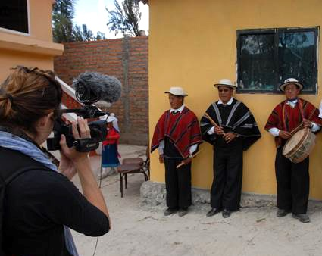
U.S. SCHOLAR PROGRAM
Project Statement
Your opportunity to lay out your proposed project specifics in as much detail as possible
Why Fulbright and why this country/institution/organizations?
Focus on what you plan to do; the specific courses you plan to teach/the methods and goals of your research
Outcomes from the grant - impact on hosts, home institution and you
How adaptable are you? How well will you deal with challenging situations?
Notes:
Let's dig a little into the project statement.
Really this is the heart of your application.
This is your opportunity to really lay out the nuts and bolts of your project.
But keep in mind, this is also where you show us your inspiration.
Why Fulbright?
Why this country?
What is it about the work you are about to do resonates with the country and how are those outcomes going to tie into the Fulbright goal of increasing mutual understanding.
Give us a sense of what you actually want to do.
Specific courses you are planning on teaching.
The methods of your research.
And also give us a sense of the outcomes you are expecting for the grant.
What is the activity for your host institution overseas.
But what is the impact on you?
The professional, personal, academic impact.
Give us a vision for that in the project statement.
And then your project statement also speaks to how adaptable you are.
How well you deal with challenging situations.
How can you navigate different systems of education or different styles of teaching.
We want you to exceed and get a sense for your vision how are you going to succeed at your proposed project.
That's a tight overview of what a project statement should cover.
Again, that's an integral part of your application.

Slide 17
U.S. SCHOLAR PROGRAM
Affiliations and Invitations
Host Institution:
If a host is identified, it will be found under Location in the Catalog
When a host is not identified, there are several resources to help find an affiliation:
International office on your campus
U.S. and Visiting Fulbright Scholar Directory
Review award description for suggested hosts or resources
Letter of Invitation:
Non-binding expression of interest from proposed host abroad
Should come from person with whom you will be collaborating
Should be on host institution letterhead
Notes:
As I mentioned, many of our awards require letters of invitation from host institutions overseas.
Some of our awards have identified potential host institutions.
Others are open to universities, N.G.O.s, research centers, cultural centers, etc. that you actually have to proactively find yourself.
If a host is identified, we generally will write that into the award description.
If the host is not identified, there are many sources available to you to find a potential host institution.
Is there an international office on your campus or Fulbright scholar liaison on your campus?
You could search our Fulbright directory to search for your institution or field or folks who have gone to a particular country to drill down to see some examples of alumni throughout the Fulbright scholar program.
And many of our award descriptions we actually will give you some indication of hosts as well.
Or provide some resources.
In some cases, the Fulbright commission or U.S. embassy may be able to assist you with finding a host institution if you don't have the connections yourself and if you are needing help connecting to a host institution.
Letters of invitation, they are generally non-binding expressions of interest from the host institution overseas.
They generally should come from the person who you will most closely be collaborating.
Although some countries and some awards will have some peculiarities around who could write the letter or what goes in the letter.
But generally we will want this to be on institutional letterhead.
It shows the host institution is able to accommodate your project but also excited about accommodating your project.

Slide 18
U.S. SCHOLAR PROGRAM
Submitting a Competitive Application
Address the Fulbright goal of promoting mutual understanding
Why you are interested in a Fulbright and why in your proposed host country
Professional expertise and skills you can offer; benefits to the host institution and host country; exchange of knowledge and experience
Cultural diplomacy; demonstrated flexibility, adaptability
Outcomes, impact, and multiplier effect
for your professional development, home campus, students, field at large; for your host institution
future collaborations; linkages: personal, professional, institutional; plans for sustaining relationships
internationalizing campus and curriculum
Notes:
In terms of submitting a competitive application, we look at feasibility, we look at quality, we look at outcomes.
But really, you want to make sure you cover all of those considerations, that also links to that Fulbright goal of promoting mutual understanding.
You want to help us understand why you are interested in the Fulbright program in that country.
You want to walk us through your professional and academic background and skills link to the parameters of the award.
And you want to give us a sense of cultural diplomacy and flexibility.
And then also tying that into what the impact could be.
Again, I want to thank Dr. Hill for giving us such great insight what he did on his grant and he is still in touch with the institution in Italy is a great example of some of the outcomes, some of the continuing connections you start on your Fulbright grant.
These activities don't stop when your grant ends- you are a Fulbrighter even after your grant.
You are part of this great network.
That's part of connecting and building the mutual understanding is continuing the conversation and continuing the connection.

Slide 19
U.S. SCHOLAR PROGRAM
Review Process and Timeline
AUG.
Program staff conduct technical reviews for completeness
SEPT.
Discipline-specific committees review applications
SEPT. –
EARLY NOV.
U.S. peer review committees discuss applications for a single geographical region
NOV. – JAN..
Applicants notified of status - Recommended applications are sent to host countries and to the J. William Fulbright Foreign Scholarship Board
FEB. – MAY
Grantees notified of final approvals
MAY – JUNE
Grant packets sent to grantees
Notes:
So I will go a little bit over our review process and time line.
This is a very quick overview but in general for the Fulbright U.S. scholar program, the deadline is August 1st.
So we do have our August 1st deadline for the competition coming up quickly.
You want to submit your application by August 1st and after the deadline, we do a technical screen and then your applications move onto peer review.
Peer review is essentially a two-phased process where they focus on the discipline of your project, review your application and committees focused on either the country or region your project involves will also review your application.
We let applicants know if they have made it through the peer review process and those who continue on go to the countries themselves and the final decision is made by the Fulbright scholarship board.
Generally, you will be notified of grant approvals anywhere between February and May, because we work with so many countries there's no one time line so we give a broad range of when final approvals and notifications will come through.
And grant activity could start as early as June the following year.

Slide 20
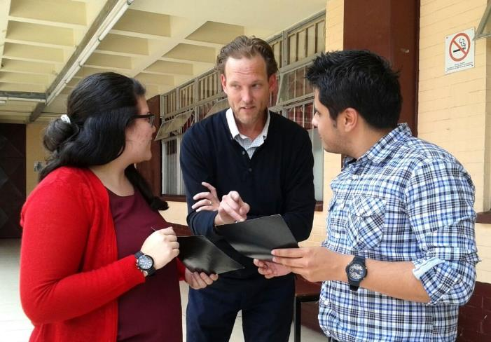
U.S. SCHOLAR PROGRAM
Application Resources
Fulbright Scholar Program website and Catalog of Awards
Apply
Application and Application Instructions
Application Guidelines, Project Statement Guidance and Samples
Learn
Webinars
The Fulbright Scholar Blog
Connect
MyFulbright- cies2.org
Notes:
I want to point your attention to some of the resources we have available.
Our website is quite robust and there are many, many resources on our website.
I want to just very clearly state that when you are applying for a Fulbright scholar award you are not alone.
There are so many different application resources.
We have very extensive application instructions.
But we also give guidance on every aspect of the application.
The C.V., the bibliography, the syllabi.
We even give project statement guidance and sample proposals.
So really, there's a lot of materials available on our website.
There are many opportunities to learn about the different programs we have on offer, including a very robust series of webinars of which this is one, but we have webinars available for different countries, different regions, different disciplines.
So really, there's a really robust series of webinars we archive.
There's also the Fulbright scholar blog as a way to get more inspiration, here are more stories about the Fulbright program and the kinds of things people have done on their grant.
One story we had today of course was Dr. Hill but there are so many different stories available on our Fulbright scholar blog to draw inspiration.
There's a way to stay connected, myFulbright-cies2.Org.
You could indicate if you are interested in different countries or disciplines and you will receive segmented messages about program developments and different webinars, special awards you may want to consider.
Again, there are a lot of resources available for you on our website.

Slide 21
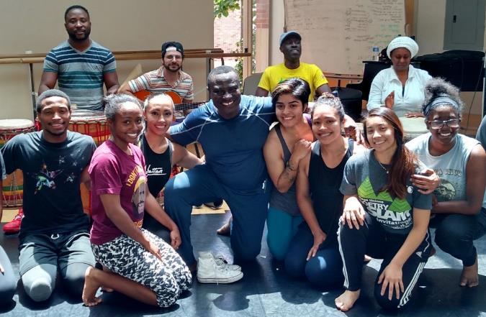
VISITING SCHOLAR PROGRAM
Scholar-In-Residence Program
Brings scholars and professionals from abroad to campuses that do not often host visiting scholars
Involves colleges and universities that serve student populations underrepresented in international exchange programs
S-I-R grantees
Primarily teach undergraduates
Provide cross-cultural/ international perspective
Application is made by the interested U.S. institution
1 semester or full academic year options
Deadline is October 15; Email: sir@iie.org
Notes:
Before we take questions, I want to look at some other programs under the umbrella of the Fulbright program really quickly.
These are different opportunities for you and your campus to engage with the Fulbright program internationally and on your campuses.
One is a Fulbright scholar-in-residence program.
We like to involve colleges and universities that serve under-represented student populations.
And generally a scholar in residence grantees will teach in residence and provide cross cultural international perspectives.
There's an application process for this.
But this is a great way for you on your campus to get involved to proactively host international scholars.

Slide 22
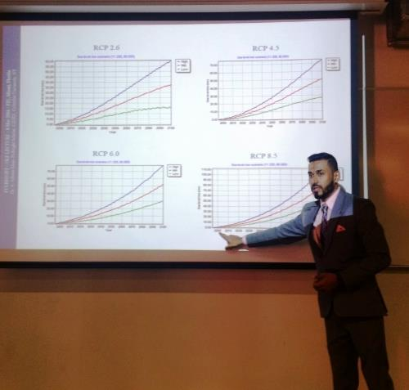
VISITING SCHOLAR PROGRAM
Outreach Lecturing Fund (OLF)
Travel grant for Fulbright Visiting Scholars already in the U.S. for short-term guest teaching
Institutionally driven application by U.S. Host Institutions
Scholars can meet, lecture and exchange ideas with
Faculty and students
Community organizations
K-12 schools
View the online scholar directory for a list of 900+ scholars who are
currently in country.
Email: olf@iie.org
Notes:
I also want to point out the outreach lecturing fund.
This is another opportunity to host an international scholar.
This is a travel grant for Fulbright visiting scholars who are in the U.S. and this grant is available to them for short-term teaching opportunities on U.S. campuses.
This is institutionally driven by host institutions in the U.S. and scholars will generally meet with faculty, community organizations and many cases k-12 schools as well.
We have an online scholar directory for a list of active scholars in the U.S.
You could contact us at olf@iie.org.
If you would like more information about these opportunities to come to your campuses in the U.S.

Slide 23
FULBRIGHT FAMILY
Other Fulbright Programs
Fulbright Arctic Initiative
Collaborative research opportunity that brings together a network of scholars, professionals and applied researchers to research Arctic issues
Fulbright Specialist Program
Short term program that promotes linkages between U.S. scholars and professionals and their counterparts at host institutions overseas
Fulbright U.S. Student Program
Recent graduates, postgraduate candidates through dissertation level, developing professionals and artists to study and research abroad
Fulbright Distinguished Awards in Teaching Program
Principally for primary- and secondary-level educators
Fulbright-Hays Awards
Faculty research, group projects and seminars in designated social sciences and humanities fields
Notes:
I want to briefly mention other Fulbright programs.
We have a wide variety of programs.
We have the Arctic initiative.
The specialist program.
The Fulbright U.S. student program.
The distinguished awards in teaching, the Fulbright-Hays award.
Today we focused on the Fulbright scholar program but that's one of many different programs available in the Fulbright family.

Slide 24
NEXT STEPS
Stay Connected to the Fulbright Scholar Program
Join MyFulbright at cies2.org
Email us at scholars@iie.org
Visit our website to learn more about the Fulbright U.S. Scholar Program
Refer your colleagues
The Fulbright Program @FulbrightPrgrm @the_fulbright_program
Notes:
At this point, I want to open the floor for some Q&A so if you have questions, please type them in the chat function of the webinar.
But I want to leave up this slide so you can stay in touch with us.
Cies2.Org, that's a way for you to indicate your interest in particular countries or particular disciplines and receive segmented messaging from us about different program development.
You could absolutely email us at scholars@iie.org.
If questions come up that you didn't think of during the webinar absolutely feel free to reach out to us, you could go to our website to learn about the program.
Even a referral program you could refer your colleagues to us, if you think some of your colleagues might be interested in considering a Fulbright grant.
Of course we are well-represented across all platforms of social media.
Facebook, Instagram, Twitter.
At this point I would like to open the floor to any questions that folks may have.
So if you want to take just a few moments to chat in your questions feel free to find the chat function of the webinar, the same place you did the soundcheck and let us know if you have any questions we could answer for any of us.
Also, before we take any questions I want to thank our panelists today.
I want to thank David Levin from the state department, Dr. Joseph Hill from R.I.T. and his interpreter Nicki Cherry and Justin Hartford who works with the national clearinghouse.
I will take just a second to scroll through any questions folks have.
But feel free to chat any questions that you have.
>> We had a really good question about a particular country.
I'm interested in a Spanish-speaking country.
Is there a team member, or is there someone I can speak to, that might be able to -- that I could talk to about, you know, a particular country.
Absolutely.
So in our catalog of awards -- and we will send a link to that to everyone who registered for the webinar, there's always at the bare minimum a staff member, team member associated with teach particular award, each particular country.
So always, always feel free to reach out to us if you have questions about things that aren't clear, or if you want to discuss awards, any particular award in more detail.
We have a great question.
Should you disclose your disability in requesting an institutional affiliation?
Is it wrong not to do so?
I would like to invite my colleagues, anyone who feels strongly about answering that question.
My answer is, you know, there are variables that you may want to consider.
But I would like to hear from my colleagues who have thoughts about that?
>> Peter, I'm happy to address that.
This is David.
>> Thank you, David.
>> There's no right or wrong answer.
Some people will actually talk about their disability within their application.
So that's part of who I am.
That's part of you as readers, reviewers will get a better sense of who I am, my identity, so they include it in their application.
Other people may include it, may say I'm not going to include it in my application but it will come up at some point, perhaps, when I'm doing my medical form.
We would learn perhaps about your disability there.
Other points in time people would simply say to us, either I'm applying, and I have a disability.
Or I have applied, I received the grant and I have a disability.
So we are talking about different points along the time line.
Other people simply choose not to do it at all.
I can work with my own disability overseas, I don't need accommodations so I don't necessarily need to tell anybody at all.
There's different points of view.
Some people don't do it because they say I don't want this to negatively affect my application.
We make a point about saying with Fulbright, we do not take this into consideration in terms of your application per se, your academic qualifications, your need for accommodations and disability would be a separate issue we would deal, a separate matter we deal with, would not be part of our selection process.
We want to convince you of that.
But, like I said, there's no specific point in time when you should, or you shouldn't disclose.
It's really up to you and your individual situation.
>> Interpreter: This is Joseph.
I agree with David.
It's up to you to disclose or not.
I did disclose I'm deaf because for the Fulbright program I was working with, I was working with a Fulbright committee in Italy specifically for deaf education as the award.
So I felt it was beneficial to disclose that, because that was to my advantage.
They need more deaf advocates to come.
So I felt that was to my advantage.
Also they knew that me being deaf, they would be able to provide me what I needed and to help me with my studies there.
And I felt that would be more successful.
And you know, I think those who I knew that went and came here as Fulbright scholars, it was beneficial.
I didn't think it would be a bad thing.
But it depends on which country and who you will be working with as to what you want to do.
>> This is Justin.
I just have one final thing to add is also, this is kind of a unique program in that you also have to develop a relationship with the possible host institution and get them to work with you as well.
So if you are concerned about how you would disclose your disability to them, to the sponsoring institution, there's a few things to that, apart from what's already been shared.
First of all there's the compelling fact you are coming with funding so they don't have to provide extra support for you.
Hopefully these are institutions people have already got relationships with, but if not, also using some of Fulbright's resources, I think Fulbright could be a great, they could sort of vouch for you, as far as your abilities.
Another thing to consider, if you contact mobility international we have over 2300 alumni around the world and some of them might offer ends for you to connect with a host institution in another country.
>> We have another question about, sort of in-country considerations.
Will Fulbright support expenses related to in-country travel.
For example, a mobility impaired scholar who is not able to use public transportation?
So I invite my colleagues with insights about that to share any insights with the audience.
>> This is David Levin again.
We would look at your needs both to work with you through the process getting you to the country you are going to, but also looking at your needs while you are there.
We would look at what your particular Fulbright assignment.
What are the parameters of that.
And how could we be of assistance for you into helping you successfully complete your assignment and that might include a need to travel through to other parts of the country.
We would look at this case-by-case as part of the reasonable accommodation we would provide you.
>> Interpreter: This is Joseph.
Really, my accommodation needs are communication.
And because I worked with the deaf program there in Italy, most of the time I had individuals who worked as interpreters there available at the deaf school and for interviews or discussions, or meetings with someone, I typically had an interpreter available.
So it worked out for me.
But outside of the school locations, I was on my own.
And most of the time I was successful.
I was able to figure out how to communicate with people, write back and forth, or often I would tell them I'm deaf or sign that I'm deaf and they would try to gesture with me and be very friendly overall.
I did have to work a little harder for myself trying to understand where I'm going, where I'm staying.
I did have additional work on my part and responsibility, but it really worked out really well.
And I can't answer anything for the mobility issues because that doesn't relate to me.
>> One other comment too, just to get clarification to David.
Sometimes what we have seen, you will have people with mobility impairments where they are on their campus and their school doesn't pay for a taxi or a bus because that's kind of considered to be something within the scope of something they would cover in their day-to-day, not really a reasonable accommodation.
We have seen that change overseas, if you are in Mexico city, the busses may not be accessible but you might need to use taxis which may incur an expense for you.
David, sounds like you were saying that's a case-by-case basis.
>> That's right, that's right.
>> Great, thanks for sharing those insights.
We have a few more questions about the application that I will take.
I know we went a little bit over, but I want to thank everybody again, we did have a little audio issue at the beginning of the webinar, so thank you for your patience and I will answer these questions that just came in.
What happens if you change institutions or leave the institution you were working when you apply?
We will get your C.V. when you apply so it should be up-to-date and reflect the state of your career.
When you hit submit on the application.
But we understand that things change in between the start of an application, between the submission of an application and when you would actually start your grant.
So if you were confirmed the grant we would check in, assign advisors to you that will work with you through your grant.
And that's something we could easily accommodate, so not a problem if you have changed institutions between when you applied and when you start your grant.
Great question, is there an age limit to apply or how long since you received your Ph.D.?
The answer is no.
Age is not a factor in consideration.
That being said, there may be some awards that want postdocs to apply.
And they will want someone who has recently received their Ph.D..
So if you have had your Ph.D. for a while, you may not be eligible for some of those early career awards.
But in terms of an age limit, there is no age limit.
It doesn't look like we have any further questions.
I really do want to thank everyone for joining today.
Really, I am delighted to have presented and worked with everyone who presented today.
I want to, again, thank David Levin from the state department.
Dr. Joseph Hill from Rochester Institute of Technology and Nicki Cherry from Rochester Institute of Technology, and Justin Harford of Mobility International USA.
I want to thank everyone, wish you a wonderful weekend and encourage you to submit your applications by August 1st.
Thank you, everyone.

