Slide 1
Notes:
[NOTE: DO NOT READ ALL-CAPS TEXT ALOUD; THESE ARE INSTRUCTIONS TO HELP YOU, THE PRESENTER]
[BOLD TEXT IS NEW FOR 2026-2027]
Welcome to this presentation of the Fulbright Scholar Program, sponsored by the U.S. Department of State's Bureau of Educational and Cultural Affairs.

Slide 2
Fulbright U.S. Scholar Program: Awards for 2026-2027

Slide 3
The Fulbright Scholar Program
Background
Created in 1946 by U.S. Congress and funded by the U.S. Government
Sponsored by the U.S. Department of State’s Bureau of Educational and Cultural Affairs (ECA)
Administered by the Institute of International Education, binational Fulbright Commissions, and U.S. Embassies
Supports research, teaching, seminar attendance, and professional projects abroad in 120+ countries
Our mission is to foster mutual understanding between nations, advance knowledge across communities, and improve lives around the world.
Notes:
You are probably here because you have heard of Fulbright before, but I want to share a bit of history that will help you understand the goal of Fulbright better.
The Program was created by U.S. Congress in 1946, and it is funded by the U.S. Government and administered by us at the Institute of International Education along with binational Fulbright Commissions and U.S. Embassies abroad. The Bureau of Educational and Cultural Affairs considers Fulbright to be its flagship international exchange program.
The Program supports research, teaching, seminars, and professional projects in 120+ countries.
For any grant or fellowship, it is always important to ensure that your application explicitly addresses the mission of the sponsor. Fulbright’s mission is unique (read the mission). We will discuss it in more detail throughout the presentation.

Slide 4
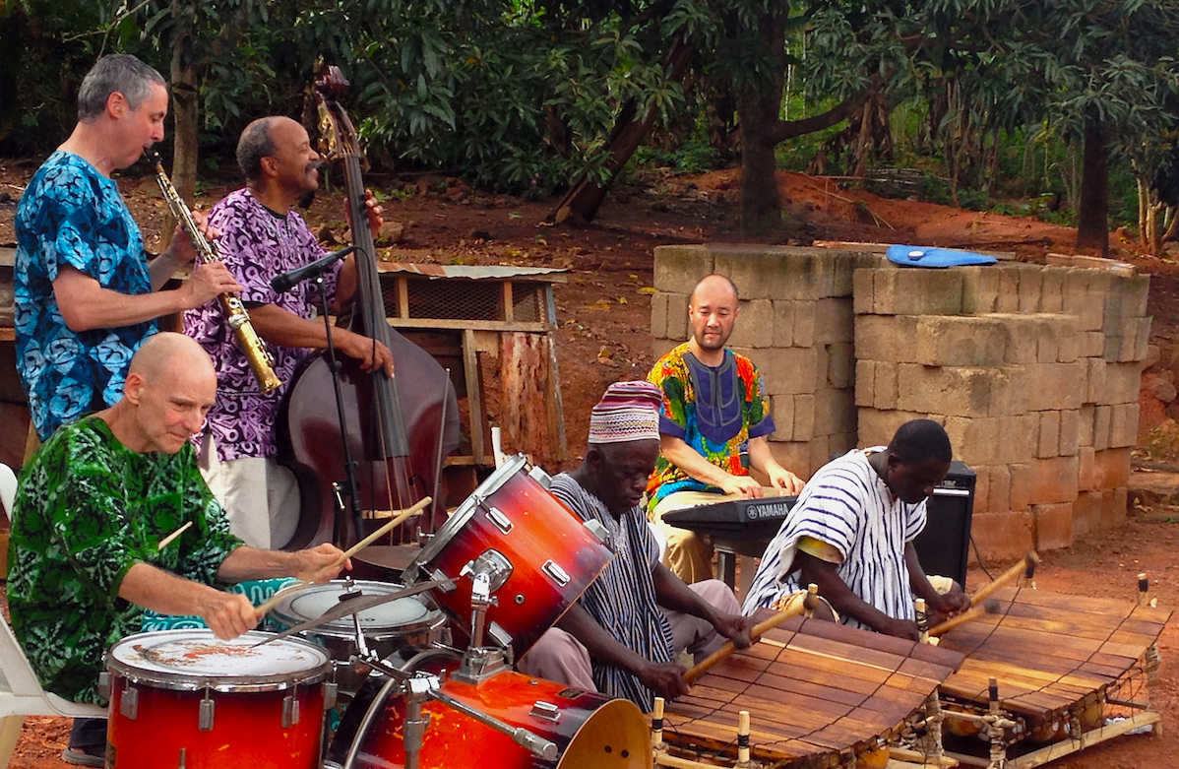
Three Key Features of the Fulbright U.S. Scholar Program
Unmatched Scale: With nearly 800 awards granted annually, Fulbright is the largest fellowship program available to U.S. scholars
A Mission of Connection: As a flagship public diplomacy initiative, Fulbright is dedicated to fostering long-term international relationships and mutual understanding
Broad Range of Opportunities: With more than 400 unique awards, the program offers options to suit nearly every academic discipline, methodology, institution type, and career stage
Notes:
There are three things that set Fulbright apart from other funding opportunities.
Fulbright is BIG: While other funders may provide a few awards per year, Fulbright offers 800 awards per year. For those of you who are administrators, learning how to best support Fulbright applicants is a great way to increase external recognition of your faculty.
Fulbright is a public diplomacy program (the largest person-to-person public diplomacy program in the world): Unlike other funding opportunities where the production of research or execution of a project is the end goal, for Fulbright, your proposed activity is a means to an end– with the main goal being the establishment of long-term international connections and bringing benefits to the host and home community/institution. A clear and viable project plan is important, but be sure to also address the mission of the program.
With over 400 distinct awards, there is an award to meet anyone’s needs.

Slide 5
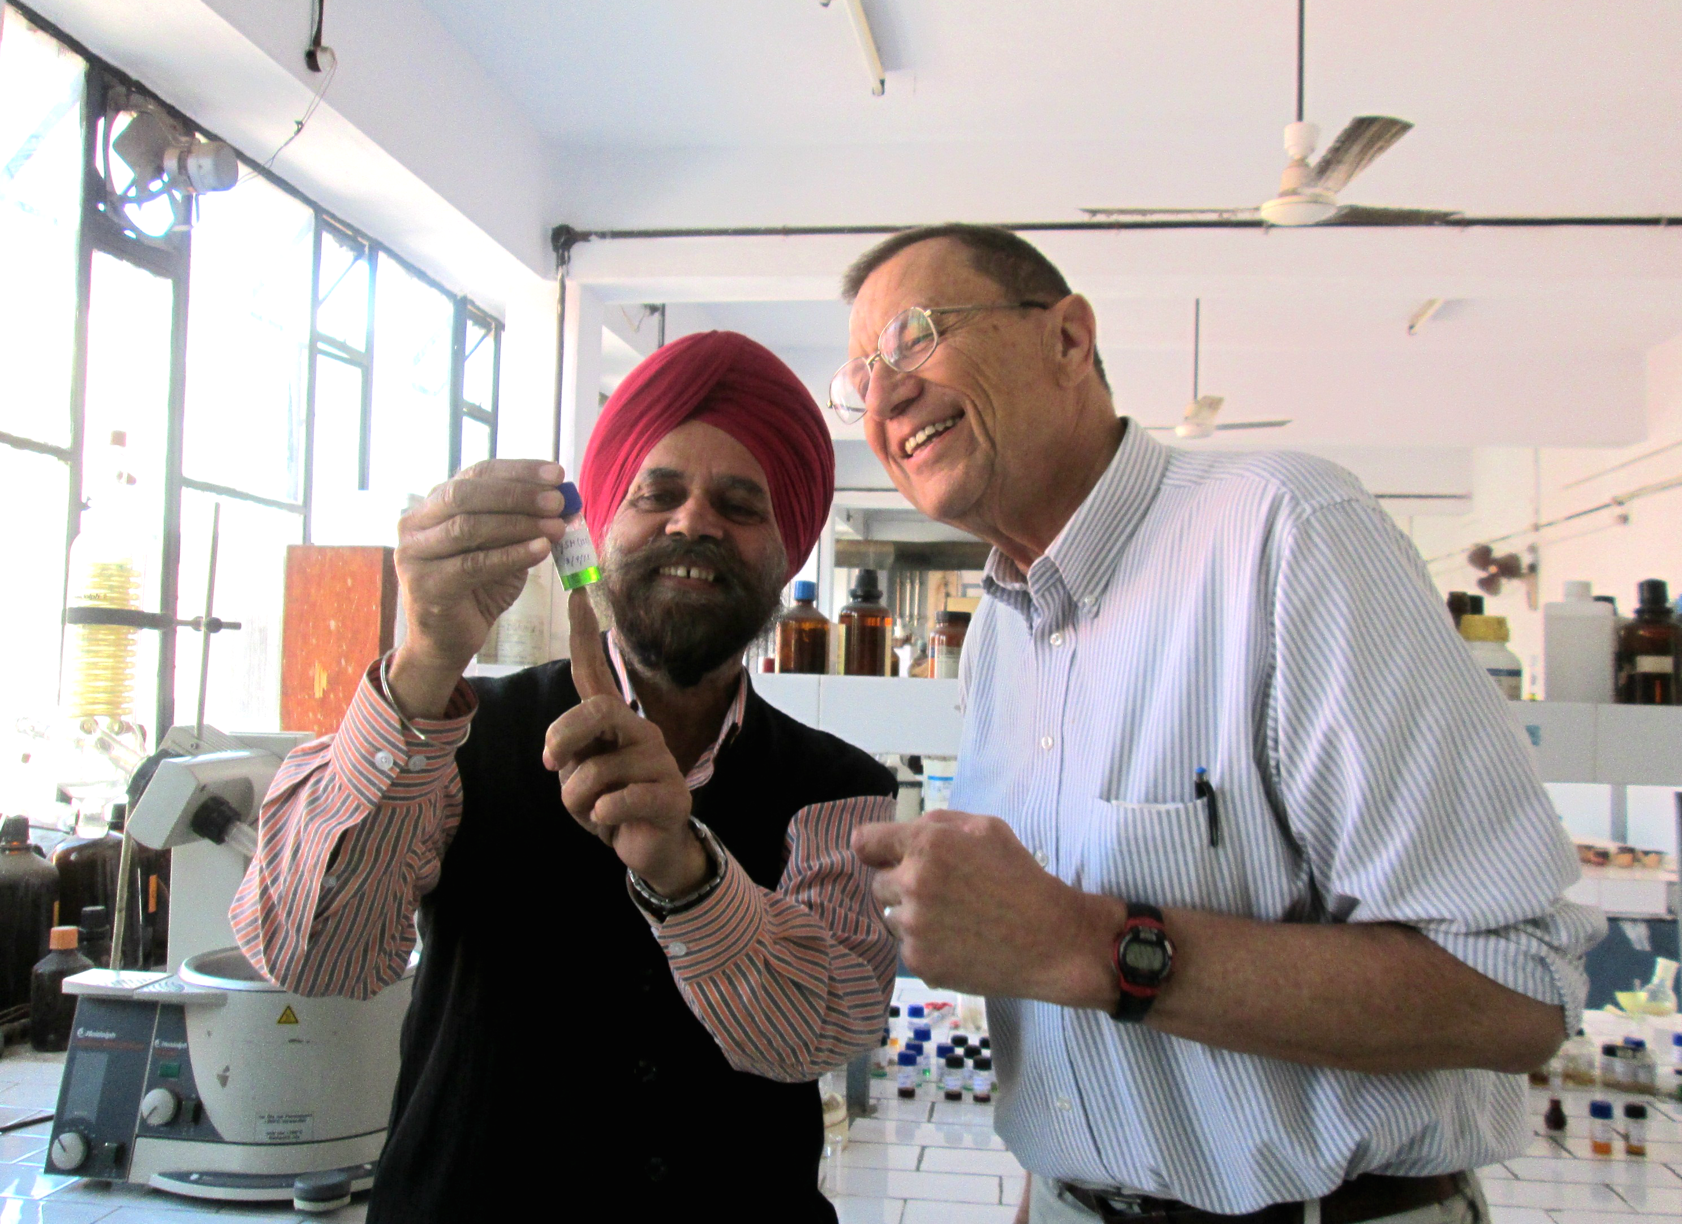
Why Fulbright?
Fulbright fuels your professional growth
Go Global: Teach, research, lead projects, and join seminars worldwide
Build Partnerships: Create lasting international collaborations.
Advance Your Work: Expand your publishing network and enrich your teaching
Ignite Ideas: Gain fresh perspectives and spark creativity
Be Recognized: Earn distinction as a Fulbright Scholar.
Stay Connected: Join a dynamic, supportive alumni community.
Notes:
You will gain professional recognition as a Fulbright Scholar, and one of the main advantages of being tied to that Fulbright brand is that you will become part of a vibrant and supportive network of alums. I have been amazed at what Fulbright alums are willing and able to do for each other across disciplines, countries, and years of participation.

Slide 6
Why Fulbright?
Fulbright supports your family
Financial Support: Around 60% of awards include funding for dependents.
Plan with Confidence: Most countries welcome accompanying family members.
Open New Doors: Many Fulbright families gain life-changing experiences—some even launch international careers.
Find the Right Fit: Use our search filters and check the “Award Benefits” tab to explore family-friendly options.
Notes:
[CHECK IF A COUNTRY OFFERS DEPENDENT BENEFITS BEFORE A COUNTRY WEBINAR AND SHARE THAT HERE.]
Something really special about the Fulbright Scholar Program is that it is uniquely family-friendly.
While approximately 60% of our awards provided dedicated "dependent support" in funds, it is usually very easy to bring your family with you abroad. The Fulbright definition of "dependents" is anyone you declare as a dependent on your U.S. taxes: partners, parents, and children.
In the case of children, we always like to note that many children who accompany their Fulbrighter parents abroad end up in international careers of their own.

Slide 7
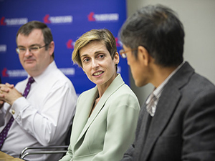
Why Fulbright?
Fulbright supports you—From application to grant
Personal Support: Every award has a dedicated team behind it.
Get Answers: Join office hours for direct guidance.
In-Country Assistance: Ongoing support from IIE and host country staff.
Learn from Experience: Connect with past grantees through the Fulbright Scholar Directory to gain insights and inspiration.
Fulbright Scholar Directory | Fulbright Scholar Program
Scholar Directory | Fulbright Scholar Program
Notes:
Another reason to recommend Fulbright is that it is a uniquely supportive program. Approximately 70% of applicants engage with IIE staff at the time of application, which at this stage is with me and members of my team. One thing that makes the Fulbright Scholar Program is that there is a face behind every award, so you always interact with a "real person" who really cares about helping you. This is also a critical way in which we support all applicants efforts: we offer resources to help applicants access the Program. We want to support applicants in all positions and all levels of resources.
Once you are selected, you are assigned an IIE advisor – on another team here at IIE – and receive support from the host country staff, whether that be at a dedicated Fulbright office, called a Commission, or a U.S. Embassy.
You also have access to that alum network we mentioned earlier even at the time of application: while we cannot share their emails directly, we have all of our past grantees on our Scholar Directory and you can look them up, ask them about their experience, and build your network of contacts.

Slide 8
Why Fulbright?
Fulbright supports you from application to grant, cont. ​
Fulbright Scholar Liaisons (at 1,250+ institutions)
Serve as campus contacts for the Fulbright U.S. Scholar Program
Offer guidance on the application process and timelines
Help with institutional support like leave or endorsements
Connect you with Fulbright alumni for insights and mentorship
Find your Liaison or become a Liaison yourself at https://fulbrightscholars.org/liaisons
Notes:
Another key resource to help you apply is your on-campus Fulbright Scholar Liaison. This is your local expert if you are at the 1250+ U.S. institutions with an appointed Liaison. They are your most critical allies for the Fulbright Scholar Program. They promote the Fulbright Scholar Program on campus, educate faculty and administrators, encourage you as you apply, and recognize you when you return.
The most critical part of their role is developing Fulbright-friendly policies on campus: they look at precedents from alums for securing leave and support from your home institution, helping to make it possible for you to take the time go abroad on a Fulbright Scholar Award. In doing this, they can also connect you with alums on your campus to help you understand precedents for leave and support and get help with your application.
You can find your Liaison on our website, and if you find you do not have one, you yourself can become that point person on campus. Please note: you do not need to have a Scholar Liaison to apply to the Fulbright Scholar Program!

Slide 9
U.S. citizenship
Degree and experience, as required by award:
Ph.D. or other terminal degree
Master's or professional or artistic experience
Teaching experience as required
Fulbright U.S. Scholar alums are eligible: Recipients of a Fulbright Scholar grant are eligible to apply for another Fulbright Scholar grant two years after the date of completion of the previous grant
Qualifications for U.S. Scholar
Notes:
[UPDATE THIS SLIDE IF YOU ARE ALSO PRESENTING S-I-R AND OLF, FOR EXAMPLE]
Now that you have heard about why Fulbright is so great, let's do a quick qualifications check.
As we mentioned at the start, the Fulbright U.S. Scholar Program opportunities are only open to those with U.S. citizenship. Unfortunately, permanent residents are not eligible for our Awards, but please keep us in mind if your status changes.
In matters of degree and experience, we have more flexibility: while all of our 400+ Awards are open to those with a Ph.D. or other terminal degree, 125+ of our Awards are open to those with a Master's degree and commensurate professional or artistic experience. If you are not sure if your degree is a terminal degree, please ask us and we can check for you.
For Teaching awards, you will qualify so long as you have taught before, so please consider if you have ever done a structured, pedagogical experience which may not have been higher education classroom teaching.
We also have no lifetime limit on Fulbright Scholar Awards! The only eligibility criterion is that you need to wait 2 years between your last day on a Fulbright Scholar Award abroad and one of our September due dates. For example, if your grant ended in December 2023, you would need to wait until September 2026 to apply, since two years would not have elapsed between your grant end and the September application due date that year. We can help you find your grant end date if you are not sure!

Slide 10
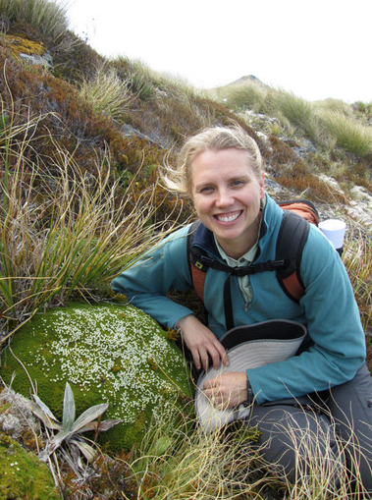
Fulbright Scholar Awards
380+ awards in 120+ countries
2-12 months
Options: Research, Teaching, Teaching/Research, Professional Project, Seminars (2 weeks)
Flex option: segment your award into 2-3 non-consecutive month(s)-long visits over 1-2 years
ONE Award per cycle / competition year
Notes:
[ELIMINATE THIS SLIDE FOR COUNTRY WEBINARS.]
Now let's talk about what you all came for: the Awards!
We offer 380+ awards in 120+ nations in all world regions, and these are typically 2-12 month grants to do research, teaching, teaching/research, or a professional project. (For seminars, these last two weeks, and I will speak more about these on the next slide).
Many grants can be segmented, meaning that you do not have to do your grant consecutively, but you can split your time up into month(s)-long visits over 1-2 years. This "Flex option" is available in all regions but not available on all awards, so check the ones that most interest you.
It is important to know all of the options, because you can only choose ONE award per cycle or competition year. We will get more into how to choose your award later in the presentation.

Slide 11
Fulbright Scholar Awards
Awards for Research, Teaching, Teaching/Research, or Professional Projects
Scholar Awards
Postdoctoral Awards
Distinguished Scholar Awards
Notes:
[ELIMINATE THIS SLIDE FOR COUNTRY WEBINARS.]
The Fulbright Scholar Program encompasses a few different kinds of awards.
If you want to research, teach, teach/research, or conduct a Professional Project, you should consider our Scholar Awards. Most of our 400+ awards are Scholar Awards.
There are two sub-types of Scholar Awards, and the first is our Postdoctoral Awards, These awards are designated for any applicant holding a doctorate (our only awards that require a doctoral degree) within 3-7 years of obtaining their degree. These awards are longer, spanning 9-24 months in length, and offer unprecedented “research time” at a critical career stage.
Another category is our Distinguished Scholar Awards. These must be explicitly offered by a country; you cannot make an award Distinguished, but rest assured that all of our awards are prestigious. Furthermore, you qualify for Distinguished not by academic rank but by the number of years you have been researching or teaching after your terminal degree, regardless of your position. Therefore, if you qualify with 7+ or 13+ years of experience, we recommend you opt in to these awards, where available!
Lastly, we offer International Education Administrator (“IEA”) awards, which are two-week Seminar awards that send higher education administrators abroad in a cohort to collaborate with each other and representatives from the host country’s higher education system.

Slide 12
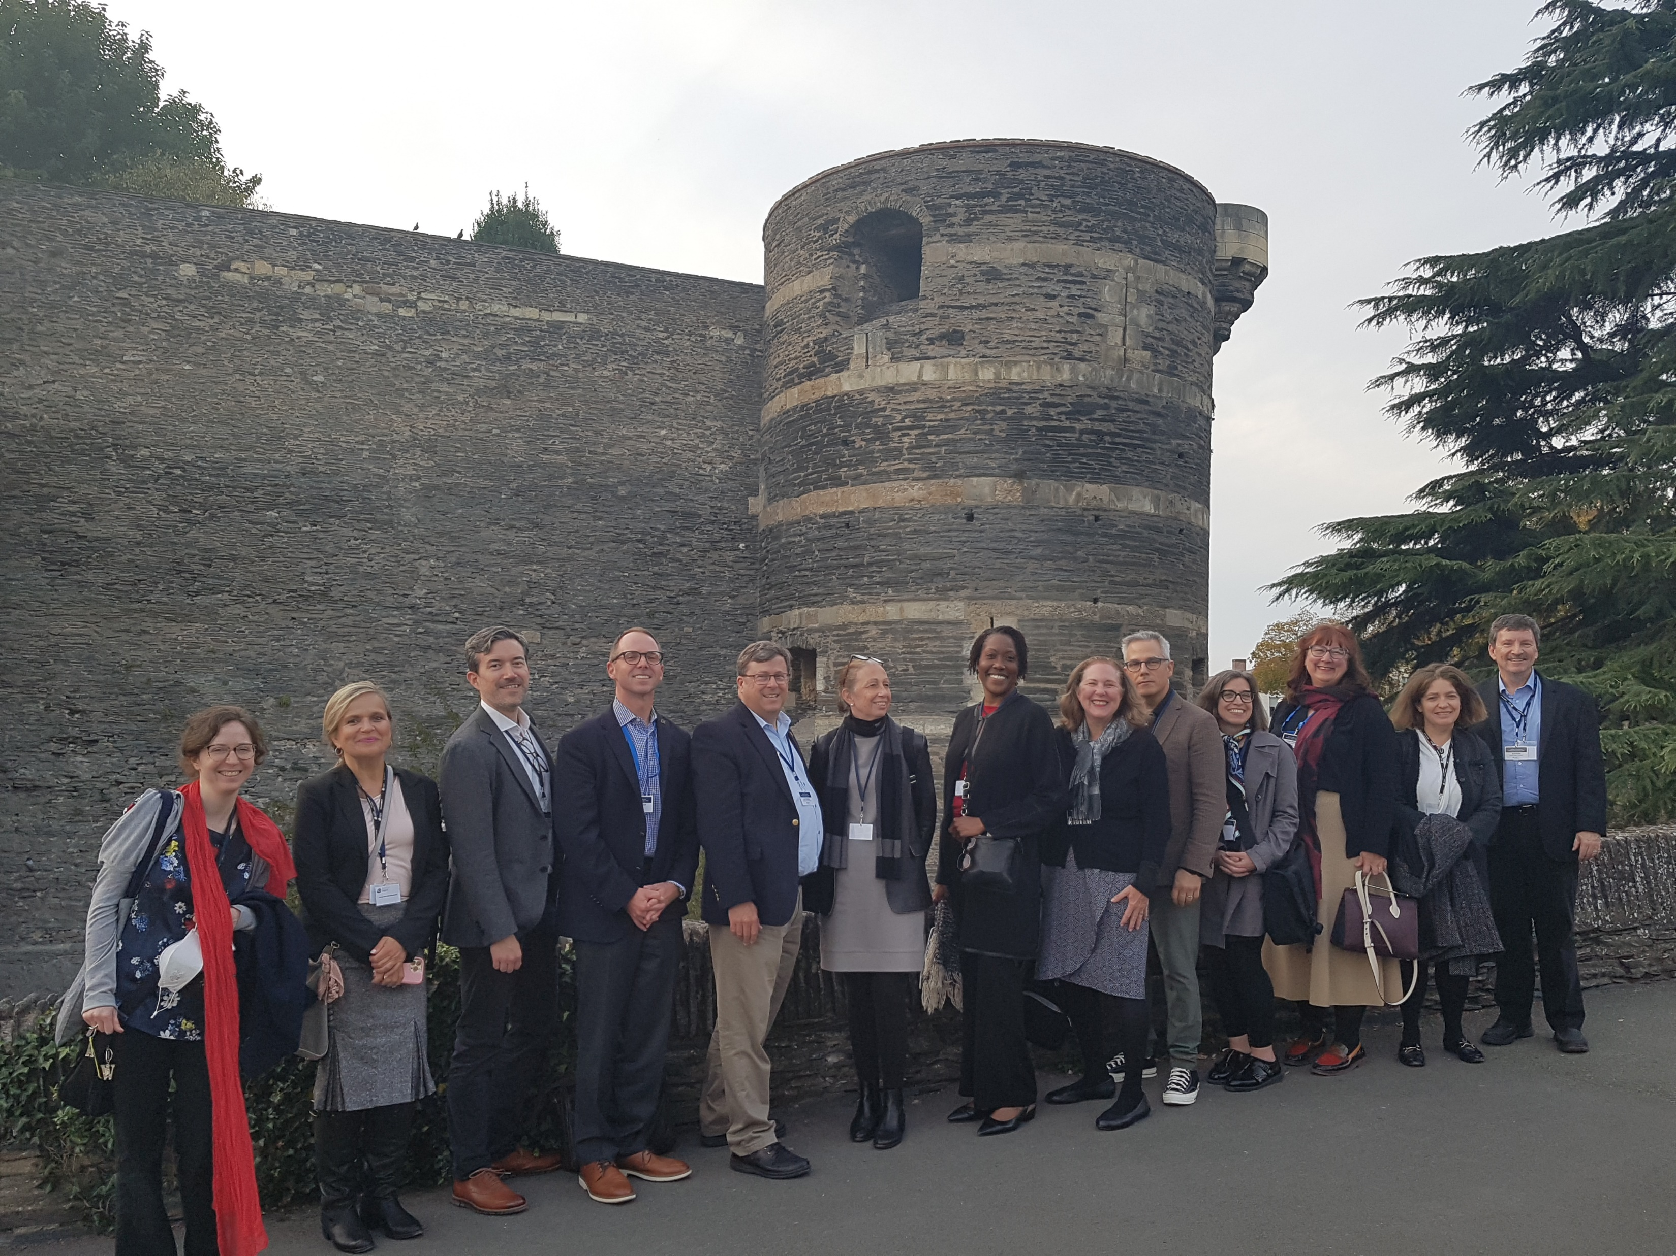
fulbrightscholars.org/IEA
International Education Administrator Awards
What do you do on an IEA seminar?
Site visits at universities and government agencies
Briefings with officials
Networking events plus tours of historical and cultural sites

Slide 13
Fulbright IEA Seminar Offerings for 2026-27
Country | Professional Profile | Application Deadline | Expected Grant Timing
Taiwan | Administrators with daily interaction with students + experienced administrators | September 2025 | Spring 2026
France & Senegal | Senior-level university administrators (provosts, deans, directors, etc.) and experienced international education administrators at HBCUs | September 2025 | Spring 2026
Japan | Experienced administrators (Wider range of experience welcome) | November 2025 | Summer 2025
Korea | Administrators with daily interaction with students | November 2025 | Summer 2025
France | Senior-level university administrators (provosts, deans, directors, etc.) | February 2026 | Fall 2026
Germany | Experienced administrators (Wider range of experience welcome) | February 2026 | Fall 2026

Slide 14
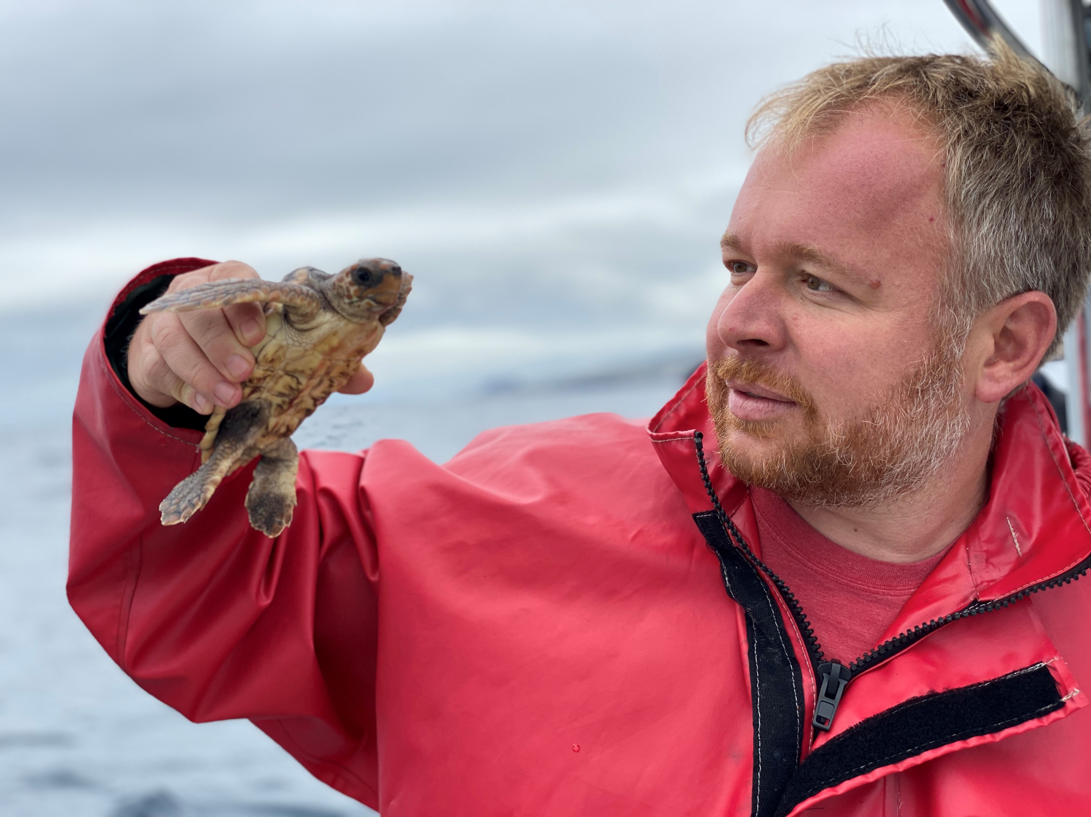
Tips for Choosing the Right Fulbright Award
Choose the most specific award that meets your needs
Target your search by country, discipline, or award type
Explore “Hidden Gems”—less competitive but rewarding opportunities
Check if you're eligible for Postdoctoral or Distinguished Awards
Reflect on your career stage, field trends, global events, and any personal or professional constraints (e.g., ability to take leave)
Notes:
[ELIMINATE THIS SLIDE FOR COUNTRY WEBINARS.]
Since we noted earlier that you can choose only one award per competition cycle or year, we want to explain some ways in which you can decide which award is best for you and your host. You do not have to consider these criteria in order, but we consider this our process for helping applicants narrow down their award of choice.
You may want to first consider whether your goal is to go to a specific country or if you are open to going anywhere, so long as they want your discipline.
Regardless of which criterion you prioritize, you should check to see if the country or discipline you have in mind has awards specific to only your discipline, as there would then be a smaller pool of possible applicants. You can also consider “Hidden Gem” countries that want your discipline; we have two Hidden Gem webinars per year to help you identify which countries have that status in a given competition.
Next, you should see if there is a Postdoctoral or Distinguished opportunity in the country or discipline you have in mind, because if you qualify based on the number of years of experience, these awards also have a smaller possible applicant pool.
Another thing to keep in mind is whether you have your heart set on a specific institution OR if you want our help finding one. The way we help you find one is by offering awards with an institution in the name of the award. While these awards are less flexible in location, they have starter contacts right on the award!
Lastly, you should always keep in mind the state of your career, your field, and current events. If there is somewhere particularly relevant for you to go in a given year, that can also give you an edge.

Slide 15
Title of Country/Discipline/ “Awards for” etc.
[Insert country slides after this slide OR award slides. Use the “Reuse Slides” function for country slides to preserve formatting.]
Notes:
[USE THIS SLIDE TO INTRODUCE THE TYPE OF AWARDS ABOUT WHICH YOU WILL BE SPEAKING OR PASS THE MIC TO A COMMISSION]

Slide 16
inbox/scholars@iie.org
Region Name or Subheading
NEW
Country: Award Name [Insert Link to Award]
Featured
Country: Award Name [Insert Link to Award]
Try to stick to no more than 8 awards per slide
Notes:
[HERE YOU INSERT NEW OR FEATURED AWARDS, DEPENDING ON YOUR AUDIENCE/THE WEBINAR SUBJECT. STICK TO NO MORE THAN 8 AWARDS PER SLIDE, AND ONLY TWO SENTENCES ABOUT EACH AWARD.]

Slide 17
Alum Name
Alum Home Institution → Alum Host Institution
Alum Award Cycle
Alum Award Type
Notes:
[FILL OUT THIS SLIDE FOR EACH ALUM. YOU ARE FREE TO READ ONLY THAT INFORMATION YOU WOULD LIKE ALOUD.]
[NOTE IF A HOME INSTITUTION HAS CHANGED]

Slide 18
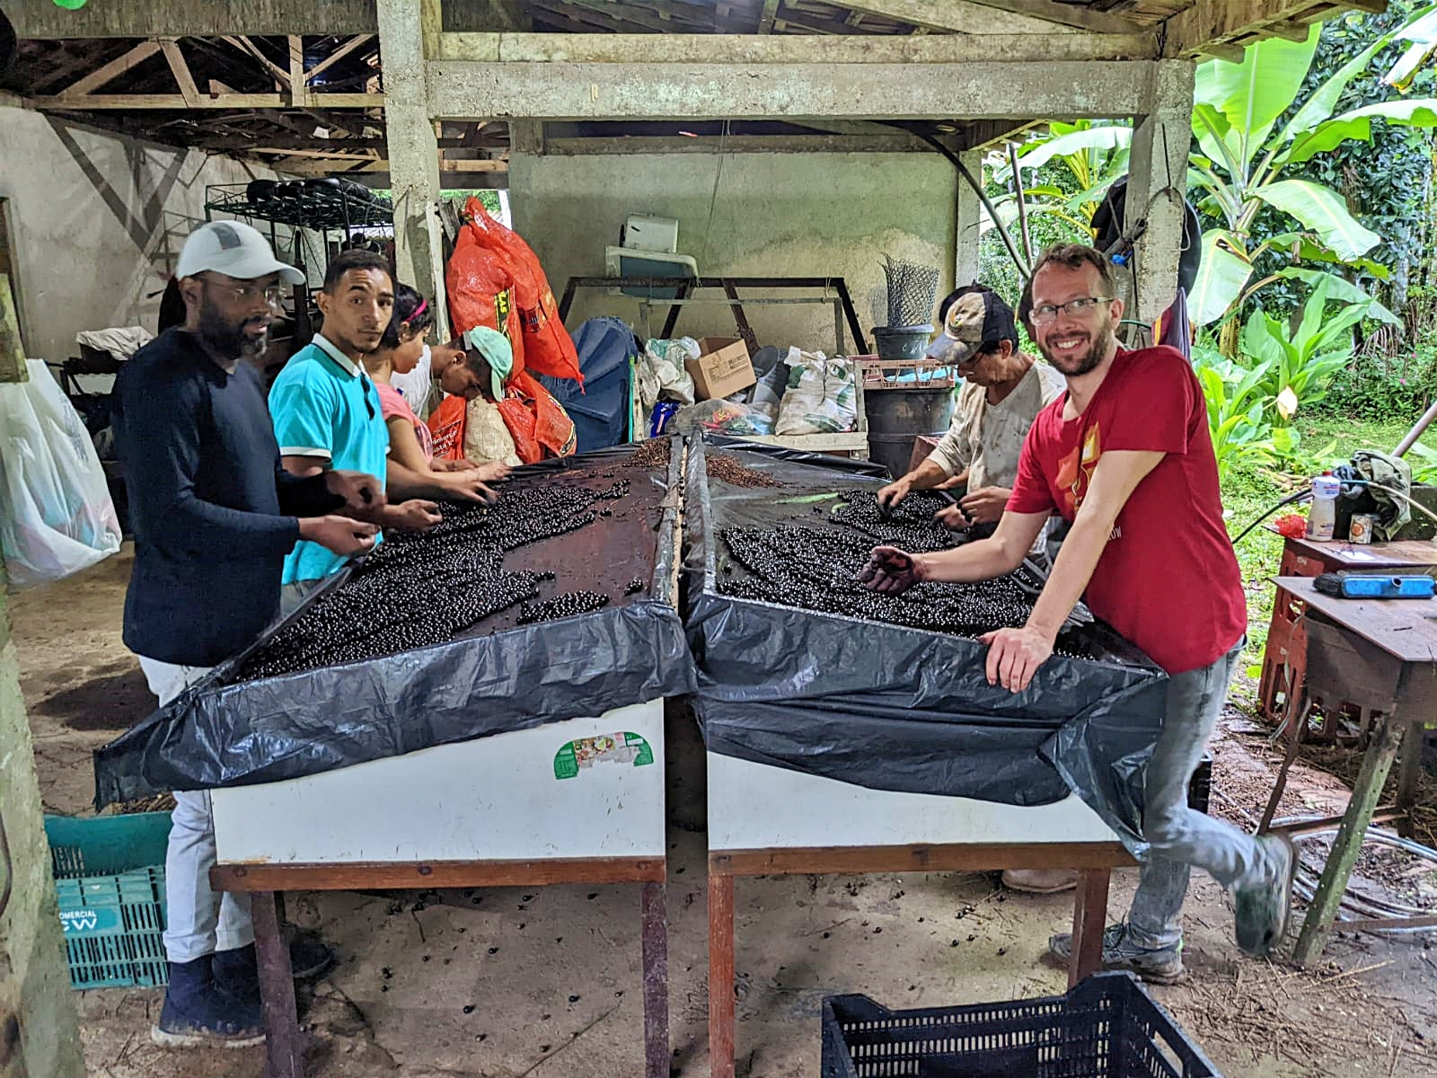
[Replace photo with alum photo, use “Change Picture” to save size and border]
Notes:
[ADVANCE THE SLIDES AS THE ALUM SPEAKS ABOUT THEIR 3 PHOTOS]
[STICK TO THREE IMAGES AND NO TEXT, IF POSSIBLE]

Slide 19
[Replace photo with alum photo, use “Change Picture” to save size and border]
Notes:
[ADVANCE THE SLIDES AS THE ALUM SPEAKS ABOUT THEIR 3 PHOTOS]

Slide 20
[Replace photo with alum photo, use “Change Picture” to save size and border]
Notes:
[ADVANCE THE SLIDES AS THE ALUM SPEAKS ABOUT THEIR 3 PHOTOS]

Slide 21
Application Components
Requirements:
Supplemental Materials:
Application Form
Syllabi or Course Outlines (for teaching)
Project Statement
Reference List (for research)
Curriculum Vitae or Resume
Portfolio (for disciplines like Arts, Architecture, and Journalism)
2 Recommendations
Language Proficiency Report (if required)
Invitation Letters (if required)
Notes:
[TRIM THIS SCRIPT AS DESIRED, FOR TIME]
Now let’s talk about the application’s components.
The Application Form is standard, asking for your demographic information.
The Project Statement is special for Fulbright: this is somewhere between a grant prospectus and a personal statement, because you not only tell us what you plan to do and how you plan to carry it out, but also who you are and why you should be selected to go abroad in-person in a given competition year. You only get 3-5 pages for this component, so use the space wisely!
The CV or Resume component is standard, but it has a page limit of 6 pages for Scholar Awards and 8 pages for Distinguished Scholar Awards.
Two Letters of Recommendation are required for the Fulbright Scholar Program application: the first one must come from your home institution (or, in the case of independent applicants, someone with whom you have collaborated recently) and its goal is to attest to you “as a colleague.” The second Letter may come from your home institution or from an external institution, and its goal is to say “what kind of expert you are.” There is only space for two Letters, so choose wisely!
The Letter of Invitation is very specific to Fulbright, so it can cause some worry. This Letter is a place where the host institution abroad says that they know who you are, agree to host you (usually only intellectually and logistically, unless a cost-share is noted on the award) and describe the activity you are planning to carry out. They can express enthusiasm for what you will do, but some countries do not do that as a culture, and that is also okay!
Supplemental materials will depend on your chosen Award activity.
If you choose Teaching or Teaching/Research, we will ask for Syllabi or Course Outlines. In an ideal scenario, you would propose the new course you plan to teach - as constructed with your host institution - AND supply past syllabi you have made, but you may also supply only past syllabi. The goal here is to show us your pedagogical approach.
The Reference List is only for Research or Teaching/Research, and it is somewhere between a bibliography and a literature review: it is a list of citations, which may or may not be annotated, that situates your project in its field of scholarly work. The goal is to show us that we are funding a novel project that is aware of what is going on around it.
The Portfolio will only be available for those in certain disciplines like Arts, Architecture, and Journalism, and it lets you upload up to 10 artifacts of your work.

Slide 22
Tips for a strong application:
CHECK ALL FOUR TABS
START ONLINE
ATTEND EVENTS
Read all four tabs of an award so you know which one best meets your needs
Start an online application as soon as possible
Attend webinars and Office Hours and read guides on our website
Notes:
[ELIMINATE THIS SLIDE FOR COUNTRY WEBINARS.]
We now want to share our best advice for writing a strong application: follow our instructions!
Every award has four tabs, and you have not read an award until you have read all four tabs.
Every award also has a contact person on the lefthand side, and you can start talking to us early to address any questions you may have.
You can also start an online application as soon as you think you may apply. There is no penalty for starting and not finishing, and you can always save and come back to the online application. Our application is designed for you to work online, with us, so we can offer you additional help as you work.
We also offer a lot of resources, which we are always trying to improve. You can join us for webinars or Office Hours and read all of our resources on our website designed to help you as you write.

Slide 23
Application Cycle
FEBRUARY
Competition Opens
SEPTEMBER 15
Application Deadline
SEPTEMBER
IIE staff conducts Preliminary Screening
OCTOBER – NOVEMBER
U.S. Peer Review
DECEMBER
Applicants notified of Peer Review result
DECEMBER
– JUNE
Final decisions are made by Fulbright Commissions or U.S. Embassies abroad and by the Fulbright Foreign Scholarship Board in the U.S.
JUNE – ONWARD
Participants are selected and prepare for departure
Notes:
[TRIM THIS SCRIPT AS DESIRED, FOR TIME]
Our application cycle is shaped the same every year for Scholar Awards, but may differ for some IEA Awards.
We open our competition in February, and our deadline is [USUALLY] September 15, giving you 7 months to write your best application.
In the back half of September, our staff at IIE conducts Preliminary Review, checking your documents and routing you to the best Peer Review committee for your application.
In October-November, we have U.S. Peer Review, where the discipline you choose on your application corresponds to the committee to which you will be assigned. All committees are equipped to evaluate interdisciplinary work, but choose your discipline carefully to have the best shot of passing Peer Review.
You will find out in December how Peer Review went for you: either you will be “not recommended,” which means your Fulbright journey is over for now (but we can always help you reapply!) or you are “recommended” which means you are passed on to in-country review.
In December-June, we work with 100+ countries to review your applications in-country. U.S. Embassies (Posts) or binational Fulbright Commissions (dedicated Fulbright offices) overseas review recommended applications and nominate candidates for selection.
The applications also go through the Fulbright Foreign Scholarship Board in the U.S. as a final step, where this board of appointees makes the final selections.
You may find out sooner, but we can only guarantee you will know for sure if you are going abroad by June of the calendar year after your application. Rest assured our IIE advisors and in-country staff are able to help you get things turned around quickly, even if your start date is in August!

Slide 24
Bring Foreign Fulbrighters to your Campus
FULBRIGHT SCHOLAR-IN-RESIDENCE (S-I-R) PROGRAM
FULBRIGHT LANGUAGE TEACHING ASSISTANT (FLTA) PROGRAM
Host scholars from other countries to teach for a semester or an academic year
Deadline: Proposals due in June to host in the following academic year
Website: fulbrightscholars.org/sir
Email: SIR@iie.org
Host native speaking language teaching assistants to enhance students’ understanding different languages and cultures
Website:
foreign.fulbrightonline.org
Email: dcook@iie.org
Notes:
[THIS SLIDE IS FOR CAMPUS VISITS AND CONFERENCES ONLY, AND CAN BE CUT FOR TIME.]
We would also like to share other ways you can get involved in the Fulbright Program.
The Fulbright Scholar-in-Residence (S-I-R) Program assists U.S. higher education institutions in expanding programs of academic exchange, by supporting non-U.S. scholars through grants for teaching at institutions that might not have a strong international component and/or serve minority audiences. The Program benefits institutions and Scholars alike. This is an ideal program for those who would like to host a visiting professor to teach but don't already have connections to faculty in other countries.
The Fulbright Foreign Language Teaching Assistant (FLTA) Program supports language assistantships at universities and colleges throughout the U.S., providing institutions with an opportunity to enhance their language programming and expose students to native speakers who bring an energetic, up-to-date cultural component to the foreign language classroom as well as student life at a campus in general.

Slide 25
Additional Fulbright U.S. Programs
SCHOLARS
STUDENTS
TEACHERS
STUDENTS
Fulbright-Hays Group Projects Abroad Program GPA@ed.gov
Specialist Program FulbrightSpecialist@worldlearning.org
Fulbright-Hays Doctoral Dissertation Research Abroad Program DDRA@ed.gov
Student Program FBstudent@iie.org
English Teaching Assistant (ETA) Program FBstudent@iie.org
Distinguished Award in Teaching Research Program FulbrightDA@irex.org
Group Projects Abroad GPA@ed.gov
Teachers for Global Classrooms FulbrightTGC@irex.org
Notes:
[THIS SLIDE IS FOR CAMPUS VISITS AND CONFERENCES ONLY, AND CAN BE CUT FOR TIME.]
The U.S. Scholar Program is large but is only one of many programs under the Fulbright umbrella.
There are other opportunities for U.S. Scholars:
The Fulbright-Hays Group Projects Abroad Program offers funding to spend time in a foreign country or region acquiring resource materials for curriculum development in modern foreign languages or area studies programs.
The Fulbright Specialist Program is a unique opportunity for U.S. academics and established professionals to join a roster of candidates who are eligible to engage in 2-6 week, project-based exchanges at host institutions across the globe. Institutionally driven from overseas, so projects must be approved for funding abroad before matches take place. This Program is administer by World Learning.
There are also opportunities for Students:
The Fulbright-Hays Doctoral Dissertation Research Abroad Program offers funding for individual doctoral students who conduct research in other countries in modern foreign languages and area studies for periods of six to 12 months. This Program is administered by the Department of Education.
The Fulbright U.S. Student Program offers opportunities for those holding at least a Bachelor’s degree to either enroll in graduate study abroad or conduct independent research through the dissertation level. It is also open to professionals and artists to study and research abroad
The English Teaching Assistant (ETA) Program is also within the Student Program and places grantees in schools overseas to supplement local English language instruction and to provide a native speaker presence in the classrooms.
There are also programs for K-12 educators you know:
The Fulbright Distinguished Award in Teaching Program allows K-12 educators to take part in a three-to six-month professional development experience abroad, pursue individual inquiry projects, take courses at a host university, and collaborate with colleagues on best educational practices. This program is administered by IREX.
Fulbright-Hays Group Projects Abroad offer funding for more than one individual to spend time in a foreign country or region acquiring resource materials for curriculum development in modern foreign languages or area studies programs. This Program is administered by the Department of Education.
Fulbright Teachers for Global Classrooms is a year-long professional development opportunity for U.S. elementary, middle, and high school teachers to develop skills for preparing students for a competitive global economy. This opportunity is administered by IREX.

Slide 26
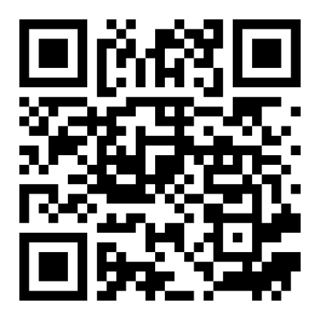
Stay Connected with Fulbright
Sign up for our newsletter!
EMAIL scholars@iie.org
VISIT fulbrightscholars.org
apply.iie.org/register/newsletter
Notes:
In conclusion, your action item after this webinar is to stay in touch with us after this presentation! There are many ways to stay in touch, including our main email address, scholars@iie.org, our website, and our social media.
The best way to stay in touch is to sign up for our newsletter via the QR code or URL on the slide. In exchange for taking 5 minutes to tell us about yourself, you are signed up for our monthly newsletter and specific mailings relevant to your discipline or countries of interest, with awards for you sent straight to your inbox!

